Slide 1
Photographer’s Ephemeris
What is an Ephemeris?
A table showing the positions of a heavenly body on a number of dates in a regular sequence.
For a photographer the most important heavenly body is the Sun, and its ray direction on the earth.
To a lesser extent the location of the moon.

Slide 2
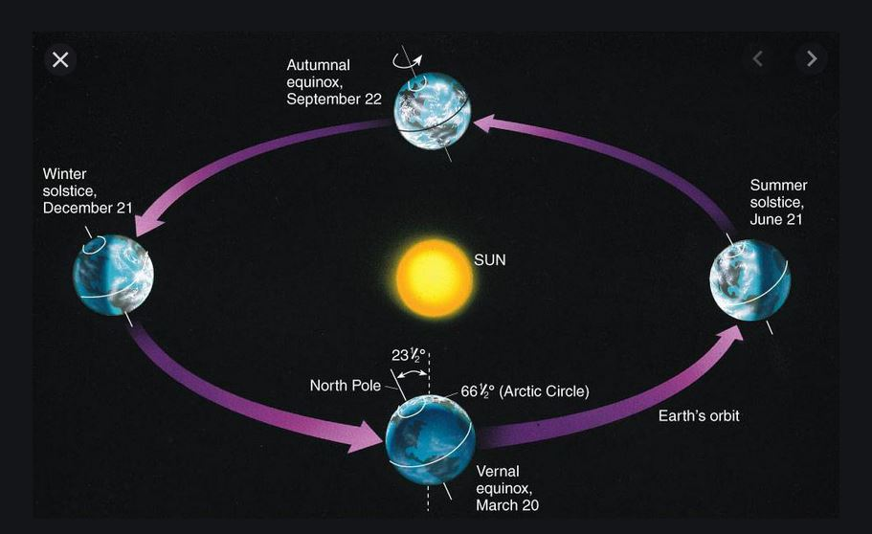
Winter
Summer
Sun more south
Shorter daylight
Sun more north
Longer daylight
The sun’s light is most pleasant during the early morning and late evening.
This is known as the “Golden Hour”.
Need to know the direction of the sunlight and the time.

Slide 3
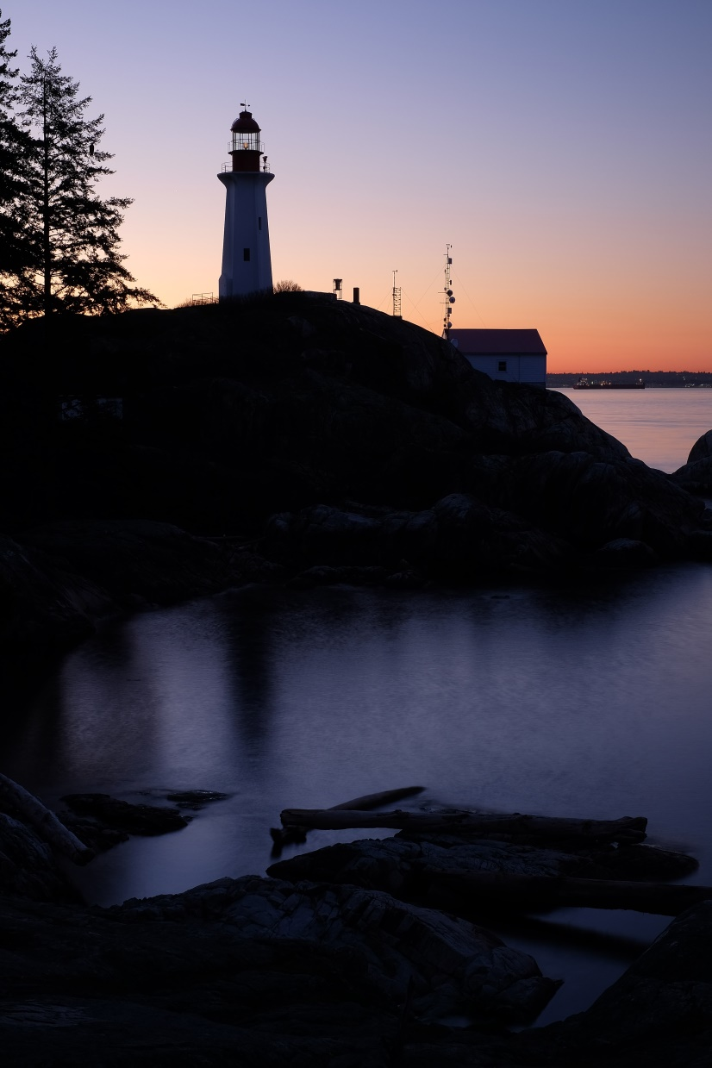
We want to avoid getting up early in the morning to find…!
Taken on 20 March 2019 at 5:57 AM.
Sunrise at 7:58.
The photographer was there far too early!

Slide 4
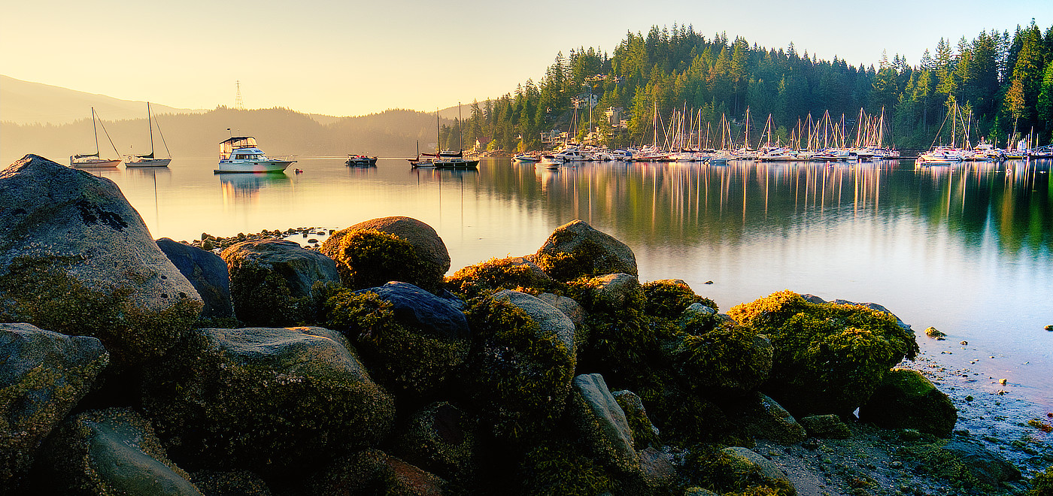
Deep Cove Sunrise
Taken 15 August, 2020 at 6:54 AM.
Internet said: Sunrise at 6:05 AM on 15 August 2020.
BUT I WAS THERE AT 5:30 AM and waited an hour and ½??! WHY?

Slide 5
The Photoephemeris: https://app.photoephemeris.com
After signing in, press the magnifying glass in upper right.
Enter the map location of interest (ie. West Vancouver), press GO.
The map can be zoomed by scrolling the mouse wheel.
Drag with the left mouse button to center the map on the location of interest.
Press the red pin in the white box on the right side and drag the pin to the location of interest.
The date can be entered by clicking on the date bar in the upper left.
The black “Mountain” pin can be employed by clicking on the black pin in the white box on the right side (under the red pin box). This pin can be dragged to the appropriate location.
The blue scrubbing bar at the bottom can be slid to any time of day.
Clicking on the TUTORIALS word (upper right) will bring up instructions and explanations.

