Slide 1
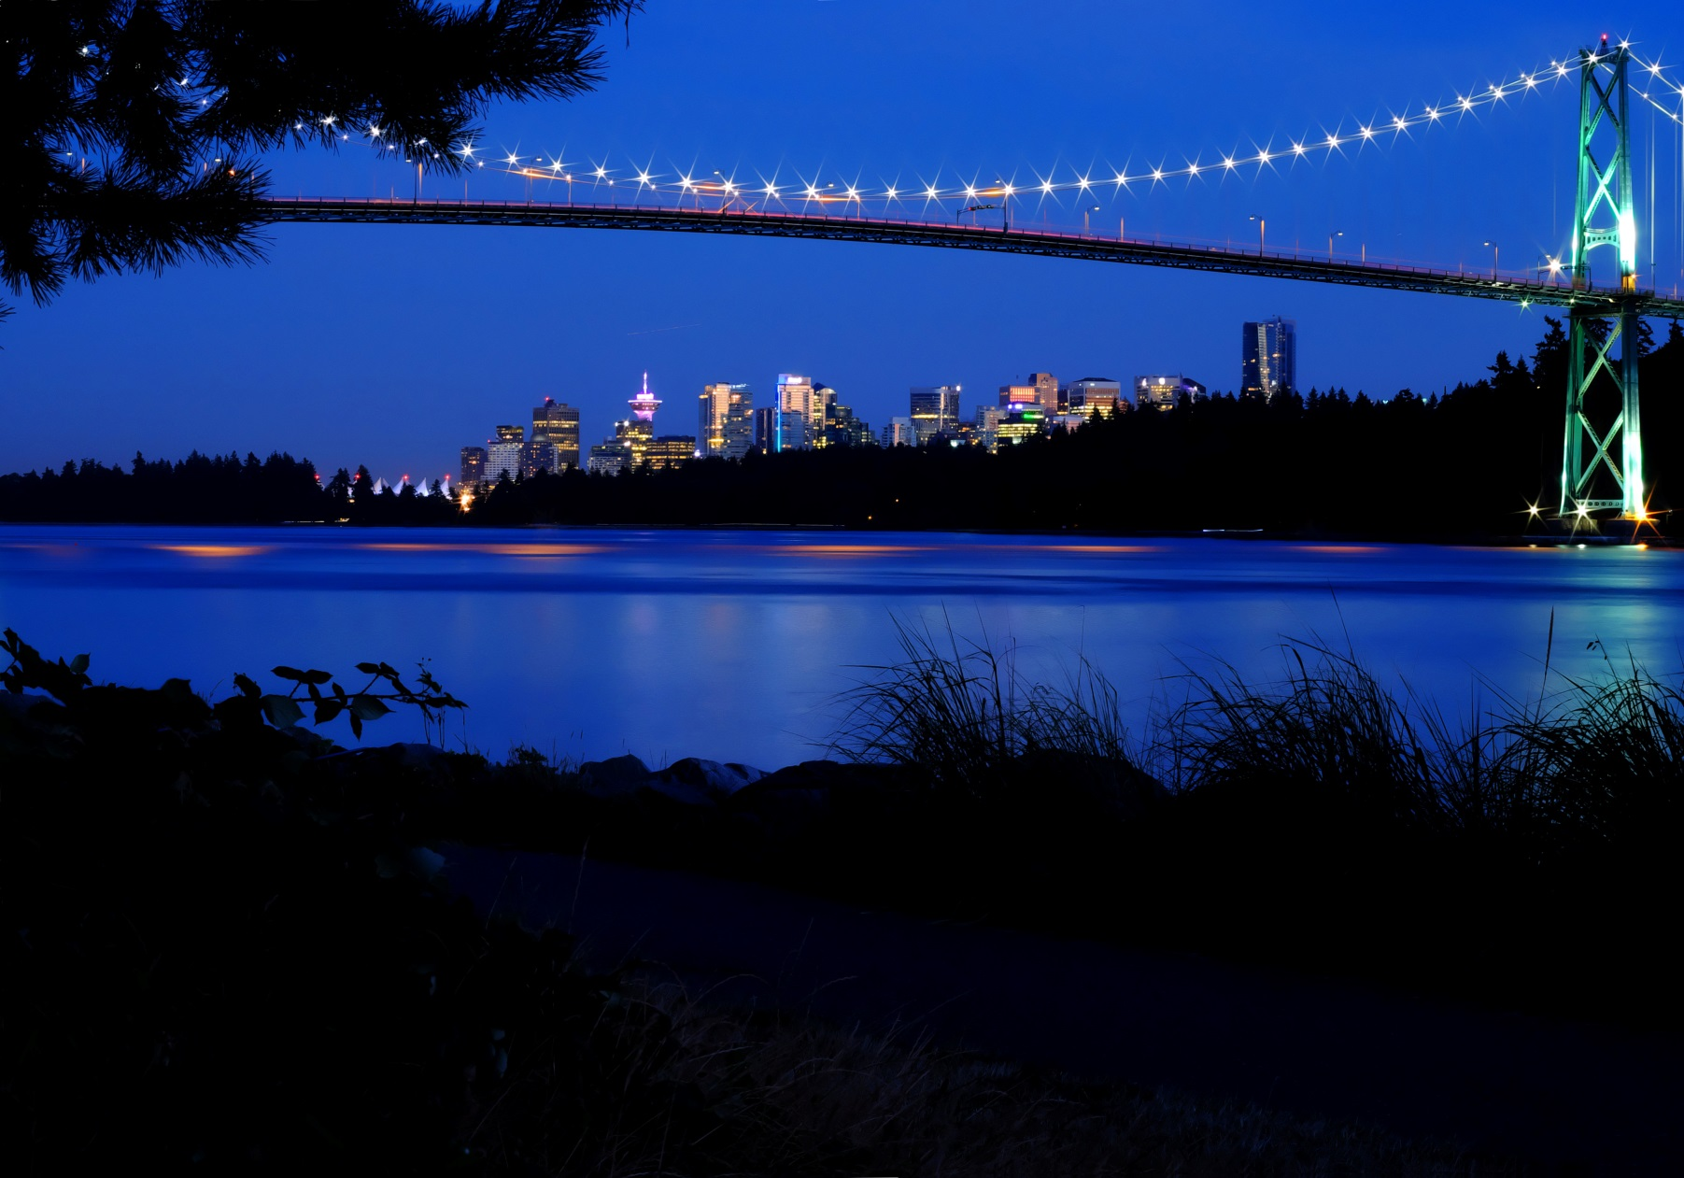
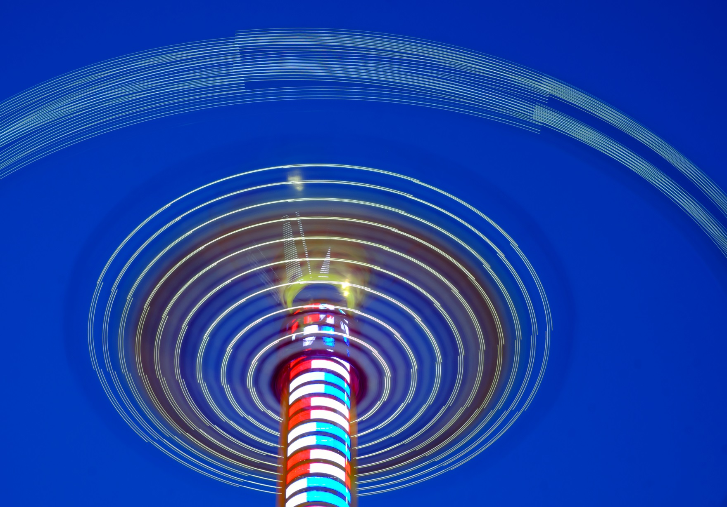
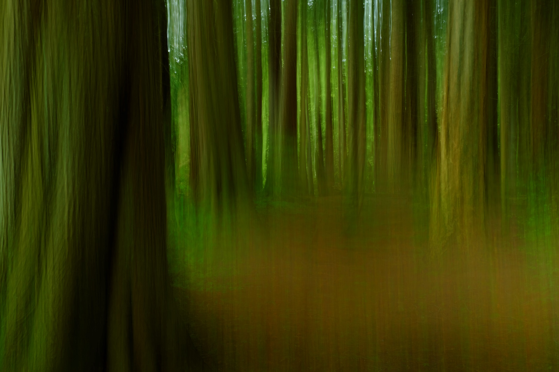
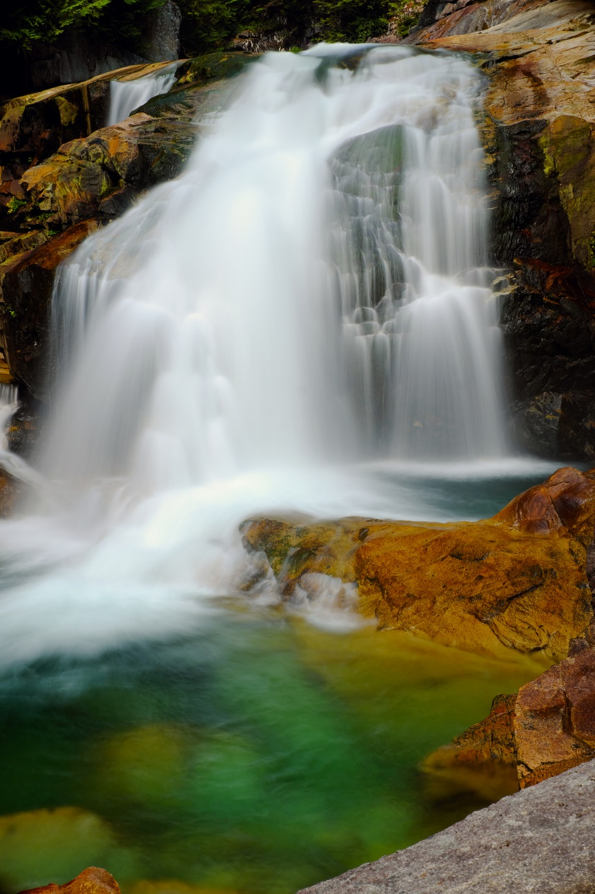
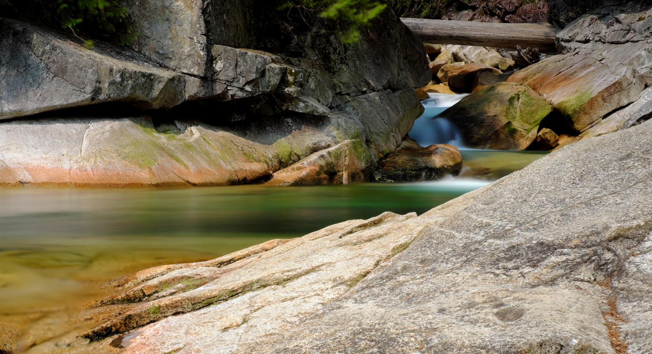
L
O
N
G
E
X
P
O
S
U
R
E

Slide 2
Long Exposures
Requirements:
1. Tripod
2. Camera which allows control of the shutter speed.
allows for a bulb setting*
3. SLR cameras a method of blocking the viewfinder.
4. Camera which allows ISO control*
reducing the ISO increases the exposure time.
5. Camera which allows manual focus*
6. Remote shutter release*
*Not essential but extremely helpful

Slide 3
Low Light Long Exposures (Evening)
20 sec.

Slide 4
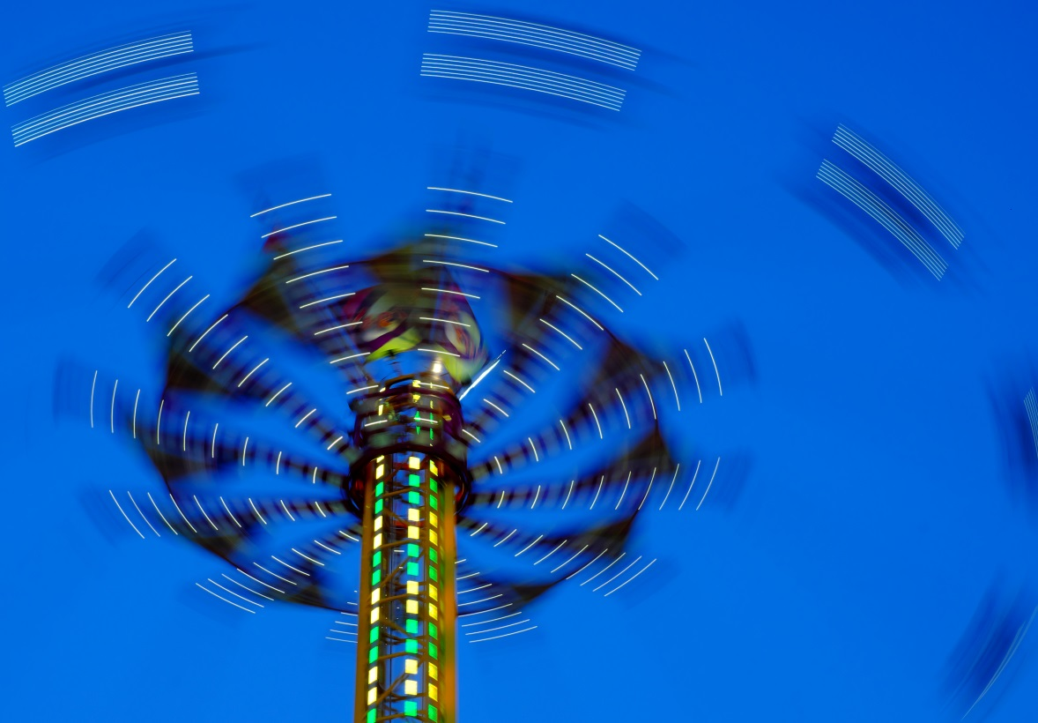
Low Light Long Exposures (the “Blue Hour”)
1.5 sec
¼ sec

Slide 5
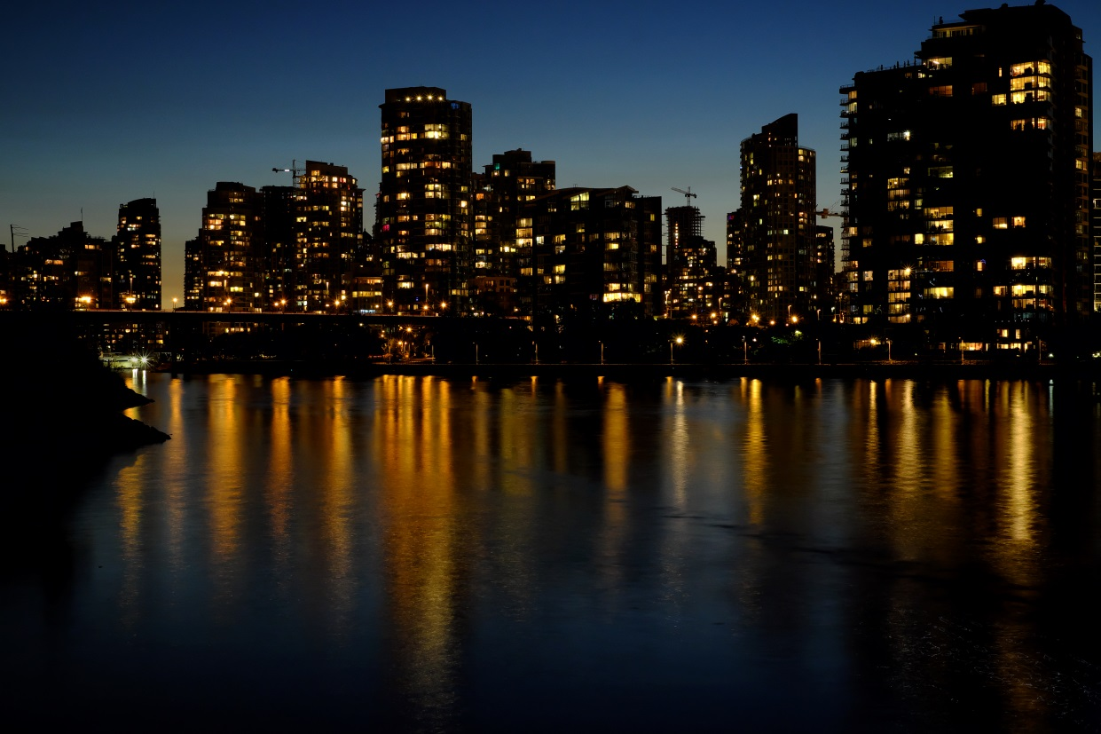
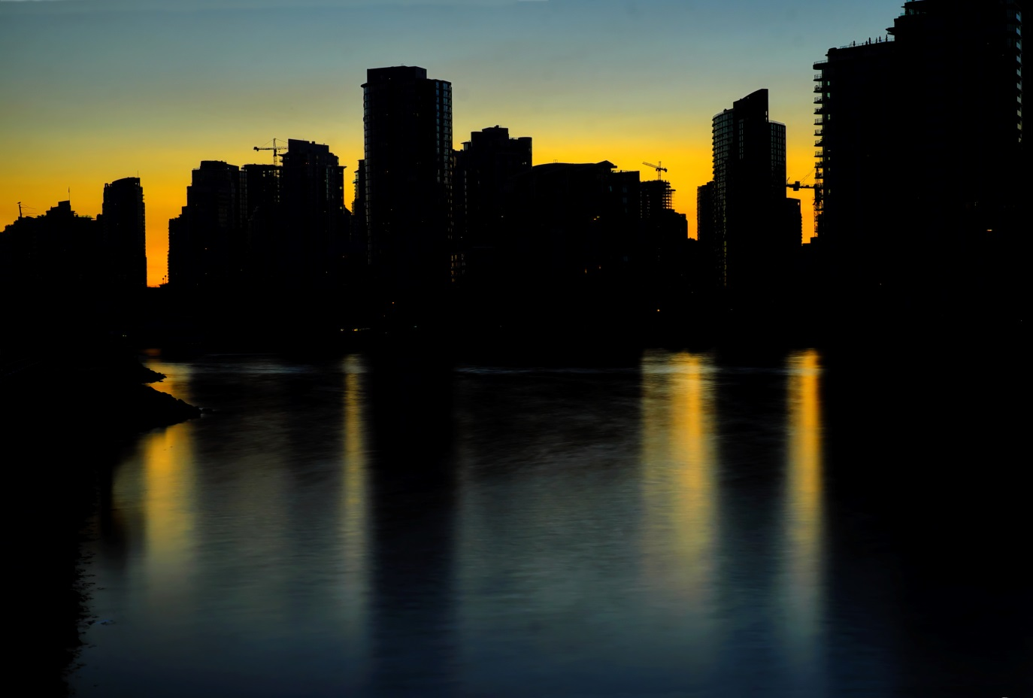
Low Light Long Exposures
8 sec
15 sec

Slide 6
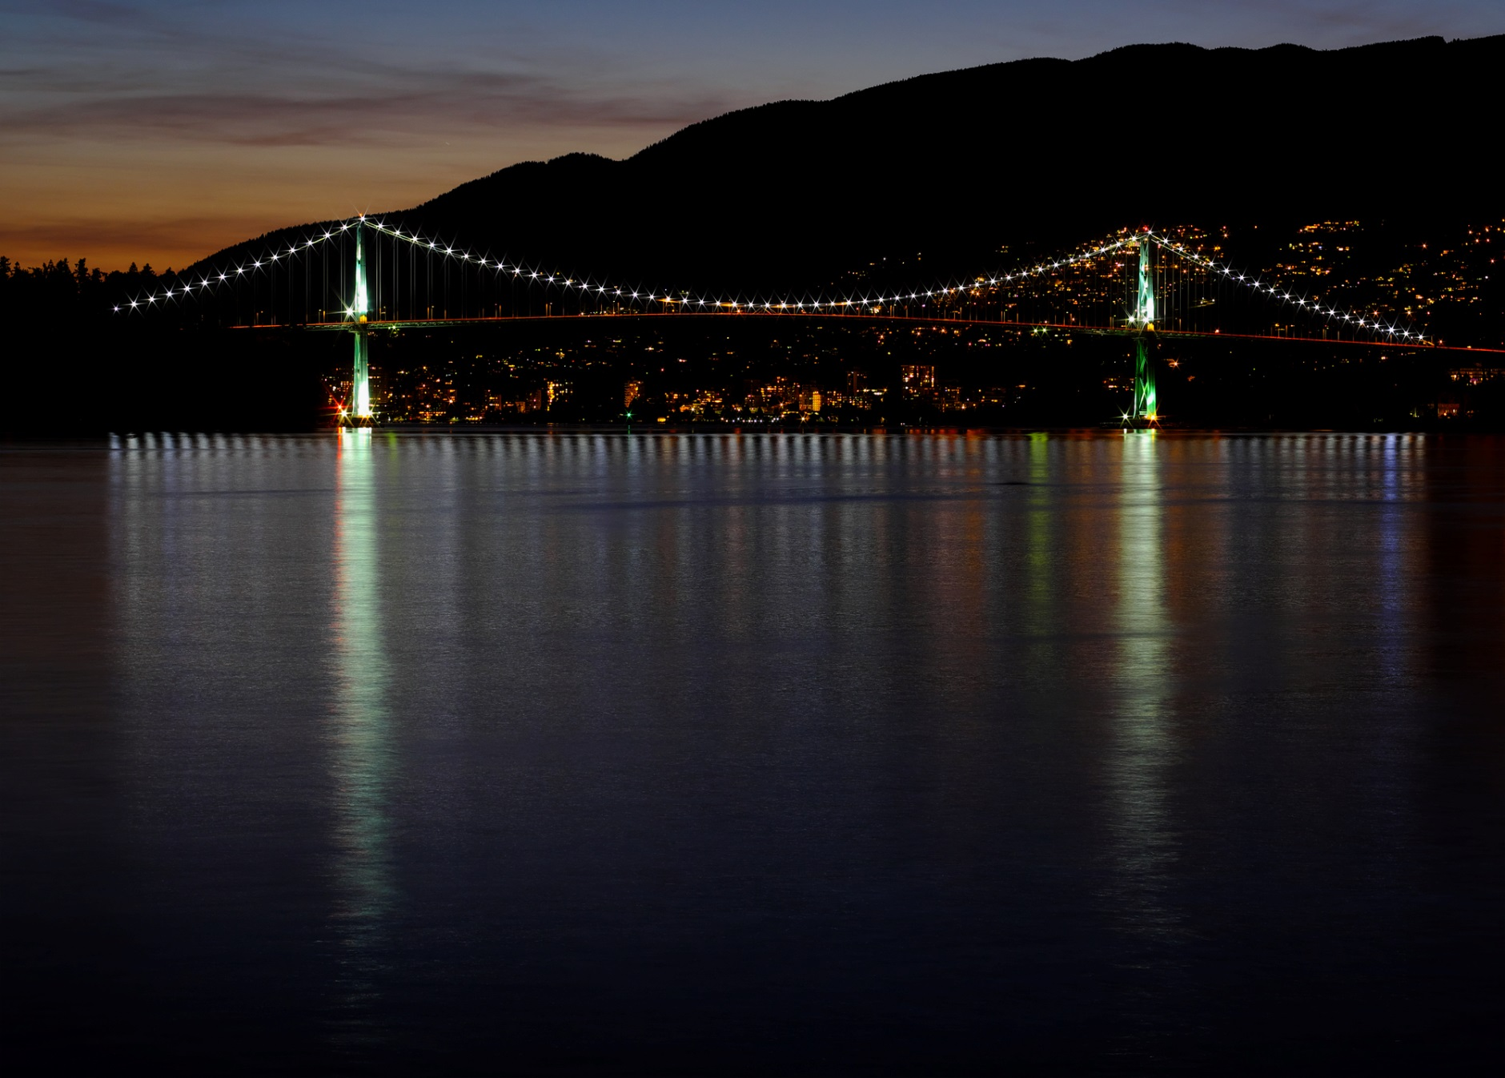
Low Light Long Exposures
15 sec.

Slide 7
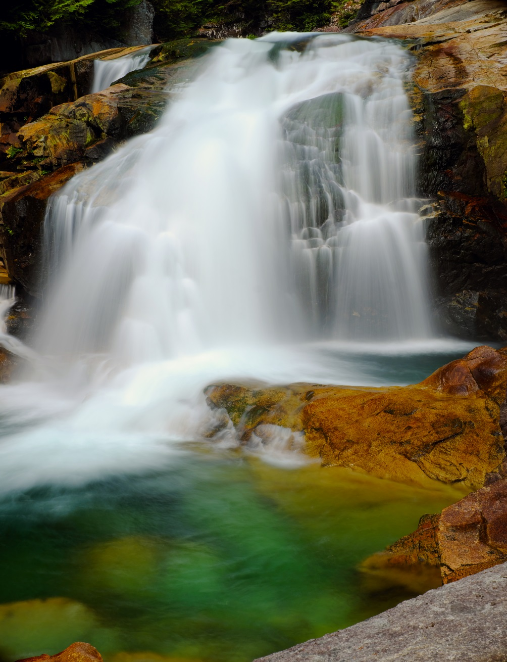
Daylight Long Exposures
Goal: Reduce the amount of light entering the camera in order to increase the exposure time.
Strategies:
Use shutter priority or manual mode
Use a small lens opening (high f#)
Use the lowest ISO
Use a ND (neutral density) filter
1.6 sec.

Slide 8
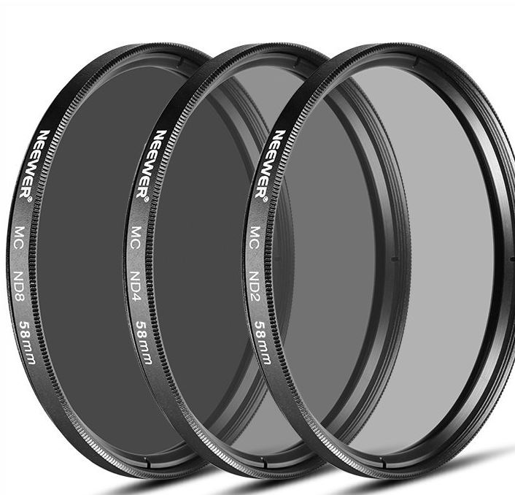
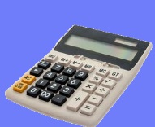
Daylight Long Exposures
Neutral Density Filters
Darkened colourless filters which reduce the amount of light entering the camera.
Sold in stop reductions and/or time reductions
The time reduction is stamped on the filter ring
The filter size is also on the ring (must fit lens)
Scenario: Without a ND filter: f16, ISO 100, 1/200 sec.
ND8 filter will reduce the light 8 times.
Increase exposure time 8x (1/200 sec [wo]-> 1/25 sec [with])
8x(1/200)= 8/200 = 1/25 sec.
ND64 filter will reduce the light 64 times.
Increase exposure time 64x (1/200 sec [wo]->1/3 sec [with])
64x(1/200)=64/200=1/3sec.
ND1000 filter will reduce the light 1000 times.
Increase exposure time 1000x (1/200sec [wo]->5 sec [with])
1000x(1/200)=1000/200=5 sec.
THE ND# TIMES THE SHUTTER SPEED (SEC) = SHUTTER SPEED WITH FILTER
(The shutter speed given by your camera is 1/sec)

Slide 9
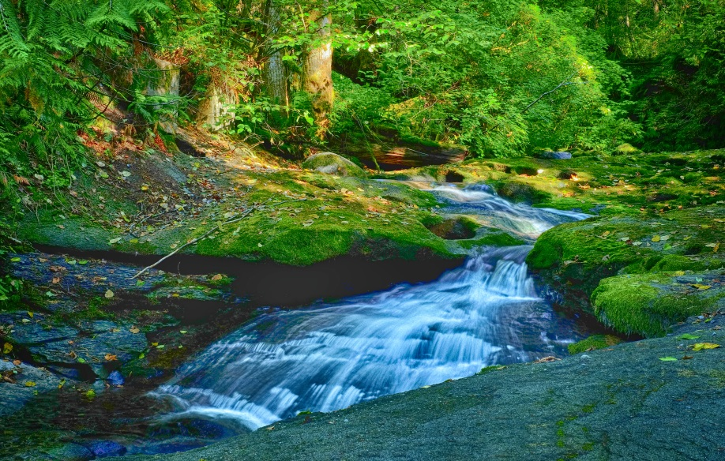
Daylight Long Exposures
Neutral Density Filters
The “Sunny 16 rule” states on a sunny day at ISO 100 and f16, the shutter speed will by 1/100.
What ND# was used to expose this scene for one second?
1 sec
(ND#) X SHUTTER SPEED (SEC) = FILTERED SHUTTER SPEED
(The shutter speed given by your camera is 1/sec)
ND# = FILTERED SHUTTER SPEED/SHUTTER SPEED (SEC)
ND# = 1/(1/100) = 100

Slide 10
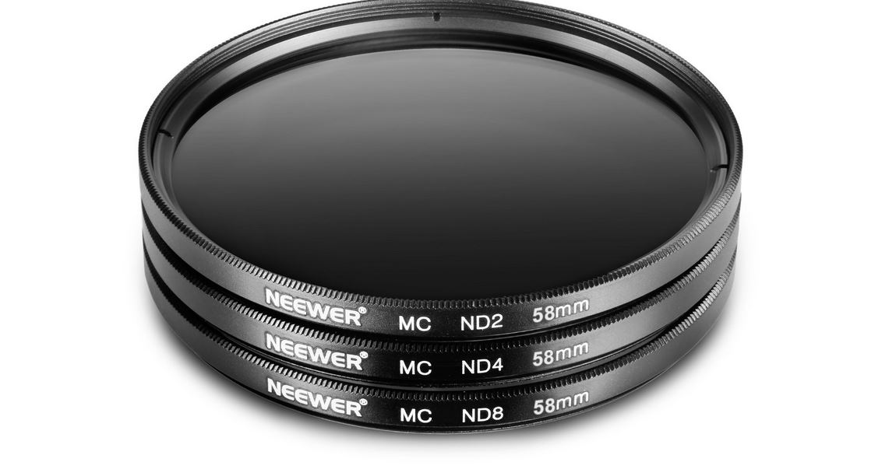
Daylight Long Exposures
Neutral Density Filters
ND filters can be screwed together.
Their dimming effect can be calculated by multiplying the ND#s.
This stack of filters will have a dimming effect of 2x4x8 = ND64
Cautions:
Each filter degrades the optical image
As the stack length increases the filter rings may protrude into the image space and cause vignetting.
Beeve’s experience:
The exposure length is determined by the movement of the subject. For long exposures of still water the exposure should be at least 10 seconds.
Most ND filters I use are: ND64 and ND1000

Slide 11
Neutral Density filters
Can also be sold by STOPS.
Related to the f# on a lens or shutter speed.
Each change in f# moving left to right reduces the amount of light by 2 times.
Going from f2.8 to f4 reduces the light on the sensor by 1 stop
Going from f2.8 to f5.6 reduces the light on the sensor by 2 stops.
Going from f4 to f11 reduces the light on the sensor by __ stops? (click to answer)
3
A ND filter has the same effect as changing the f number.
If you are at f4 and put a 2 stop ND filter on the lens the effect is the same as moving the f stop to f8.
If you are at f5.6 and put on a 3 stop ND Filter the effect is the same as moving to f___? (Click to answer)
16

Slide 12
Neutral Density filters
Since aperture (f stops) and shutter are inversely related if the f# is increased the shutter speed must be decreased by the same factor.
Originally if we have a shutter speed of 1/100 seconds and add a 2 stop ND filter the shutter speed must be reduced by 2 stops. Since each stop changes the amount of light reaching the sensor by 2 times, a 2 stop ND filter will cause an increase in shutter speed of 2x2 = 4 times. The shutter speed with the filter will now be 1/100 x 4 = 1/25 seconds.
How much will a 4 stop ND filter change the shutter speed if the original speed was 1/250? ______________________________ (Click for answer)
4 stops = a reduction of 2x2x2x2 = 16 times in shutter speed. If the original speed 1/250 seconds then the speed needs to be reduced 16 times.
16x1/250 = .064 or 1/15 seconds
How much will a 10 stop ND filter change the shutter speed if the original speed was 1/250 _____________________ (Click for answer)
1000x1/250 = 4 seconds

Slide 13
Neutral Density filters
Can also be sold by STOPS.
Related to the f# on a lens or shutter speed.
Notice: THE FACTOR OF REDUCTION IS THE SAME AS THE ND#
ND Stops | Facort of Reduction | ND#
1 | 2 | 2
2 | 2x2 = 4 | 4
3 | 2x2x2 = 8 | 8
4 | 2x2x2x2 = 16 | 16
5 | 2x2x2x2x2 = 32 | 32
6 | 2x2x2x2x2x2 = 64 | 64
7 | 2x2x2x2x2x2x2 = 128 | 128
8 | 2x2x2x2x2x2x2x2 = 256 | 256
9 | 2x2x2x2x2x2x2x2x2 = 512 | 512
10 | 2x2x2x2x2x2x2x2x2x2 = 1024 | 1024
11 | 2x2x2x2x2x2x2x2x2x2x2 = 2048 | 2048
12 | 2x2x2x2x2x2x2x2x2x2x2x2 = 4096 | 4096
All that is required is to know the ND#. The light will be reduced by this factor when the filter is in use.

Slide 14
Neutral Density filter Types
Fixed: Have one light reduction amount
Advantages:
High image quality
Disadvantages
Inconvenient screwing on and off
Variable: Consist of two polarizing filters which counter rotate.
Advantages:
Convenient
Disadvantages:
Get the artifacts associated with polarizing filters screen (rainbow)
Reflections are colour shifted
At their darkest settings get a cross pattern
Thicker…degrade image
https://www.youtube.com/watch?v=jMCJtggkXX0&feature=youtu.be

Slide 15
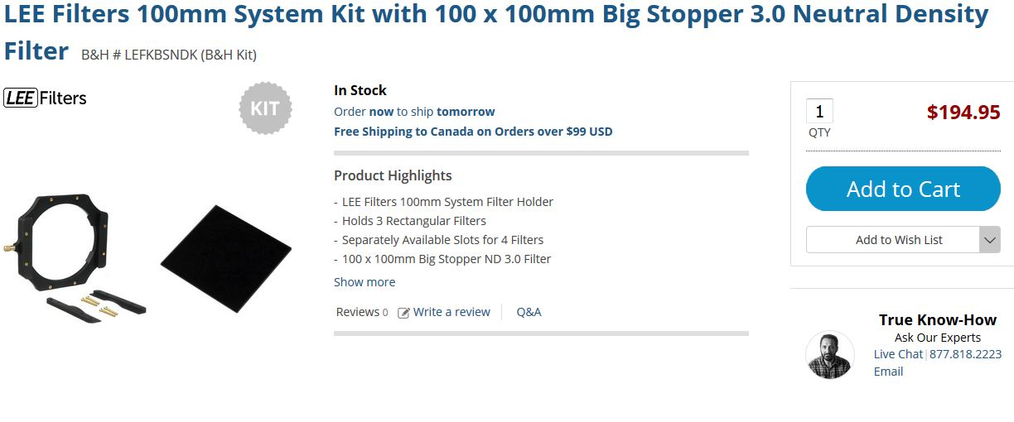
Neutral Density filter Types
Rectangular with a holder
Very convenient since gels easily slip in and out

Slide 16
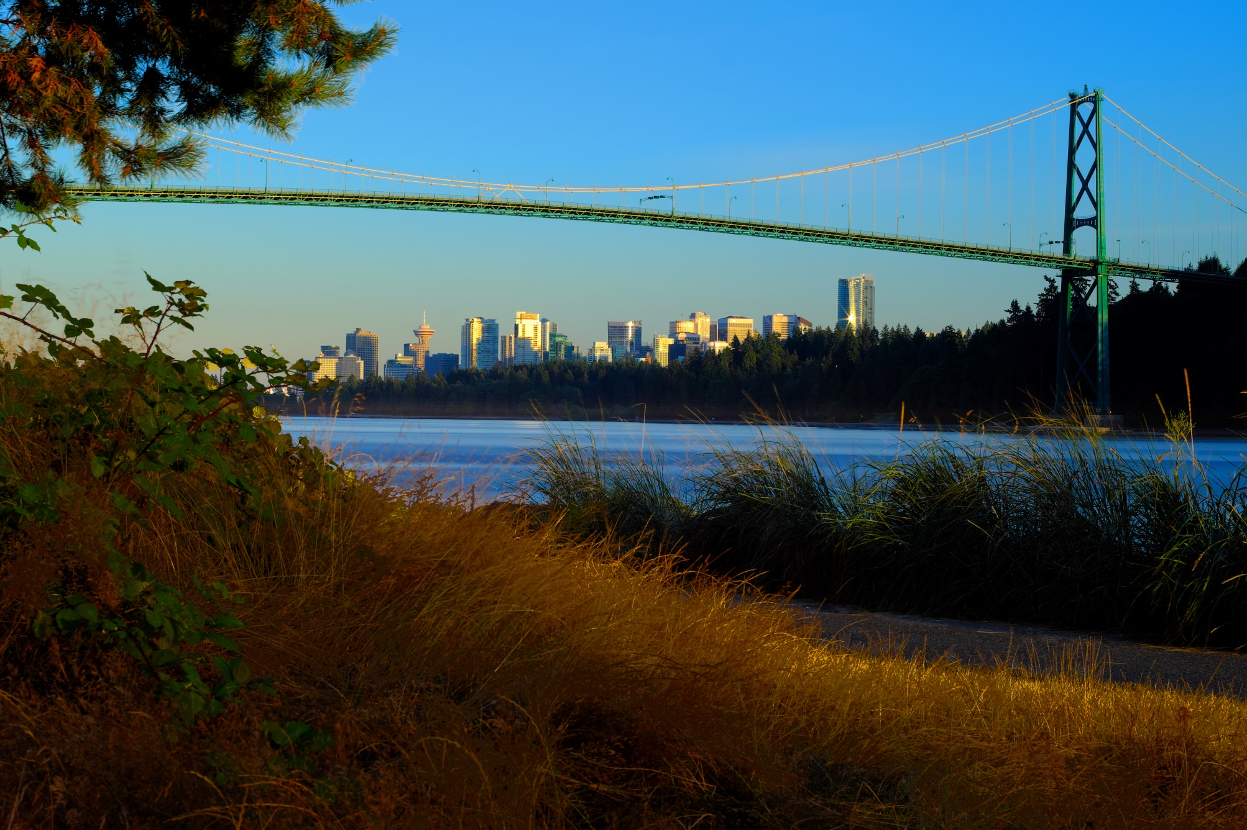
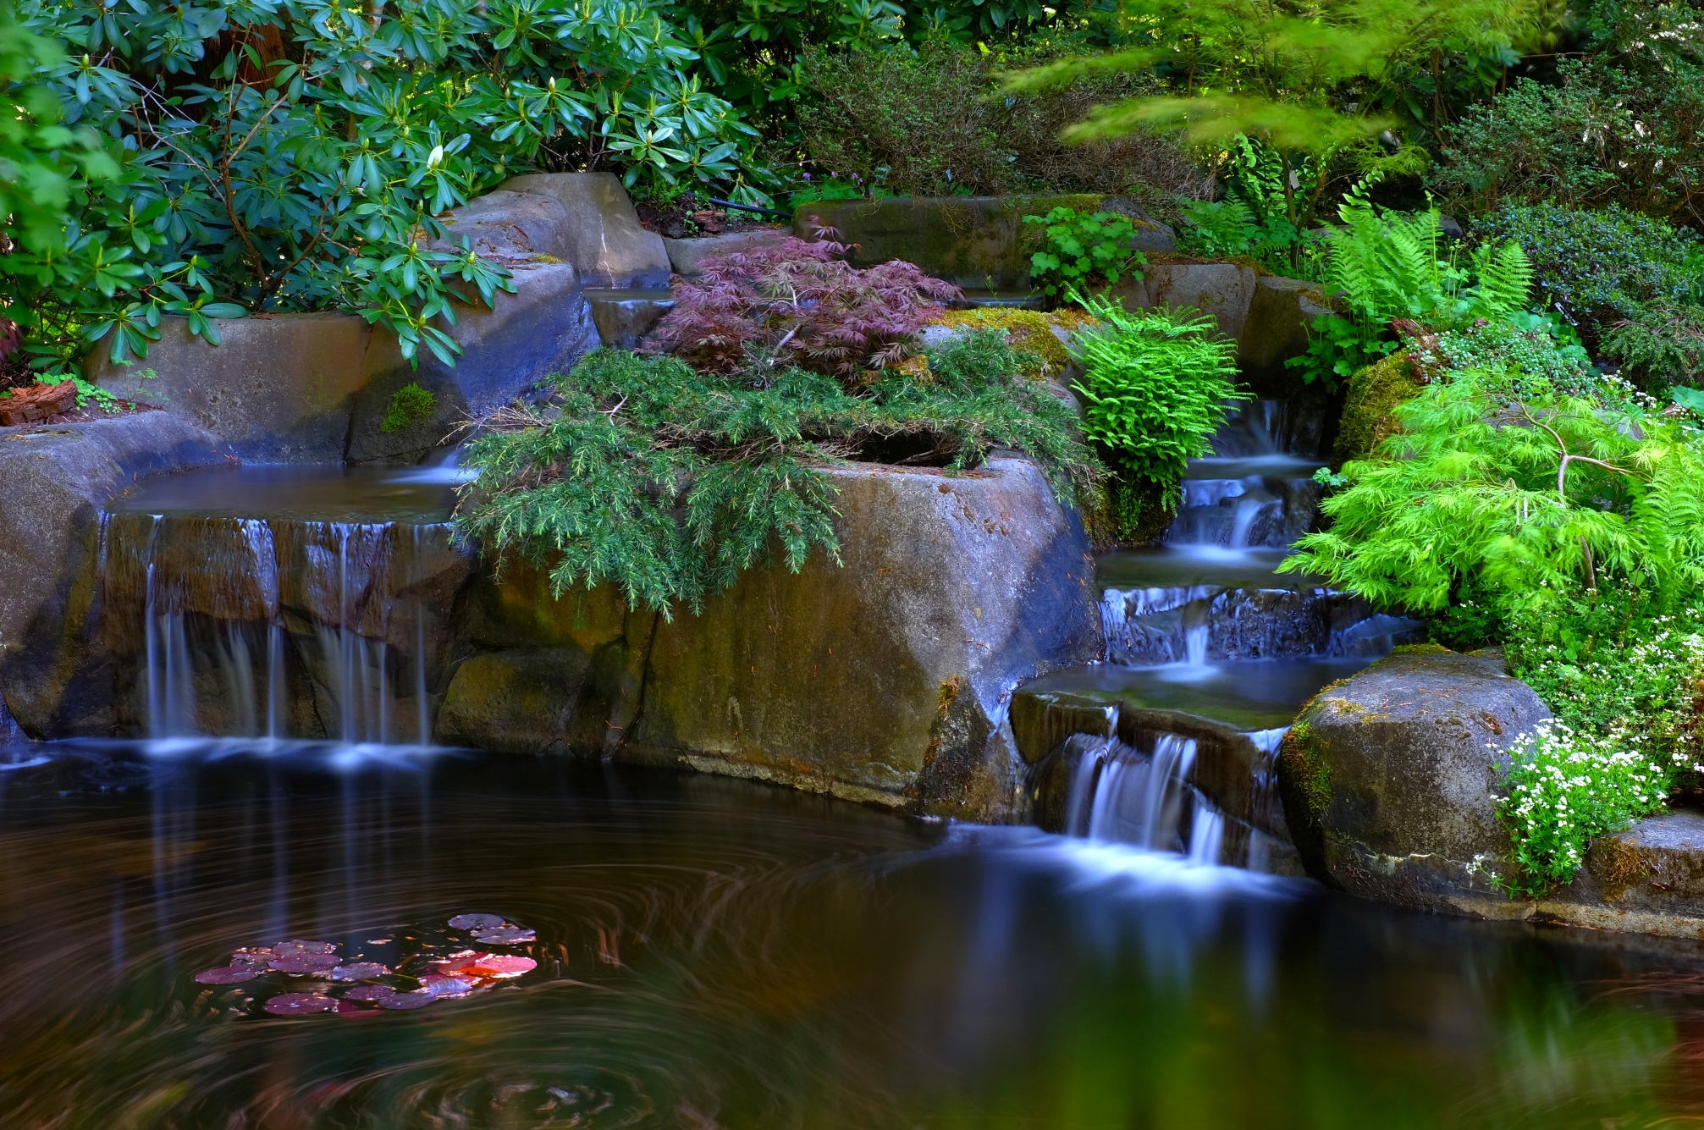
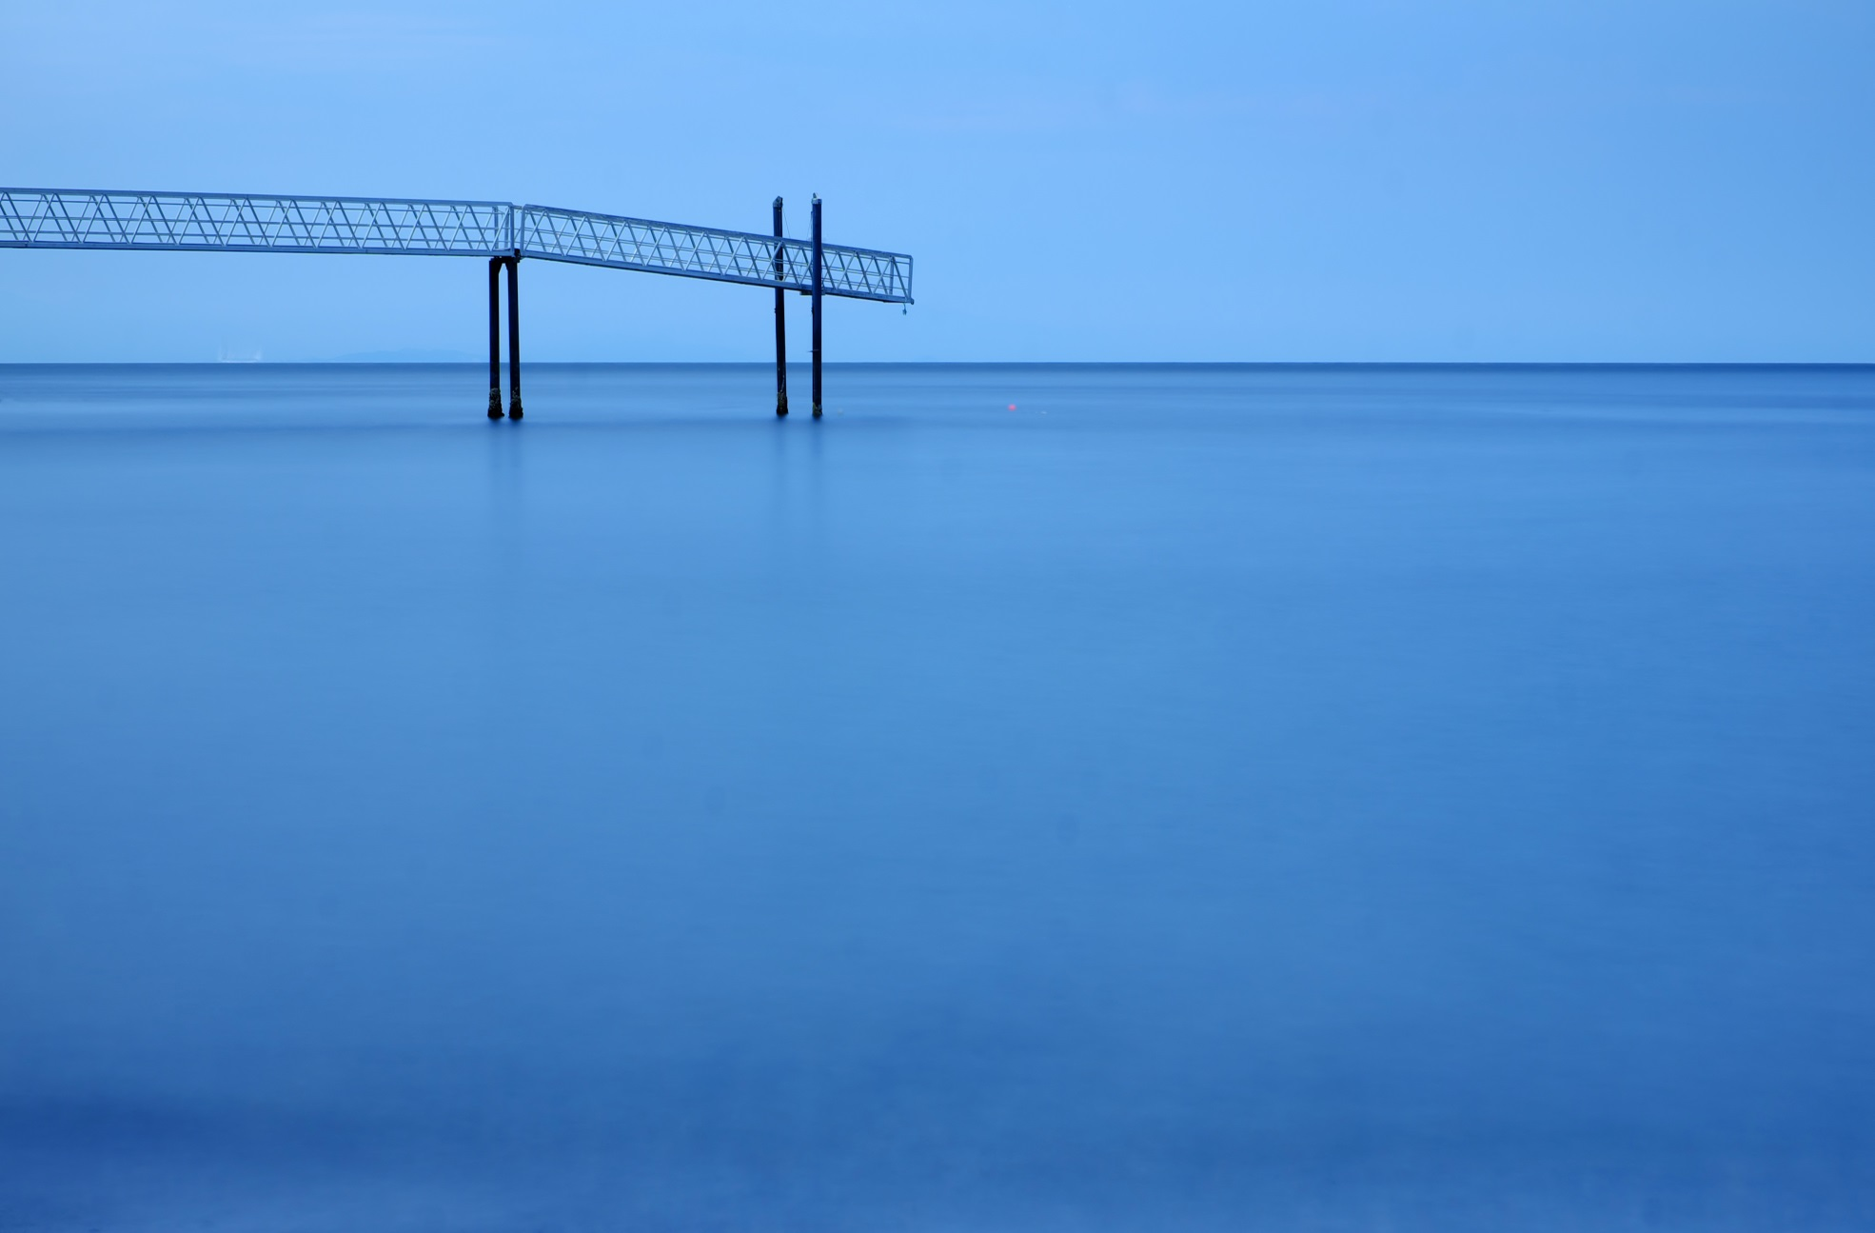
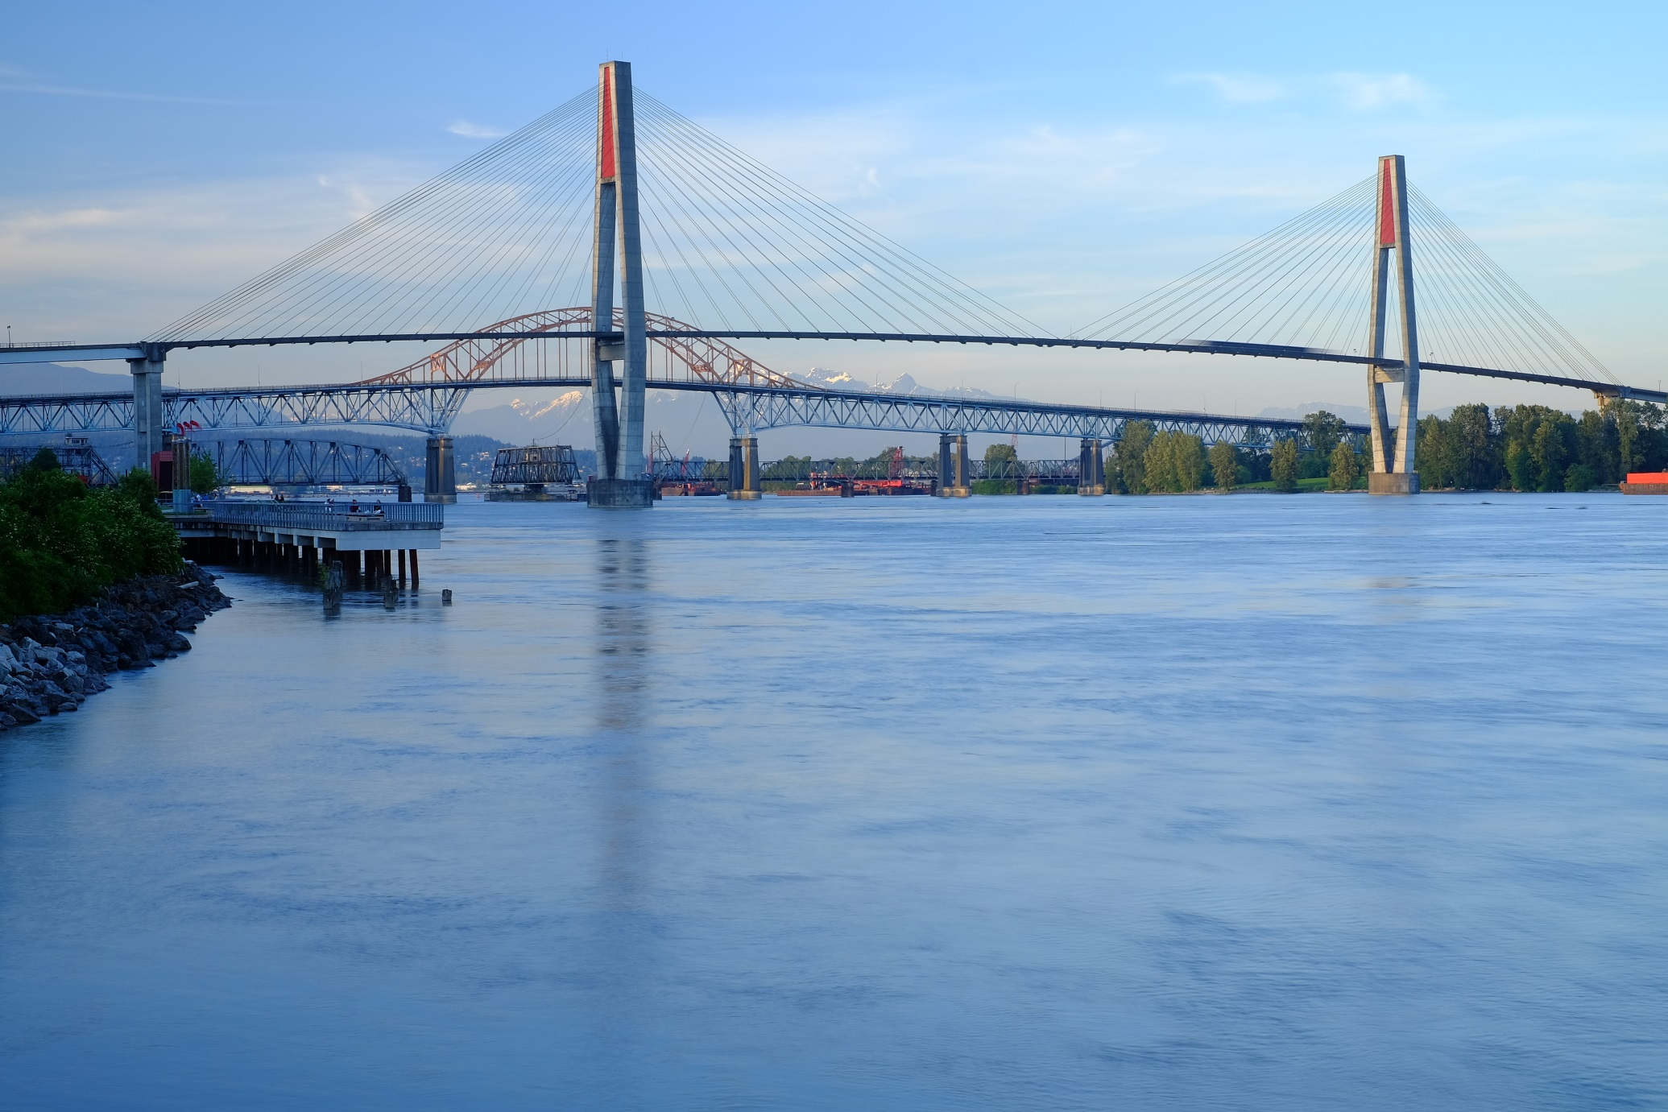
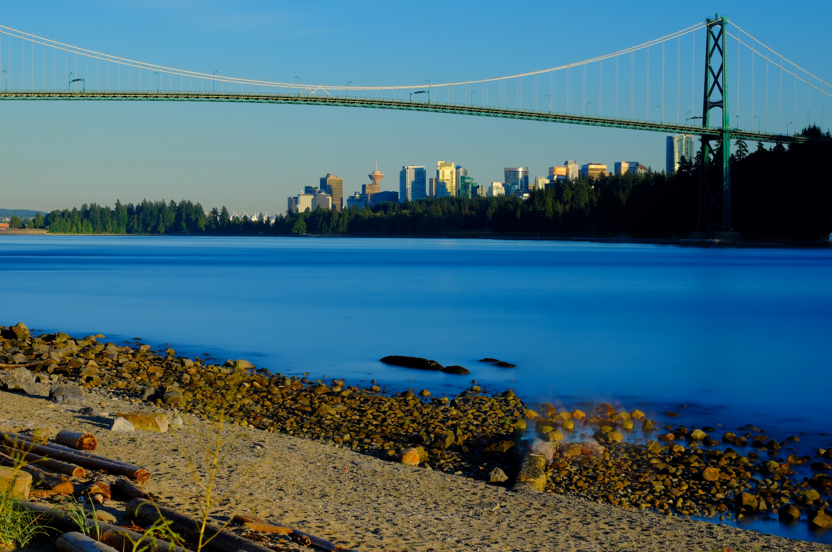
Daylight Long Exposures: Examples
58 sec
420 sec
40 sec
240 sec
1 sec

Slide 17
Daylight Long Exposures: Procedure
Setup camera on tripod
Focus on scene.
-You may have to use manual focus or back button focus because your camera may not focus with the ND filter attached.
Select a small aperture (large f number)
Select the lowest ISO
Read the shutter speed without the filter.
SLR cameras: install the cover over the eye piece of the viewfinder.
Determine the exposure time desired and attach the appropriate ND filter(s).
or
Calculate the exposure time with the ND filter in hand.
7. Set the shutter speed to the calculated time
-If the time is beyond the lowest shutter speed of your camera use bulb.
8. Take the picture.
-it is helpful to set camera delay to 2 seconds to avoid initial camera shake
-a remote shutter release
-avoids hand camera shake
-can lock shutter open and leave

Slide 18
Long Exposures
Miscellaneous:
Very long exposures of sunsets/sunrises can increase the colour since as time passes the colour moves through the sky.
Exposures of multiple seconds increases noise. Cameras have Long Exposure Noise Reduction (LENR) however this doubles the exposure time.
Moving objects can be eliminated with long exposure.
In camera movement (ICM) is facilitated by decreasing the shutter speed.

Slide 19
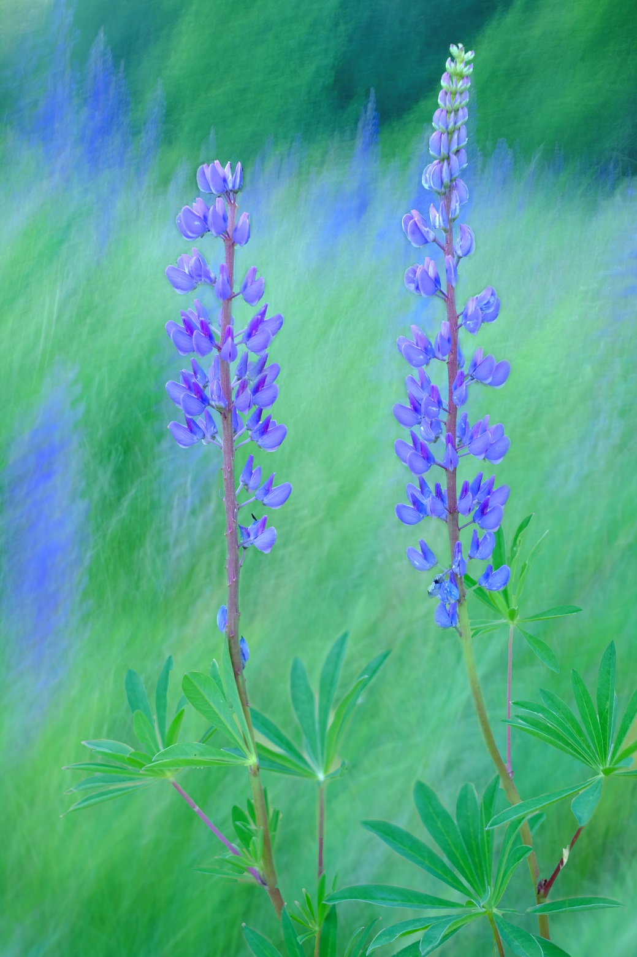
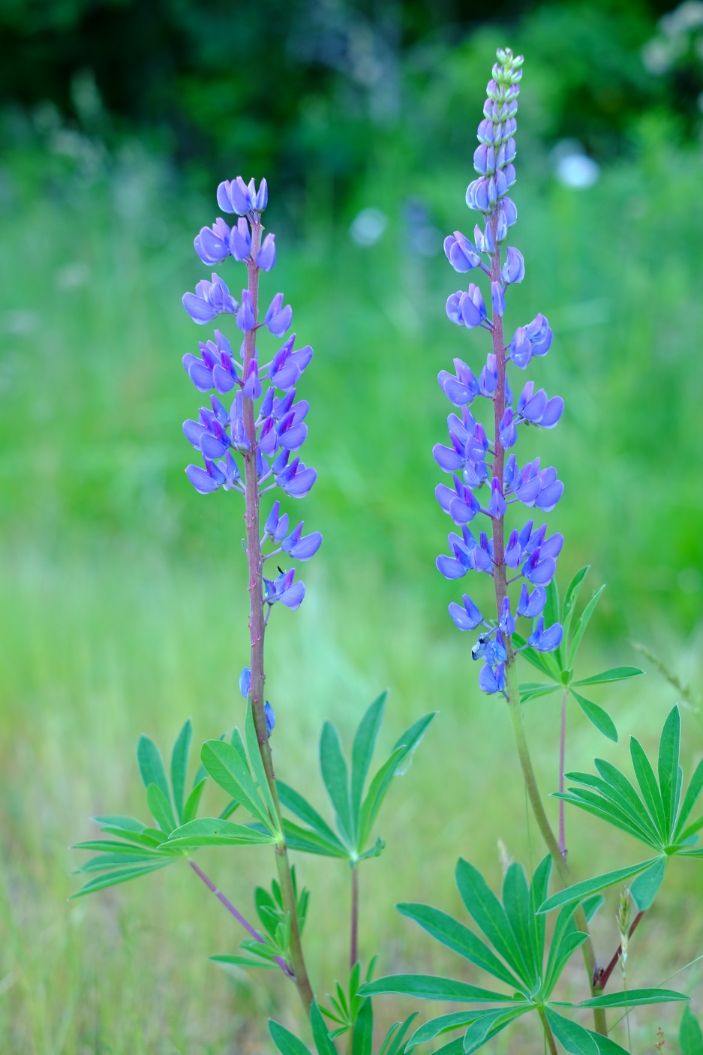
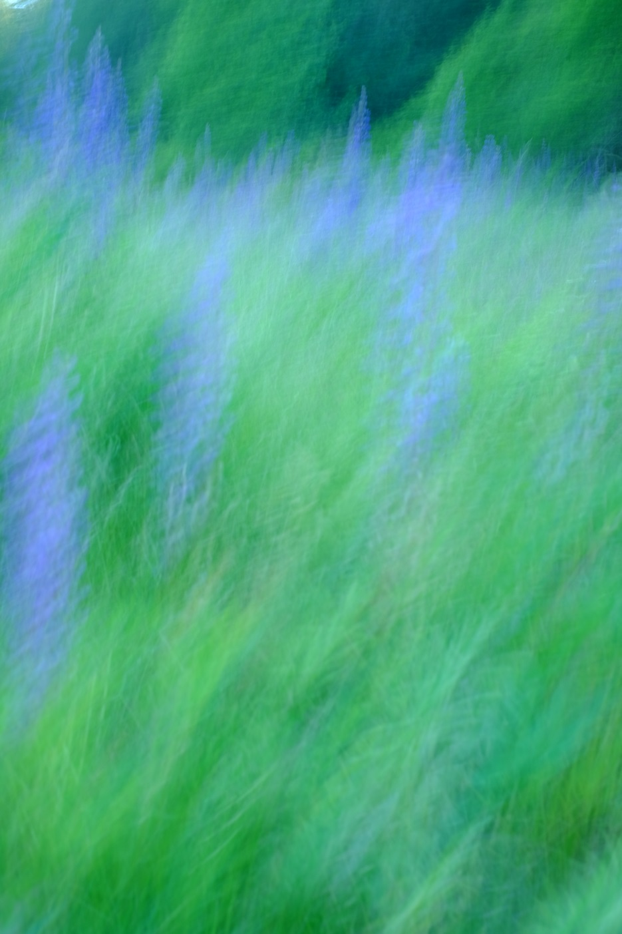
In Camera Movement:
1/100, f2.8
1 sec, f/5.6

Slide 20
This is the end of the slide show, however ND filters can also be sold using an “optical density” decimal. This is a mathematical way of describing ND filters and is useful to know only when purchasing these filters.
You can end the slide show now or continue to learn about Optical Density.

Slide 21
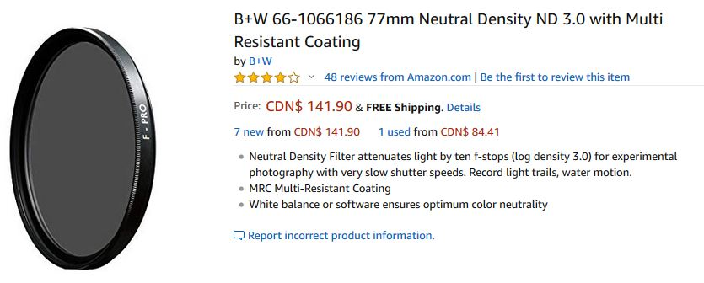
Neutral Density filters
Can also be sold by Light blocking strength: Optical Density
A decimal number related to the light stopping ability of the filter
The decimal tells you this is an OPTICAL DENSITY.
This is a ND64 filter
This is a ND1000 filter
ND# = 10^{Optical Density}
This is very mathematical an not necessary to know in order to use ND filters, only to buy them.

Slide 22
Neutral Density filters
Light blocking strength: Optical Density
A decimal number related to the light stopping ability of the filter (ND#=log₁₀Optical Density)
Stops | NDx | Optical Density
1 | 2 | 0.3
2 | 4 | 0.6
3 | 8 | 0.9
4 | 16 | 1.2
5 | 32 | 1.5
6 | 64 | 1.8
7 | 128 | 2.1
8 | 256 | 2.4
9 | 512 | 2.7
10 | 1024 | 3.0
11 | 2048 | 3.3
12 | 4096 | 3.6
13 | 8192 | 3.9
14 | 16384 | 4.2
15 | 32768 | 4.5
16 | 65536 | 4.8
17 | 131072 | 5.1
18 | 262144 | 5.4
19 | 524288 | 5.7
20 | 1048576 | 6.0
This table may be useful when purchasing a ND filter.
After obtaining the filter only the ND# (light reduction factor) is necessary to know.

