Slide 1
Make a Christmas Card using a table top photograph

Slide 2
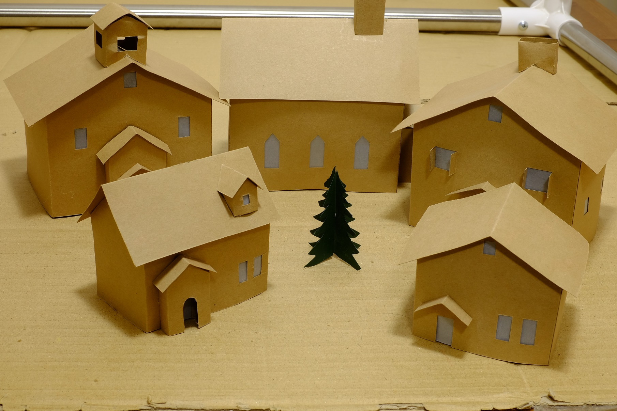

Slide 3
Fuzzy white blanket becomes snow

Slide 4
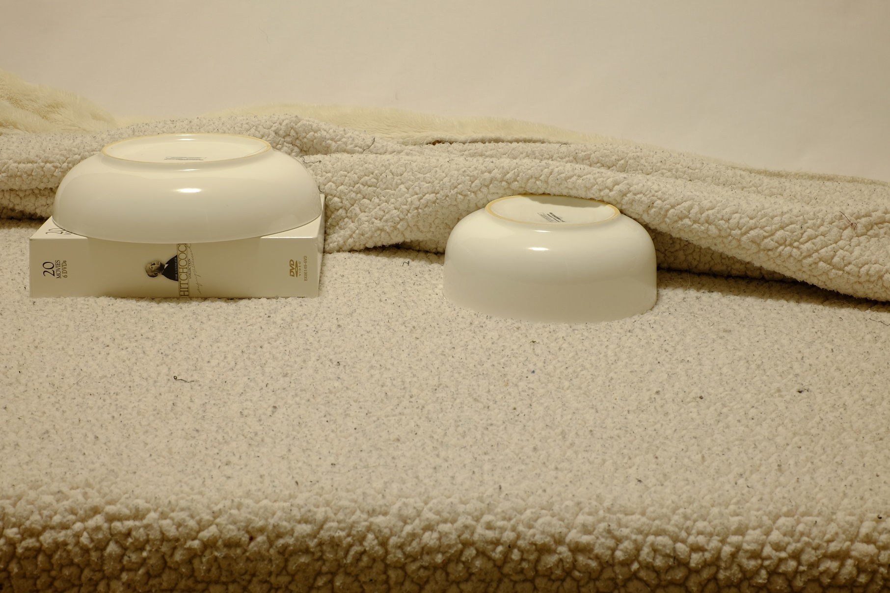
Bowls under the blanket create hills

Slide 5
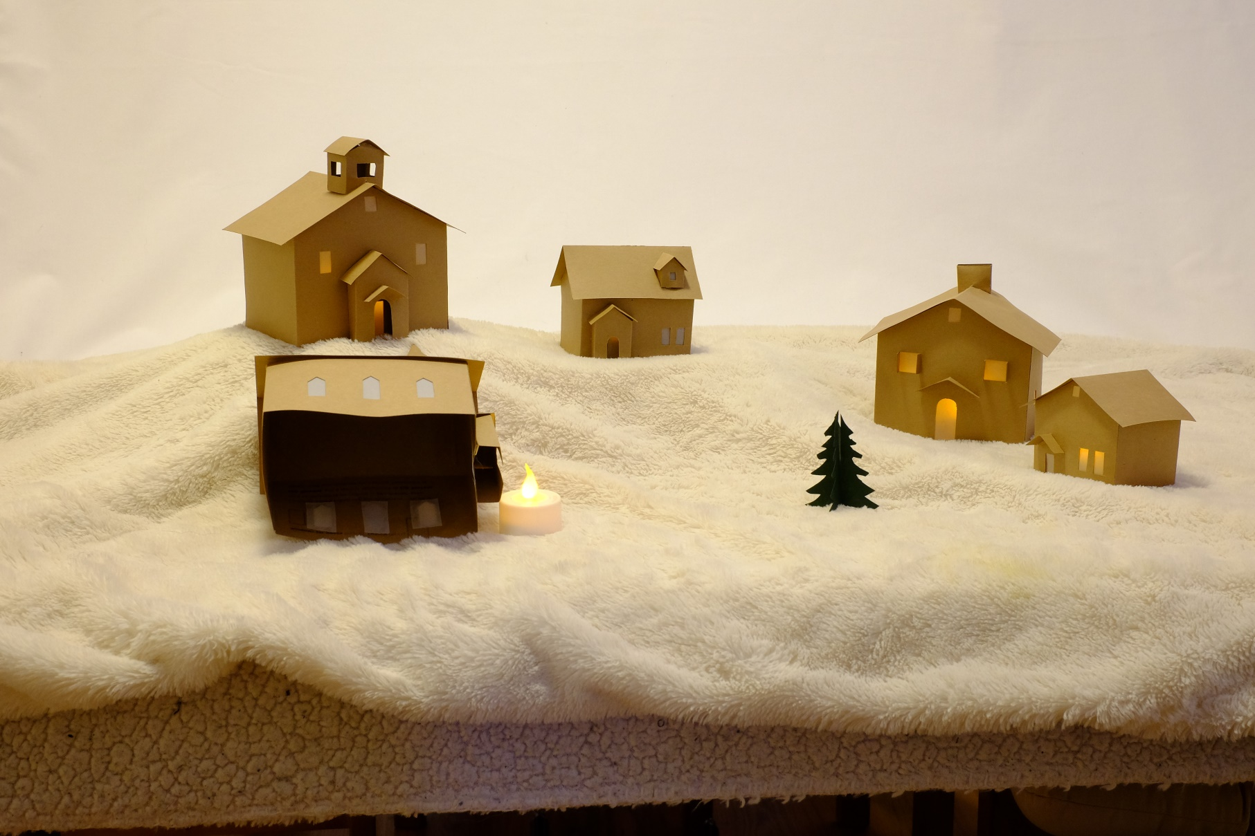
Tea lights inside the buildings create interior lights

Slide 6
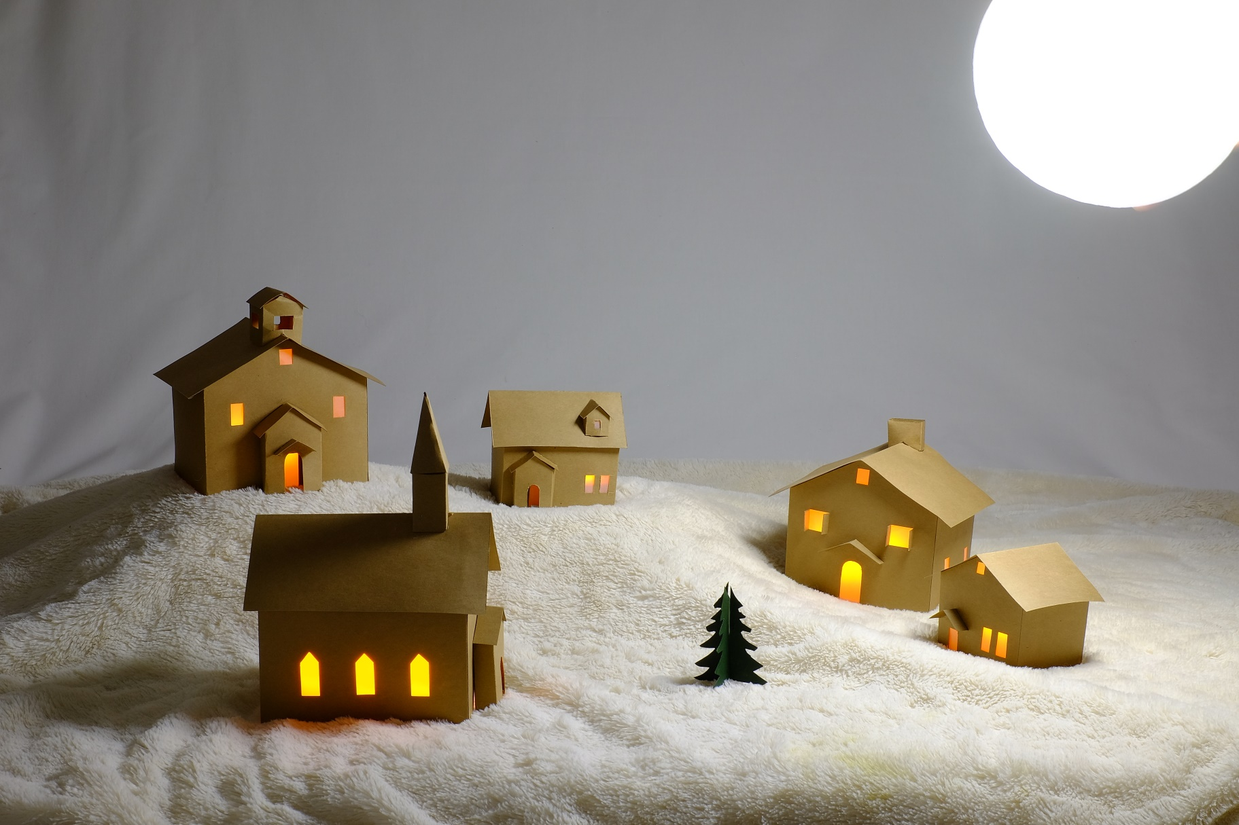
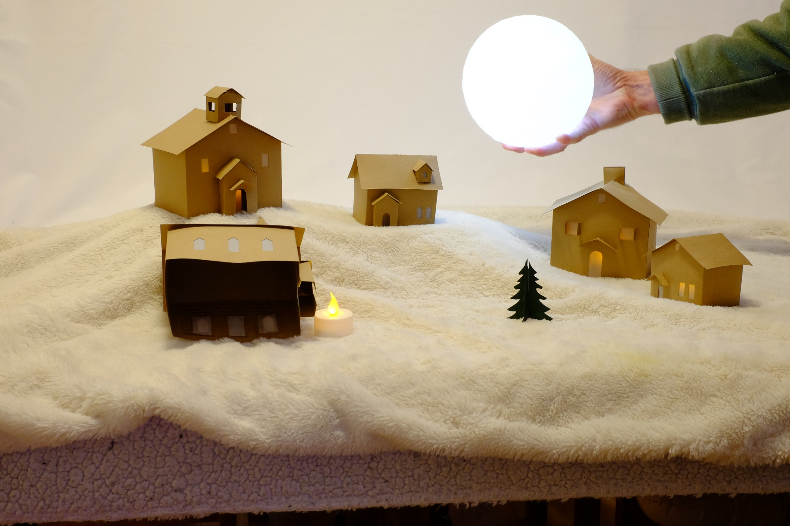
An electric moon became the light source

Slide 7
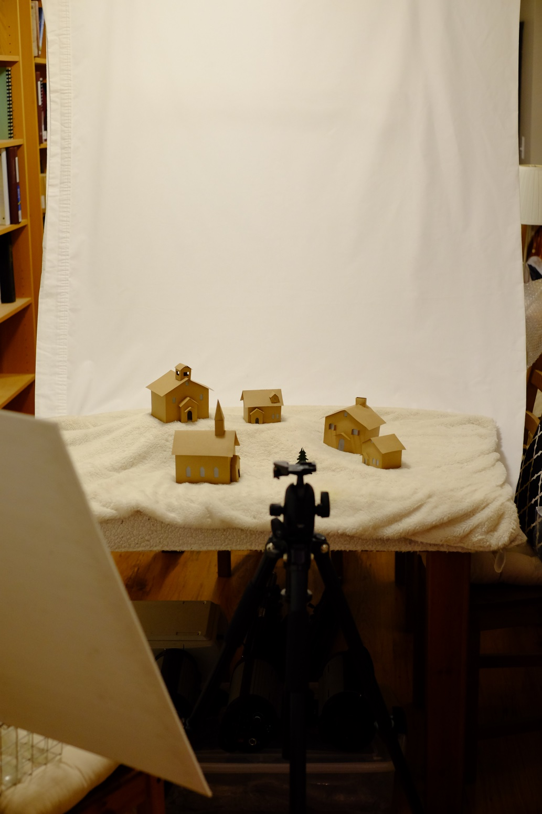
Final setup

Slide 8
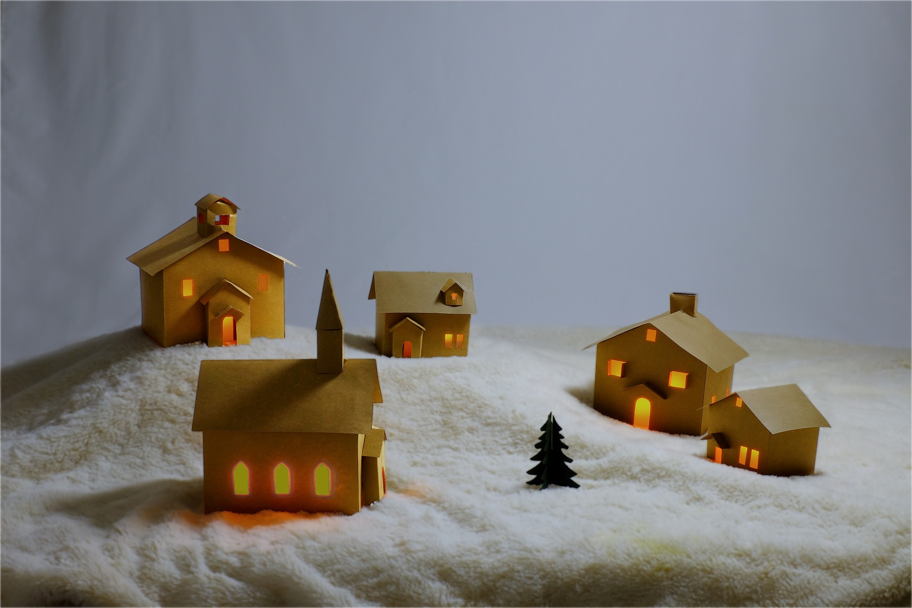
Final photograph from the camera but a grey wrinkled sky?

Slide 9
Final photograph

Slide 11
Making the card
Steps
Purchase blank cards
Print words inside/outside the card
Size the image to a printable size (5x7)
Get the image printed
Trim the print to fit the card
Glue print to the card

Slide 12
Blank Cards (with envelopes)
Size 6.5” x 10”
Available at art stores
(Michaels or Opus)
Available online.

Slide 13
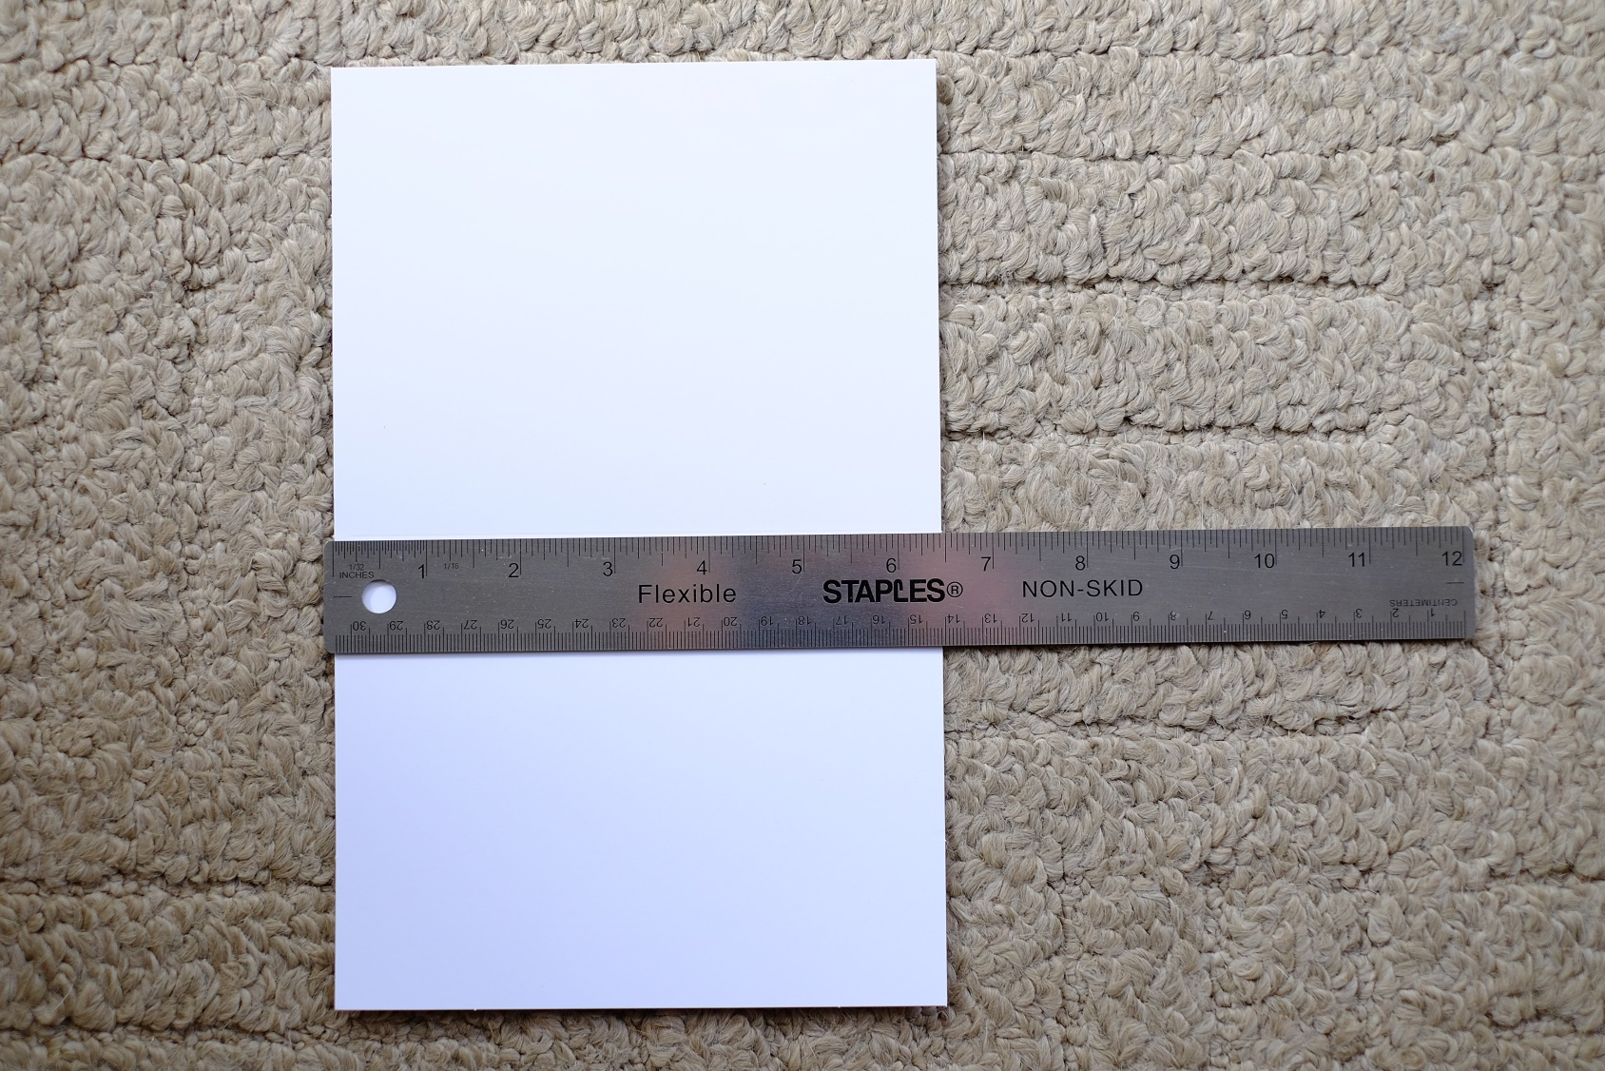
Blank Cards (with envelopes)
Full size 6.5” x 10”
The card is going to be folded in half along its length.
This means there will be two words areas inside each 6.5” x 5”.

Slide 14
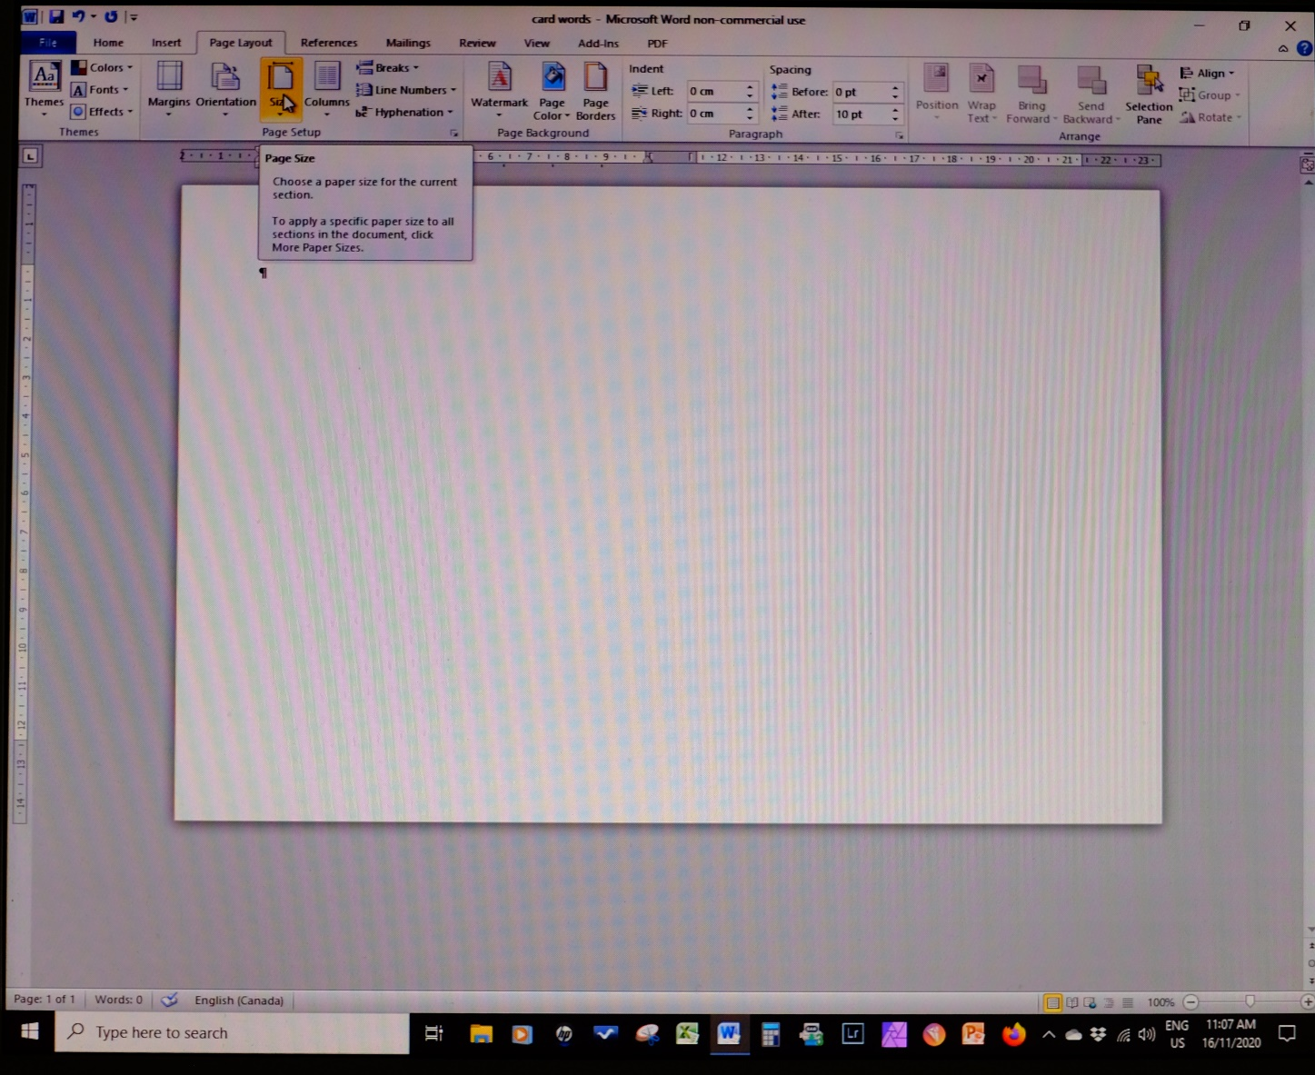
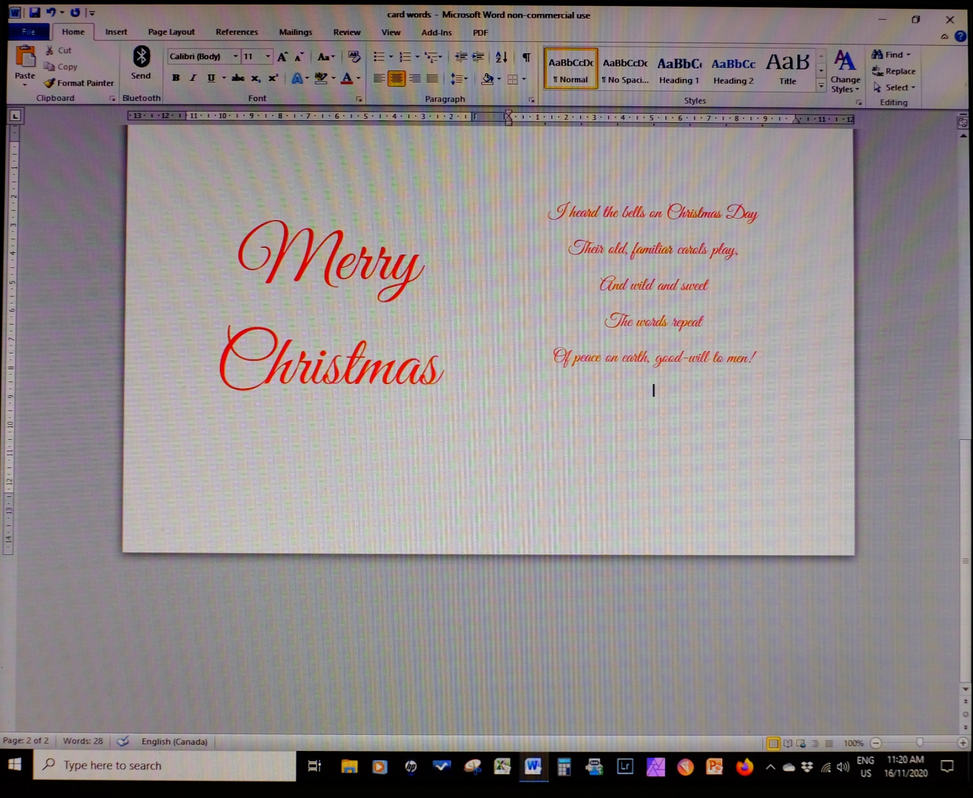
Printing words (inside)
Full size 6.5” x 10”
Microsoft Word
Page Layout:
Set the page size to 6.5” x 10”
Use a landscape orientation
Make two columns
Type words
The card is going to be folded in half along its length.
This means there will be two words areas inside each 6.5” x 5”.

Slide 15
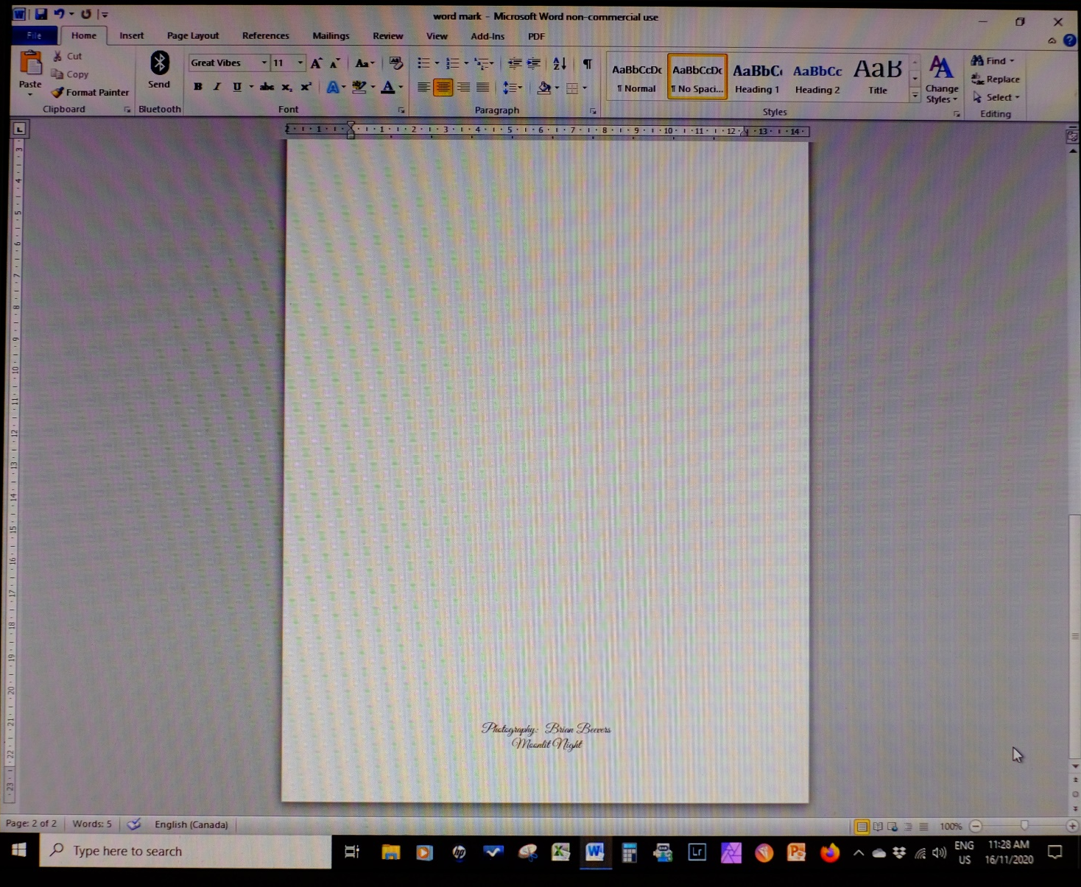
Printing photo title/credits (outside back)
Full size 6.5” x 10”

Slide 16
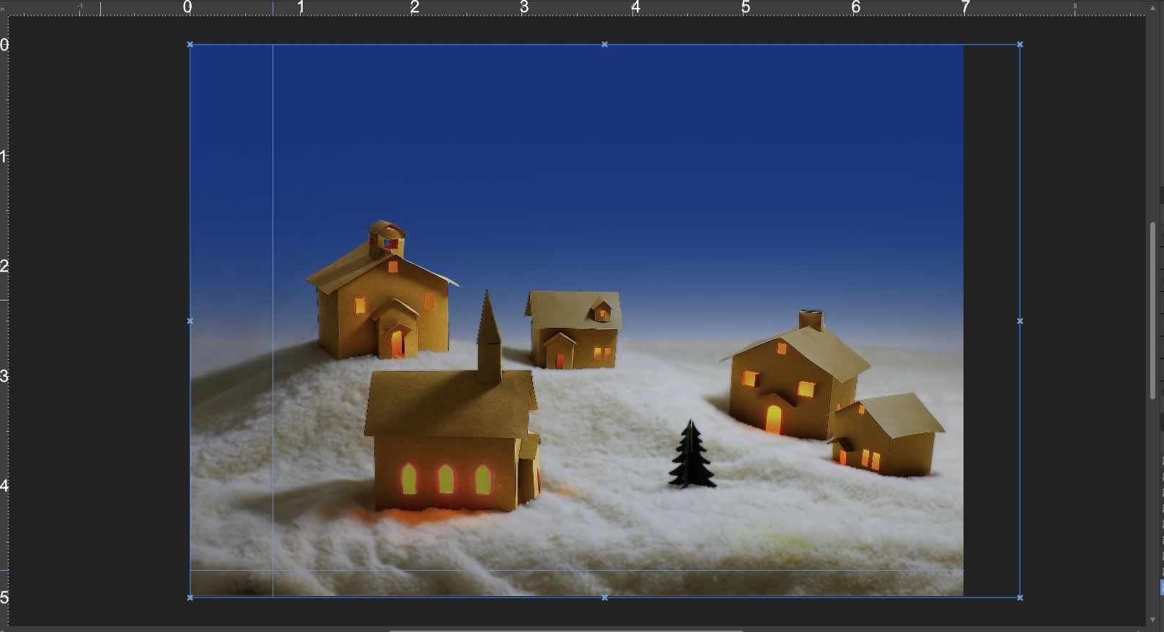
Sizing the image to a printable size
Full card size = 6.5” x 10”
When folded in half the picture receipt size will be 6.5” x 5”
Select a commercial print size nearest the picture receipt size…5”x 7”
Step 1: Crop the image to the print size.

Slide 17
Sizing the image to a printable size
Full card size = 6.5” x 10”
When folded in half the picture receipt size will be 6.5” x 5”
Select a commercial print size nearest the picture receipt size…5”x 7”
Step 2: Determine where to trim print to fit the card size.

Slide 18
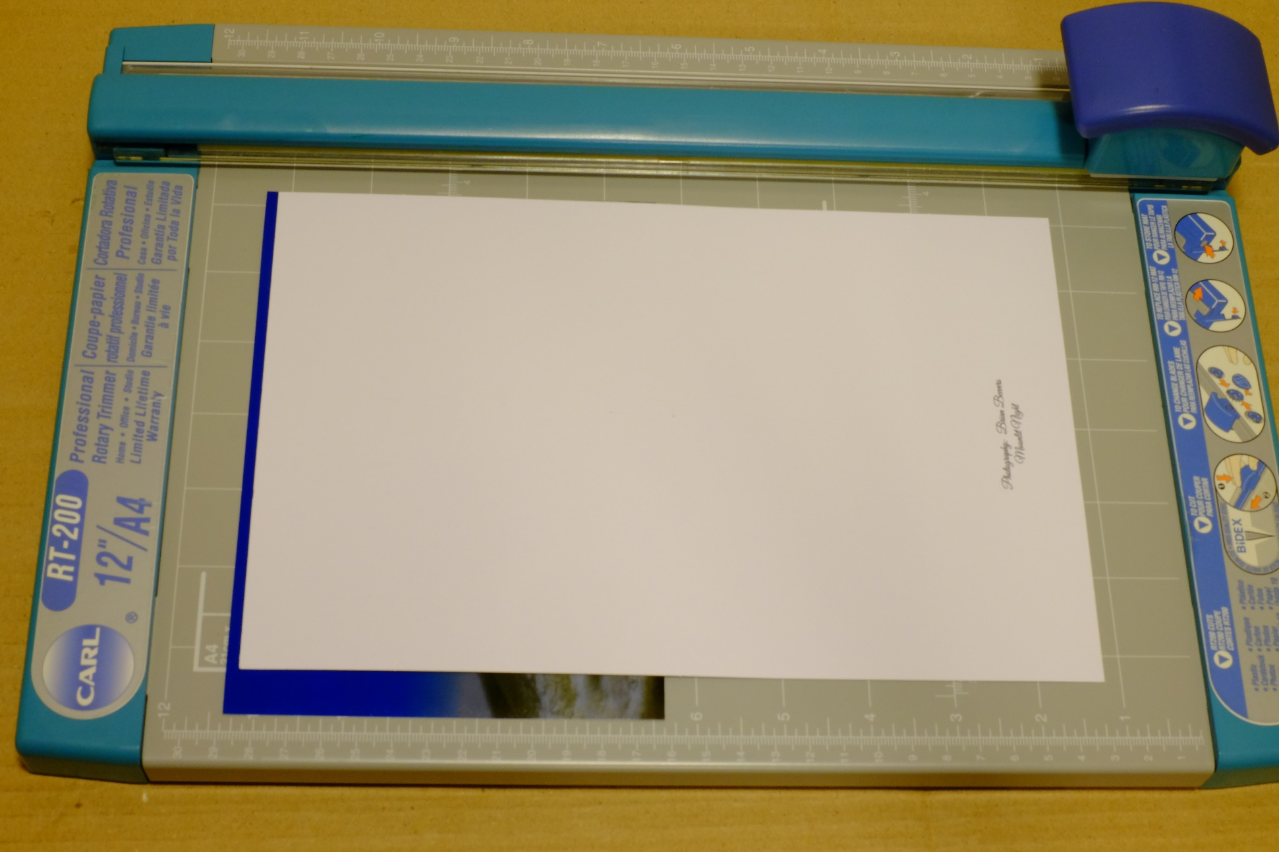
Trimming the print

Slide 19
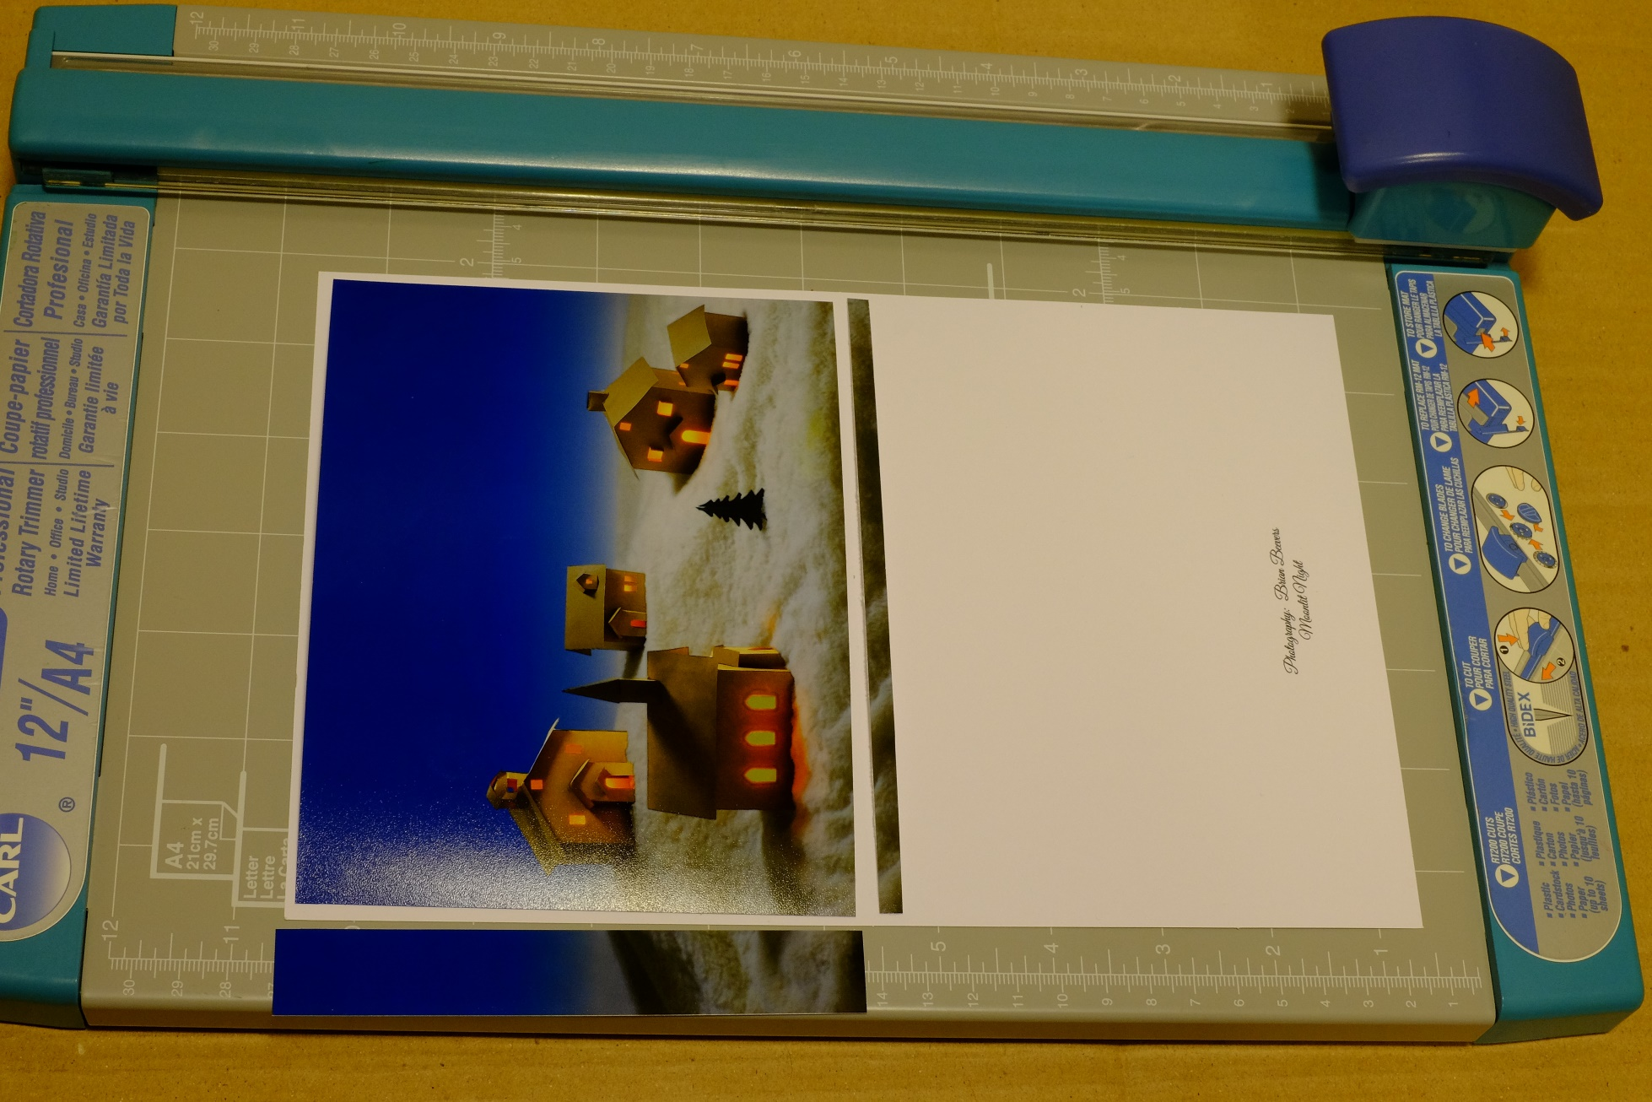
Trimming the print

Slide 20
Gluing the print
Double sided photo and document tape
Available at art stores and online

Slide 21
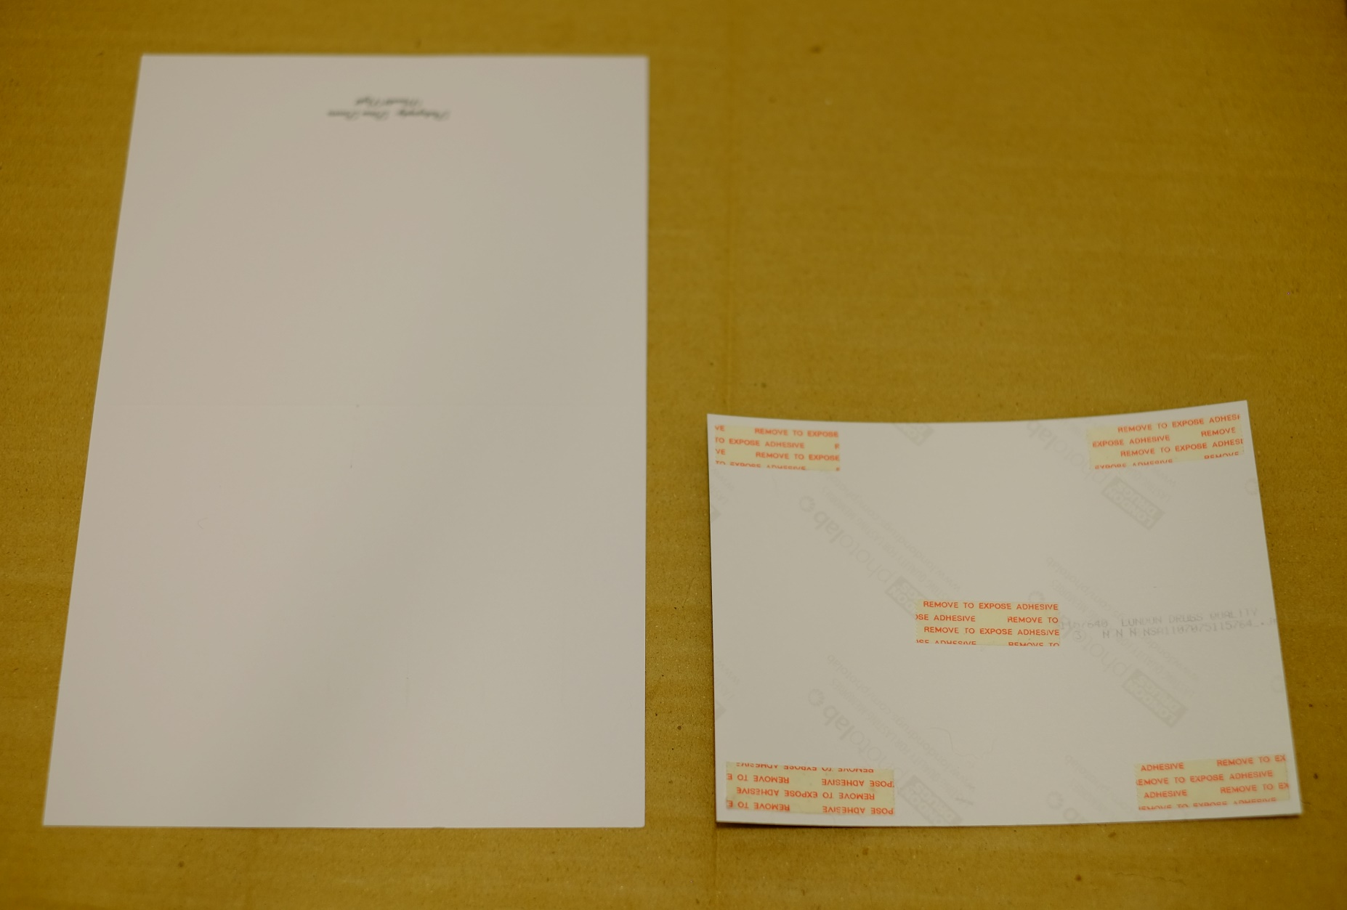
Gluing the print
Apply to the back of the print…

Slide 22
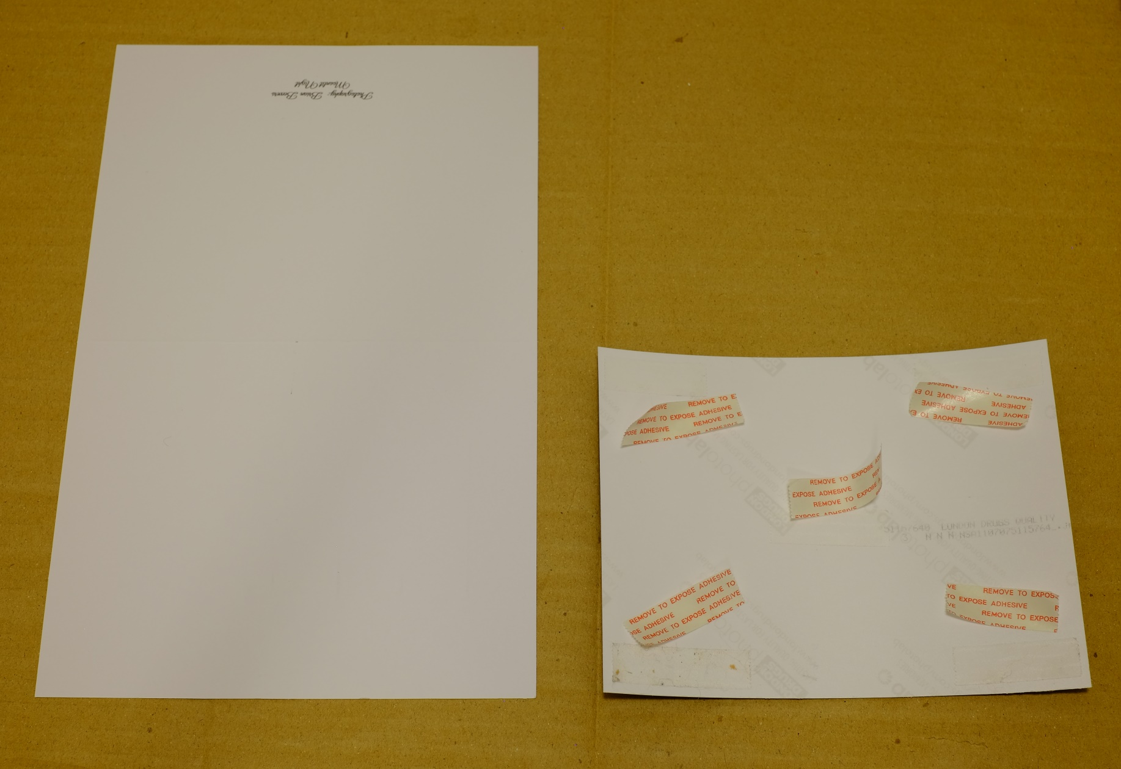
Gluing the print
Apply to the back of the print…
Peel off the tape backing, attach to the card.

Slide 23
Finished card

