Slide 1
The Histogram
Its use in setting exposure

Slide 2
Building A Histogram
Award Winning Portrait
Pure Black
Tone
Pure White
Pixel Count
1
20
1
76
2
Shades of grey
Increasing lightness

Slide 3
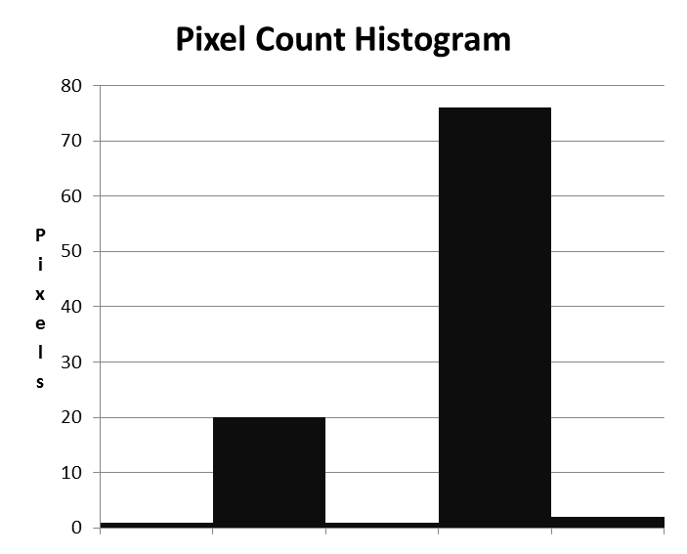
Interpreting A Histogram
Pixels on this line are pure white. There is no darkness. Information is lost.
BLOWN OUT WHITE
Pixels on this line are pure black. There is no light. Information is lost.
Tone
Pure Black
Pure White
Shades of grey
Increasing lightness

Slide 4
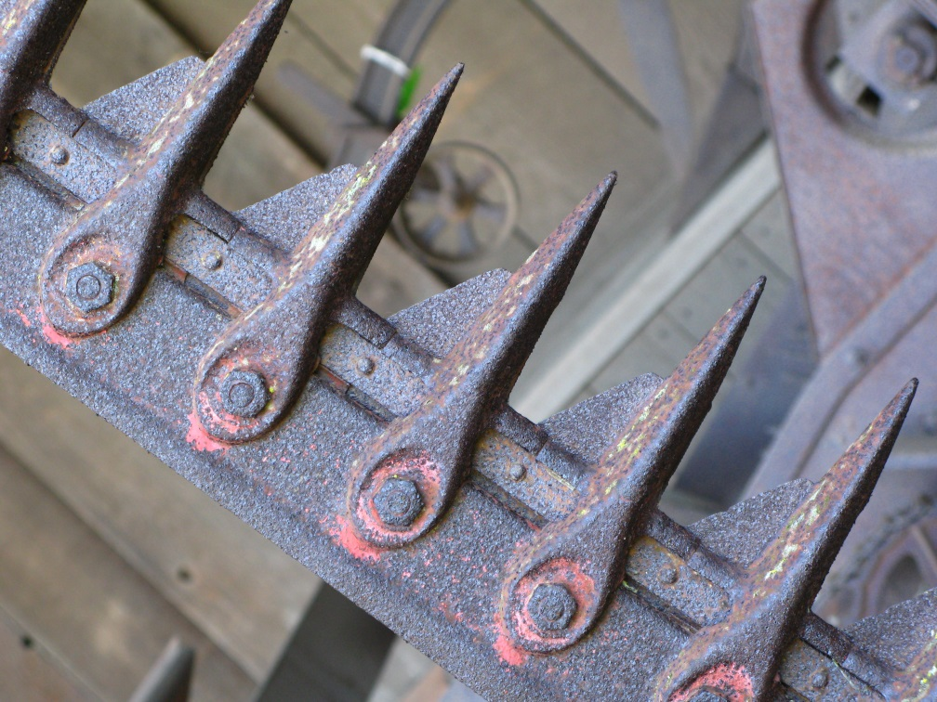
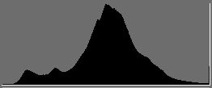
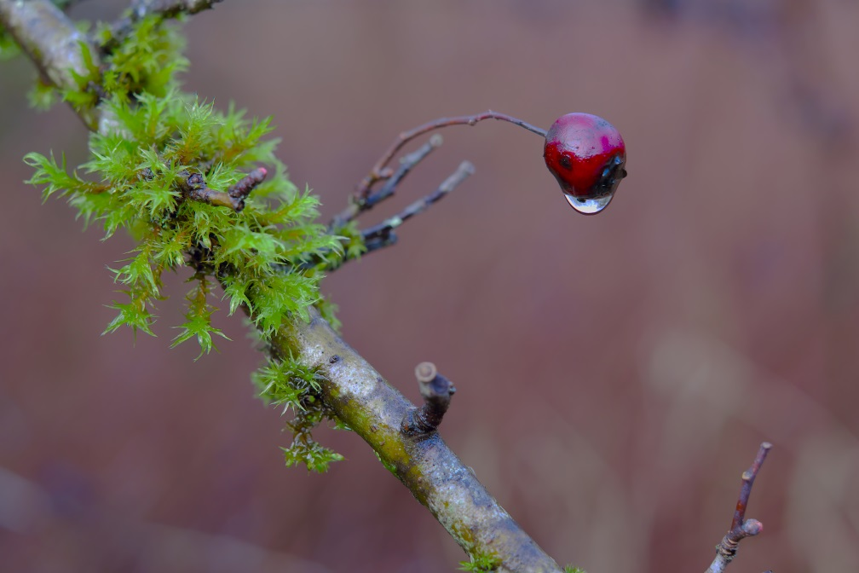
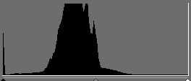
Examples:
Low Contrast, mid tone
Center the histogram

Slide 5
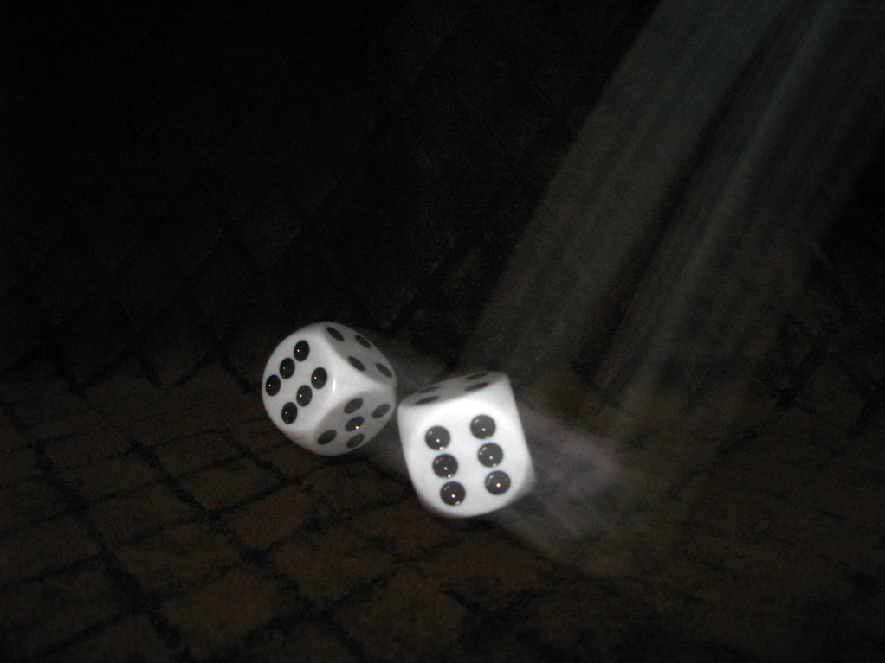
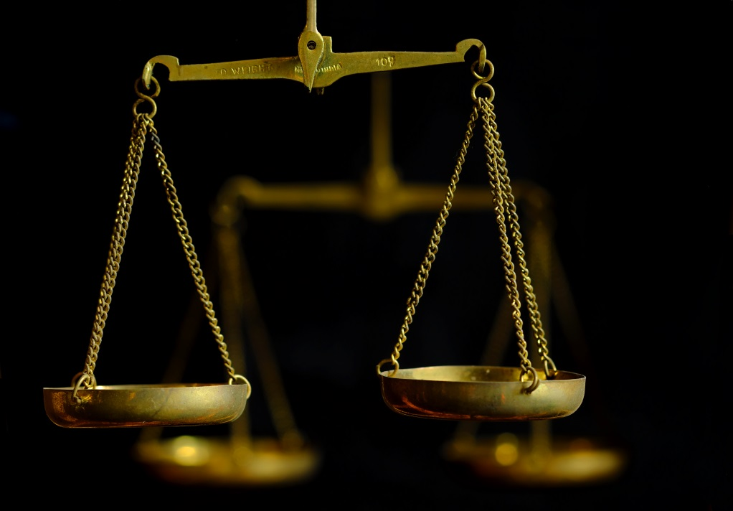
Examples:
shift histogram to left
Low key
It would be a mistake to center the histogram.
Destroy the background.
Over expose the subject.

Slide 6
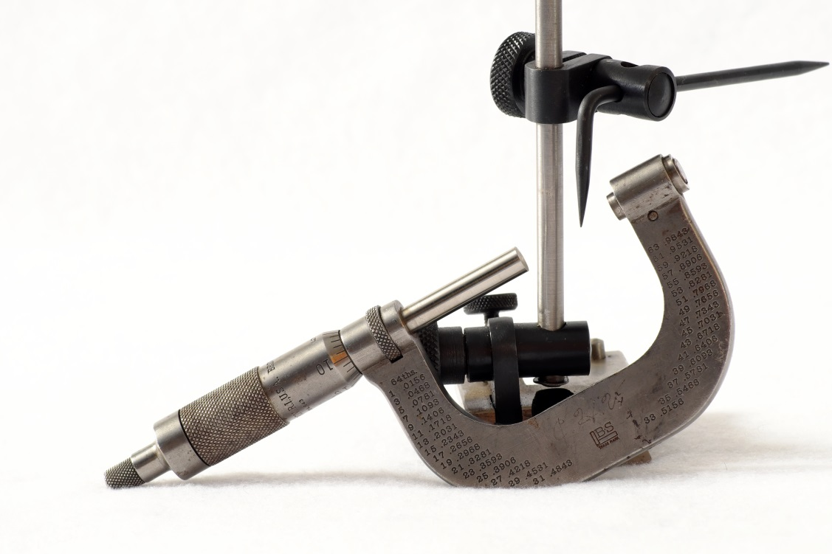
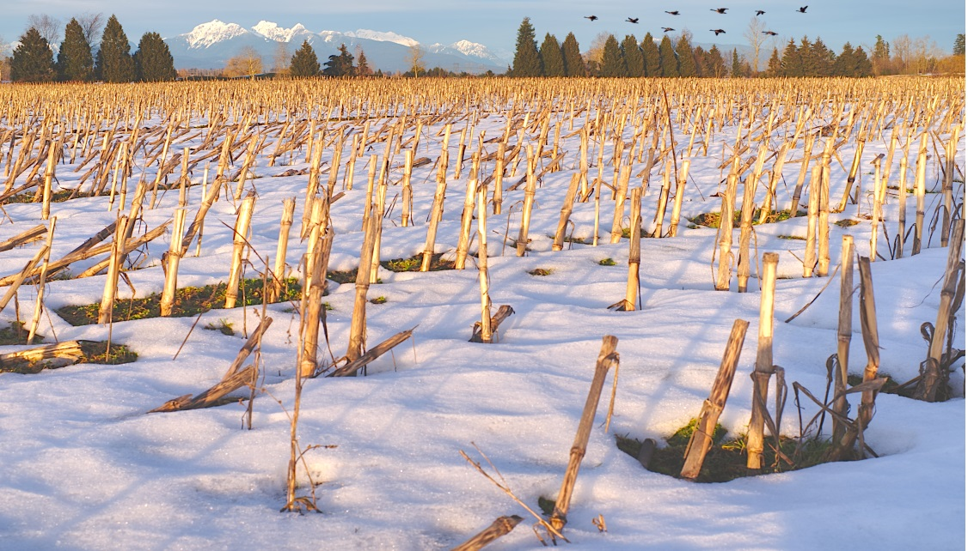
Examples:
High Key
White background contrast with dark tools. Shift hard right until the subtle shadow under tools almost disappears.
Snow has structure and colour. Shift right but not so far as to loose structure in the snow.

Slide 7
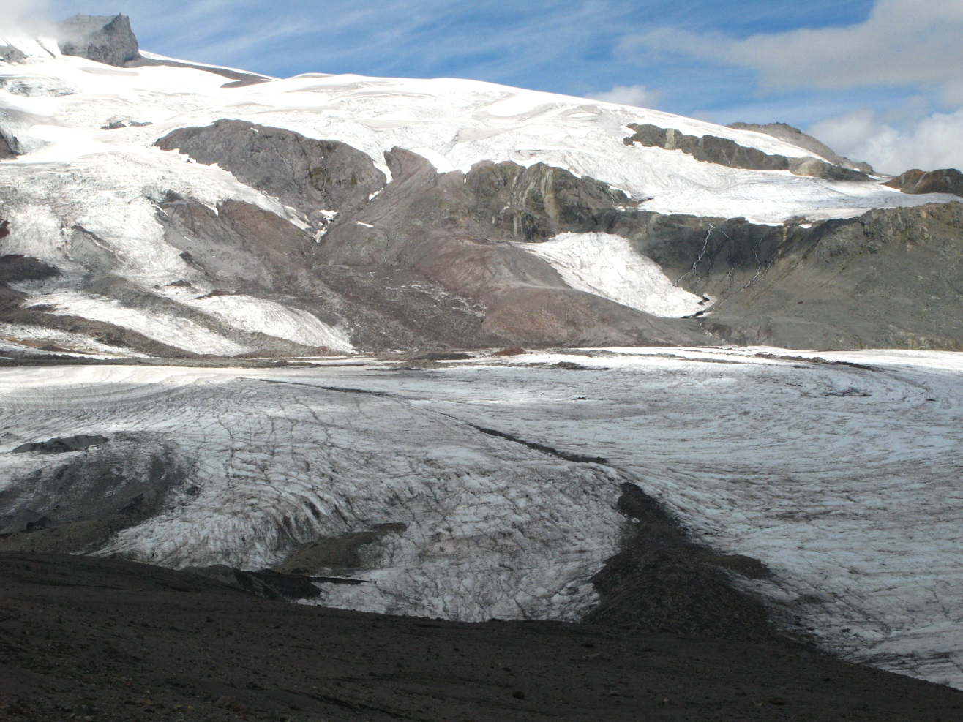
Examples
Opps
Many pixes pilled up on the right side resulting in blown out snow.
Room to shift the histogram to the left.
Better to expose correctly for the snow and underexpose the mud in the foreground.

Slide 8
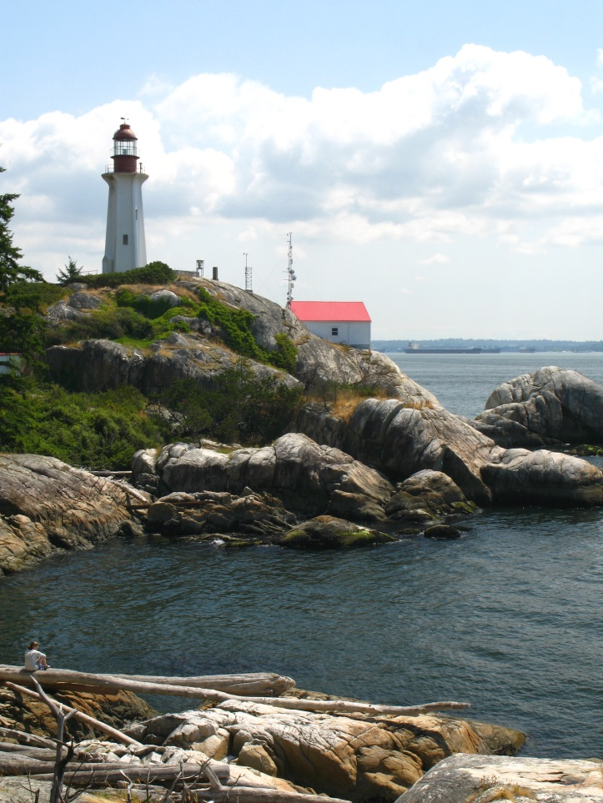
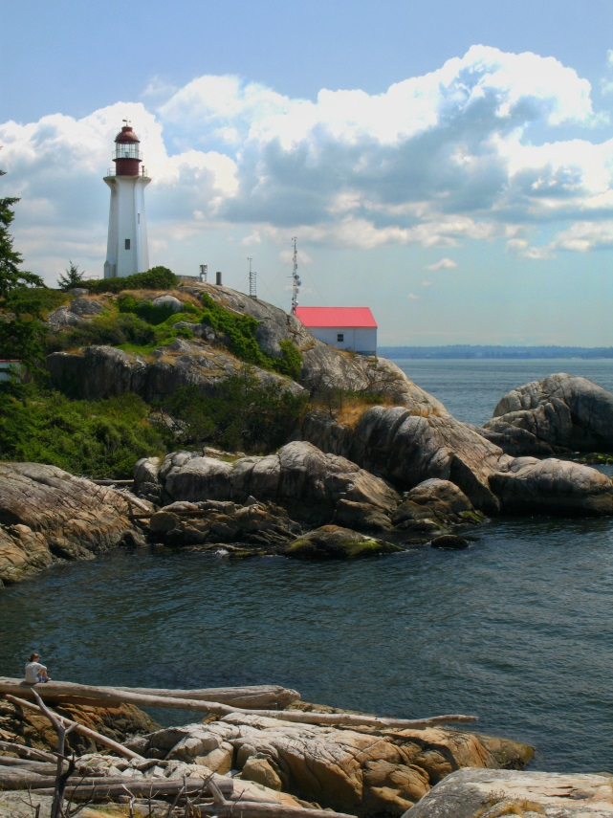
Examples
OOPS!
Highlights in clouds are badly blown out.
Significant number of pixels piled up along the right.
Room to shift to the left.
Photoshop editing no help. Information in the clouds is lost.
This is a candidate for HDR.
Common problem with mid day light.

Slide 9
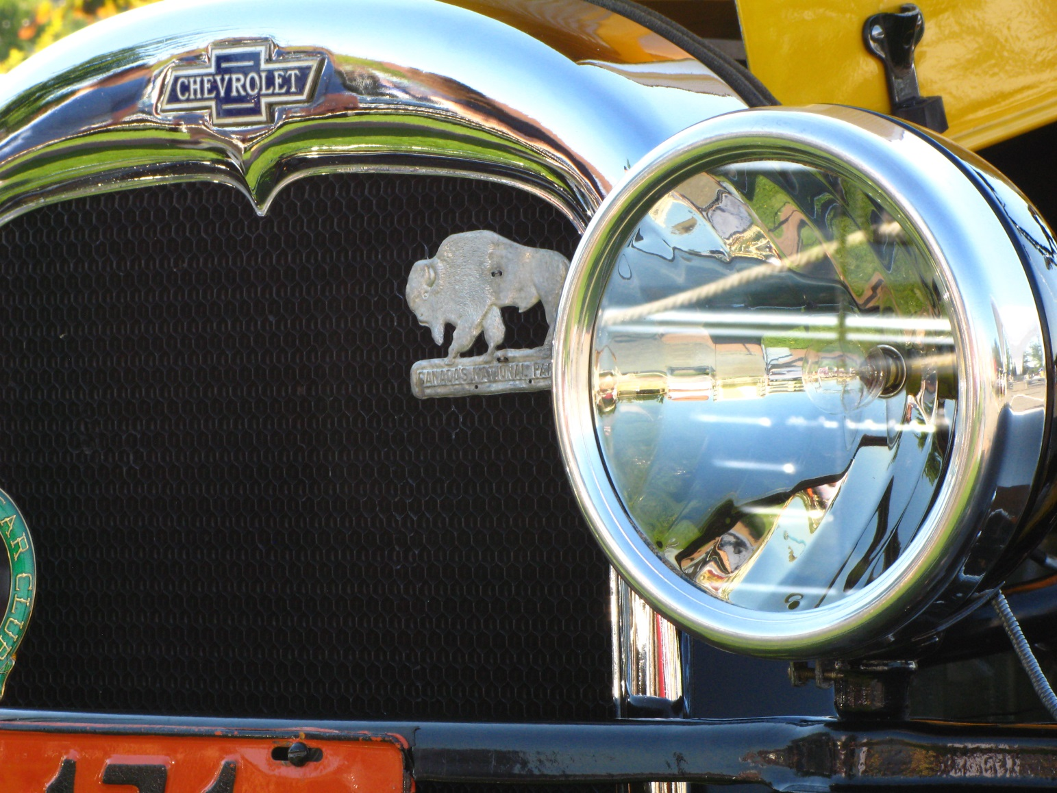
Examples
What is the important subject?
How would you expose using the histogram?
Expose for the structure in the black radiator.
Shift to the right.
A little over exposure in the chrome can be tolerated.
If too many pixels piled up on right…HDR

Slide 10
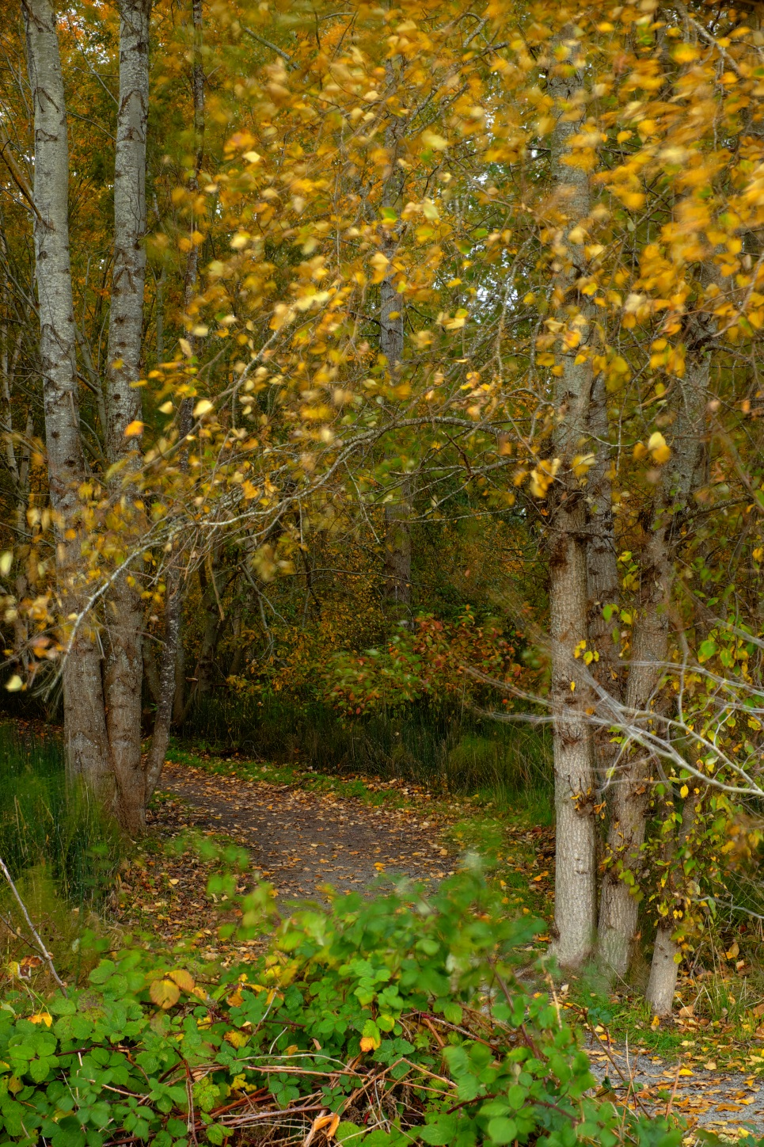
Examples
What is the important subject?
How would you expose using the histogram?
Preserve the leaves. Don’t overblow the leaves.

Slide 11
Examples
Work backwards
What type of image will have this histogram?

Slide 12
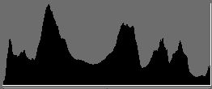
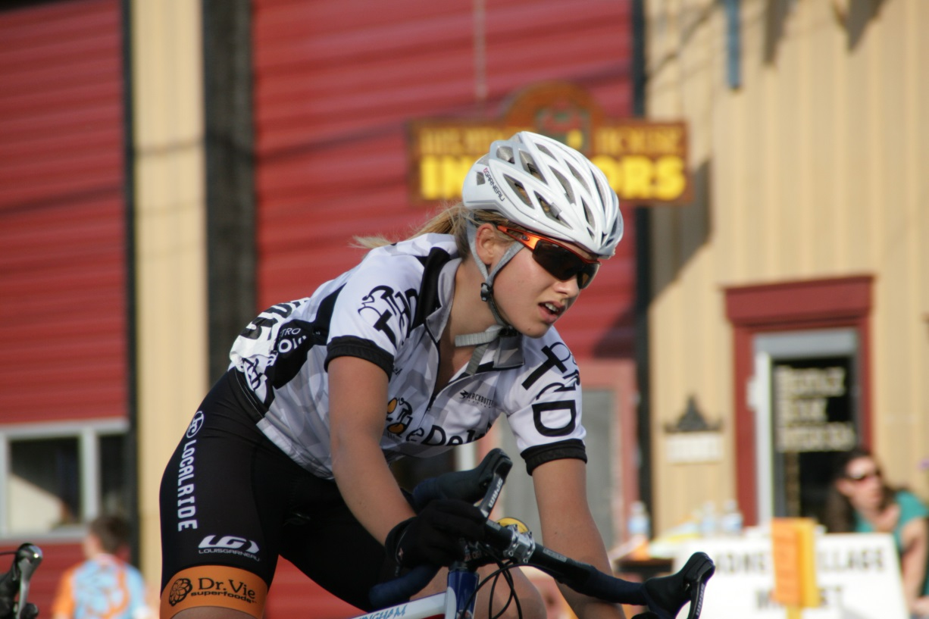
Examples
Work backwards
What type of image will have this histogram?

Slide 13
Exposing Using A Histogram
Examine the scene:
a. Bright: shift the bulk of the pixels to the right
Dark: shift the bulk of the pixels to the left
If pixels are touching either the left (black) or right (white) determine what in the scene is under or over exposing.
If on the left (losing information in the shadows)
Not important information in the shadows…take the picture.
Important information in shadows increase the exposure.
If increasing the exposure causes pixels on the right (over exposure) determine if this blow out will be a problem. In general it is best to avoid blow outs.
If over exposure will be a problem consider doing HDR. (Multiple exposures at different exposure levels.) The scene has a higher dynamic range than the camera is capable of recording.
If on the right (losing information in the highlights)
Not important information in the highlights…take the picture. In general avoid this.
Important information in the highlights…decrease the exposure
If a decrease in exposure causes loss of information in the shadows, determine if this will be a problem.
If under exposure will be a problem, consider doing HDR.
In general, it is best to avoid having pixels against the right side. Image dependent.

Slide 14
Exposure Management:
There are four ways to control exposure
Manual mode
Change the aperture
Increase f number shifts histogram to the left (increase in depth of field)
Decrease f number shifts histogram to the right (decrease in depth of field)
Change the shutter speed
Increase speed shifts histogram to the left (decreases subject blur)
Decrease speed shifts histogram to the right (increase subject blur)
Change the ISO
Increase ISO shifts histogram to the right (increase noise)
Decrease ISO shifts histogram to the left (decrease noise)
An automatic mode (Aperture priority, Shutter Priority, Program mode, full auto)
Exposure compensation

Slide 15
Exposure
1. Exposure Compensation:
Allows for the photographer to override the exposure setting selected by the camera.
Must be in one of the “creative” modes.
Canon: A-DEP, Av, Tv or P (point and shoot Canon G7, some preset modes.
Point and shoot: some of the preset scene modes.
Nikon: P, S, A or M.
2.
is the symbol for exposure compensation.
Activate the exposure compensation system in your camera.
Nikon: button on top right with exposure compensation symbol.
b. Canon: turn switch to
Turn the appropriate dial to select the appropriate compensation:
Nikon: main command dial.
Canon: quick control dial.

Slide 16
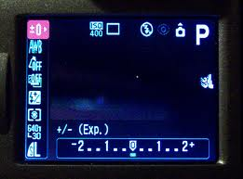
Exposure
Exposure Management:
In the view finder or on the viewing screen you will see:
Most cameras allow for 1/3 stop adjustments.
One click of a dial means 1/3 of a stop adjustment.
Automatic modes: Exposure compensation
Manual mode: Change Aperture or Shutter speed or ISO
To shift the histogram to the left:
This is 0 compensation
3 clicks
This is -1 stop (1/2 light)
3 clicks
This is -2 stops (1/4 light)

Slide 17
Exposure
Exposure Management:
In the view finder or on the viewing screen you will see:
Most cameras allow for 1/3 stop adjustments.
One click of a dial means 1/3 of a stop adjustment.
Automatic modes: Exposure compensation
Manual mode: Change Aperture or Shutter speed or ISO
To shift the histogram to the right:
This is 0 compensation
3 clicks
This is +1 stop (2X light)
3 clicks
This is +2 stops (4X light)

Slide 18
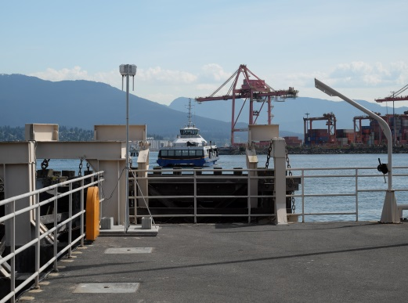
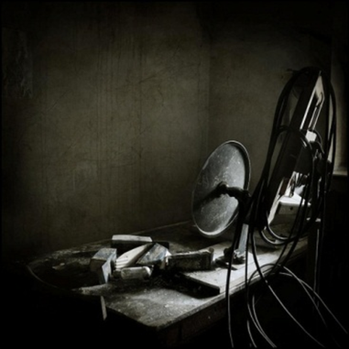
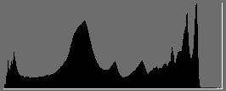
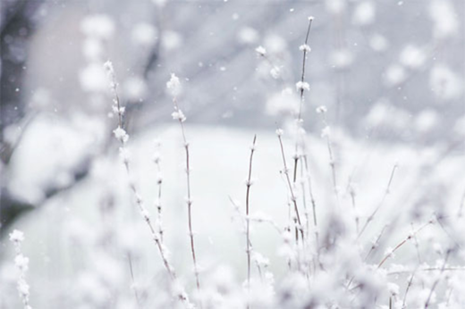
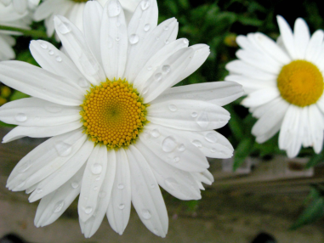
Exposure
Exposure Management:
Examples
Use the histogram to determine the amount of compensation.

