Slide 1
Creative Camera Techniques
Depth of Field
Notes:
Example of deep depth of field
HAVE TO CLICK TO BRING UP THE CAPTION
Everything in focus, gives a clear bright mood

Slide 2
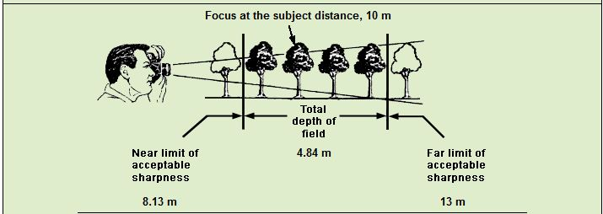
Depth of Field
What is Depth of Field?
The distance both in front of and behind the focus point which appears acceptably focused.
Notes:
HAVE TO CLICK TO BRING UP DOF GRAPHIC

Slide 3
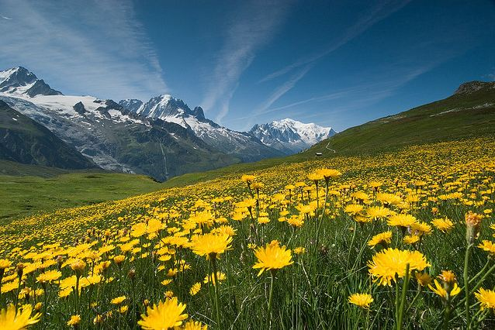
Depth of Field
Deep
FL 35 mm
Focus 50 m
f 16
http://www.diyphotography.net/aperture
Everything in focus…bright mood

Slide 4
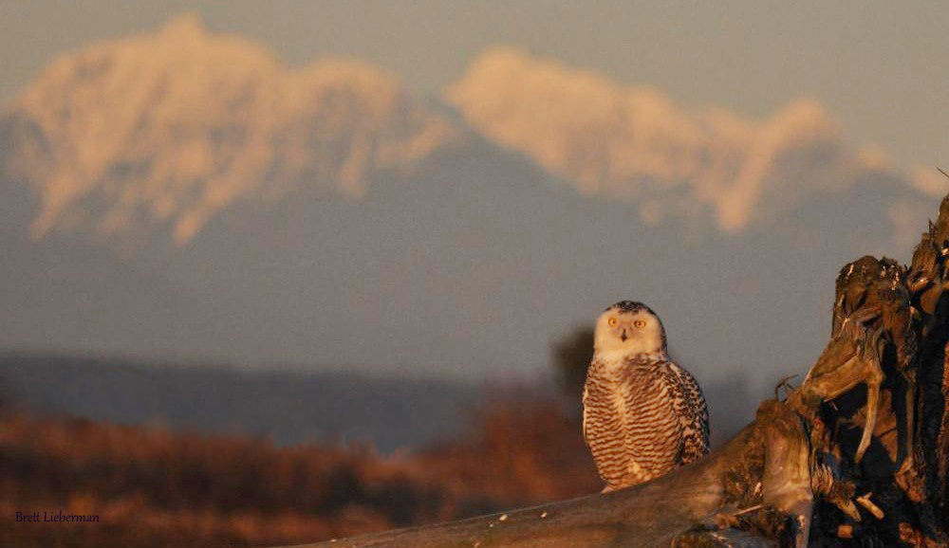
Depth of Field
Shallow
Nikon DX
FL ~200 mm
Focus ~40 m
f 4
Shallow Depth of Field: Draws eye to the subject

Slide 5
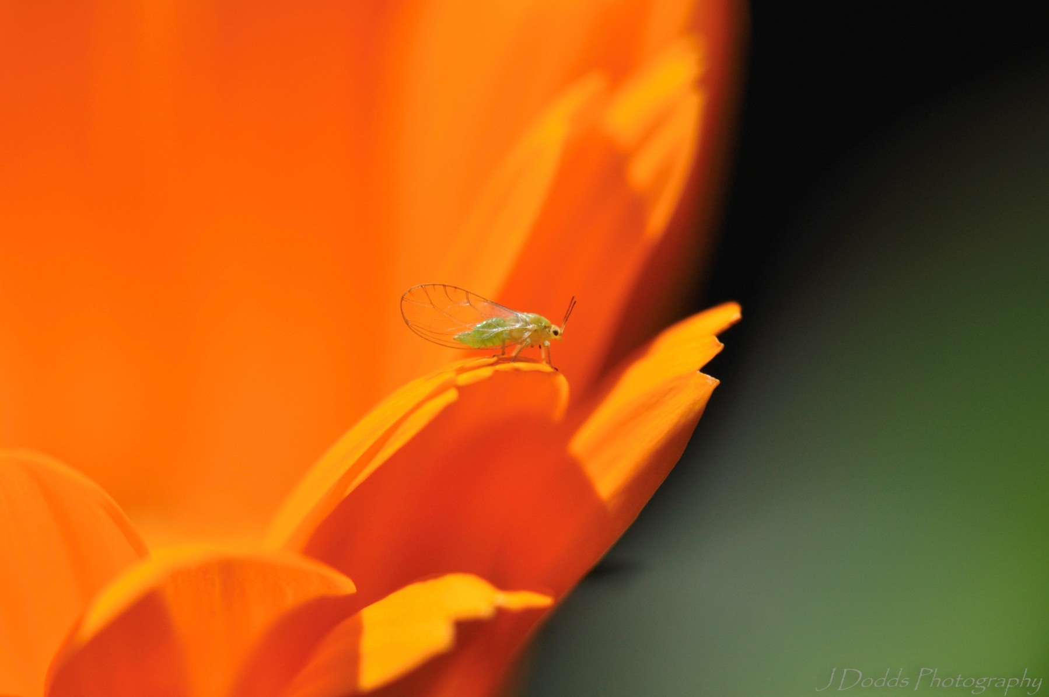
Depth of Field
Shallow
Nikon D90
(DX format)
FL 105 mm
Focus ~3.2 cm
f 10

Slide 6
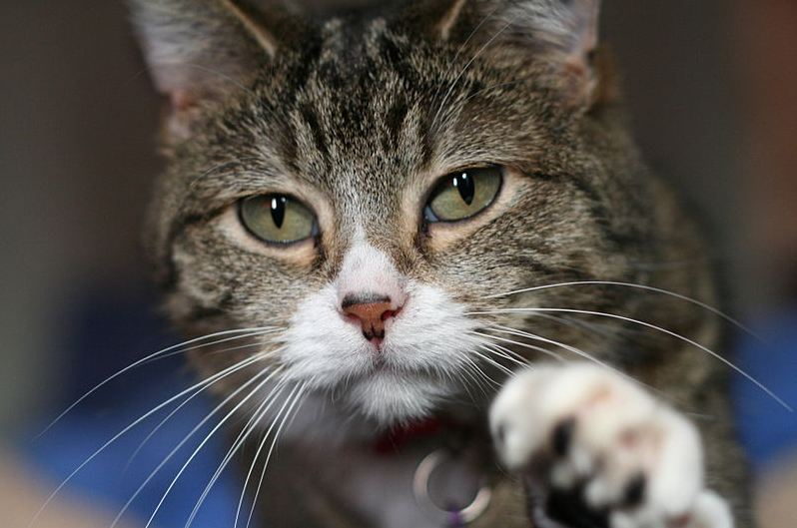
Depth of Field
Shallow
FL 100 mm
Focus ~1.5 m
f 2.8

Slide 7
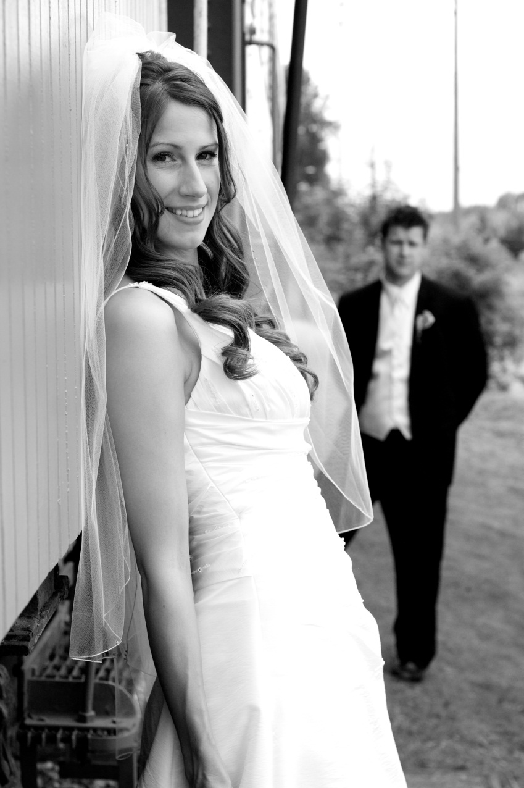
Depth of Field
Shallow
Canon 30D (APS-C)
FL 50 mm
Focus ~1.5 m
f 5

Slide 8
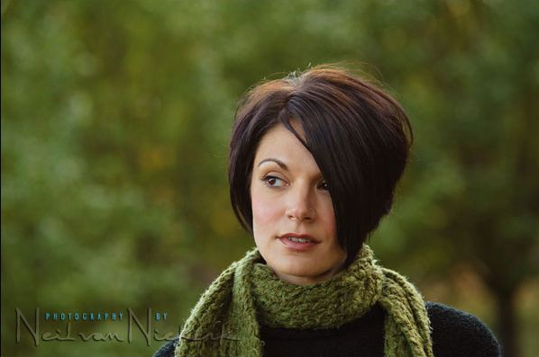
Depth of Field
Shallow
FL 100 mm
Focus ~3 m
f 2.8
Blurred background produces a soft mood.

Slide 9
Depth of Field
Shallow
FL 200 mm
Focus ~15 m
f 4
Subject is isolated from the background.
Be careful when using a shallow depth of field that there is not a bright area behind the subject which competes with the subject.
http://www.lyitdesign.com/phpBB3/viewtopic.php?f=5&t=18

Slide 10
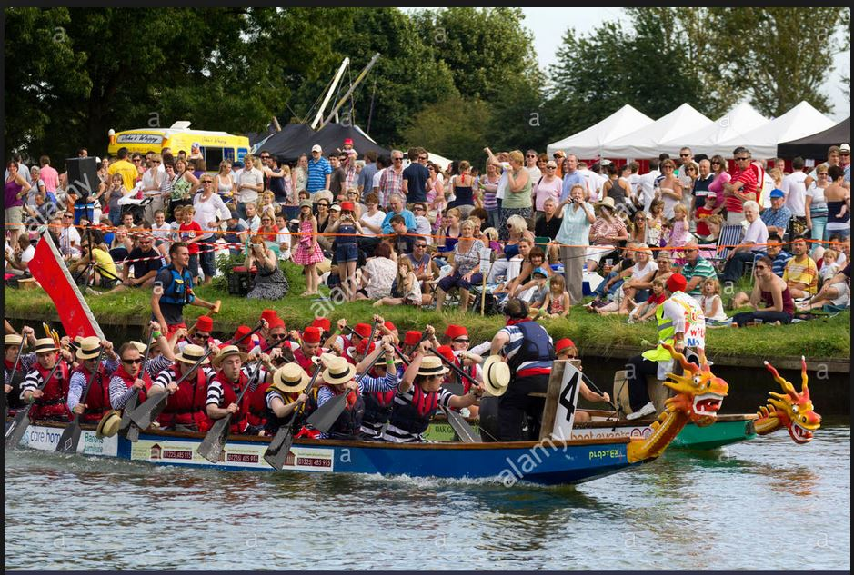
Depth of Field
Depth of Field too deep:
No separation of shore and boats.
Subject unclear.

Slide 11
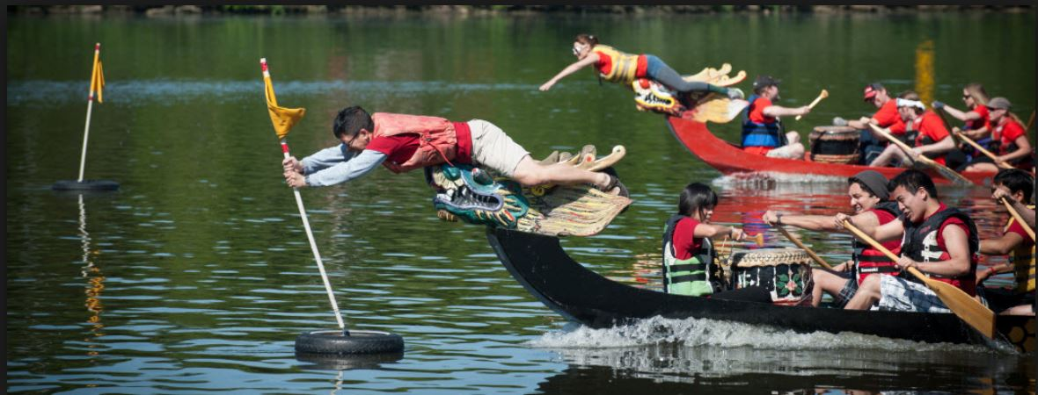
Depth of Field

Slide 12
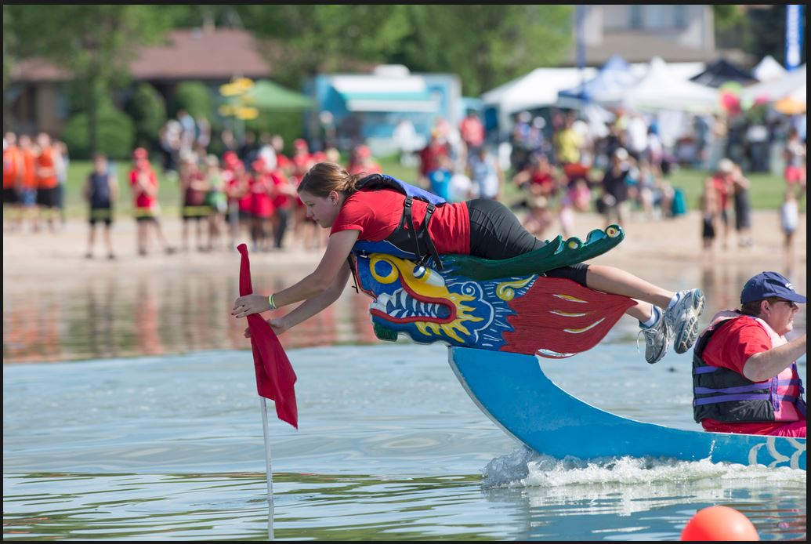
Depth of Field
Shallow depth of field
Correct focus
Subject clearly defined
PERFECT! (almost)

Slide 13
Depth of Field
Camera Controls of Depth of Field:
Focus Distance:
a. The closer the focus the shallower the Depth of Field. (Focal length constant). Affects composition.
2. Lens Focal Length:
a. The longer the focal length the shallower the Depth of Field. (Focus distance constant). Affects composition.
3. Aperture:
The larger the aperture number, the deeper the Depth of Field. This is the only control which does not affect composition.
c. Convenient to set camera on Aperture Priority mode (‘Av’ Canon, ‘A’ Nikon)
Depth of Field Calculator (computer): http://www.dofmaster.com/dofjs.html
iPhone app: “SetMyCamera”

Slide 14
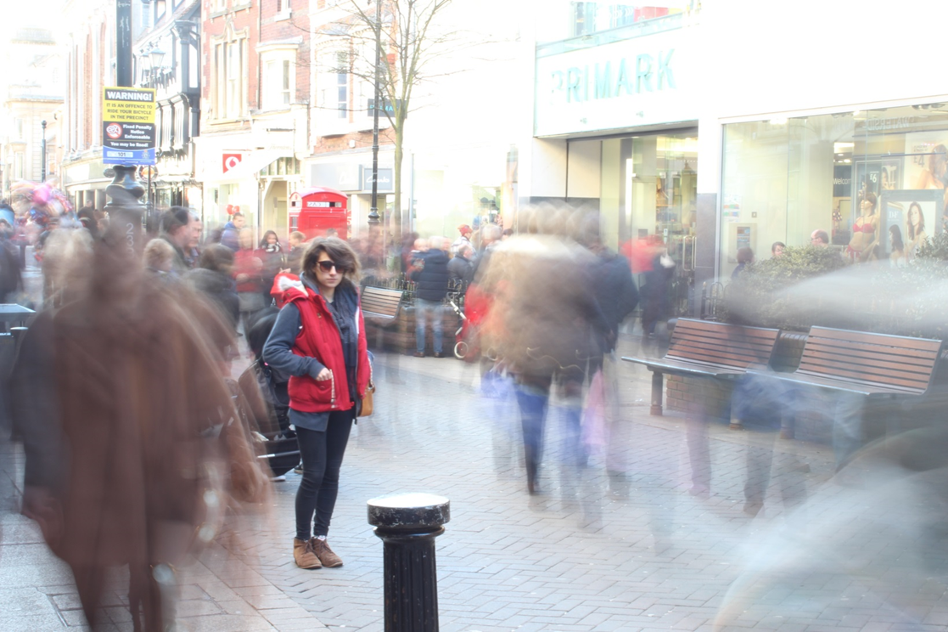
Creative Camera Techniques
Motion
Contrast between blurry images and the clear image draws attention to the clear subject.
A stationary person on a busy street gives the feeling of motion: moving in a crowd of people.
Notes:
Example of deep depth of field
HAVE TO CLICK TO BRING UP THE CAPTION
Everything in focus, gives a clear bright mood

Slide 15
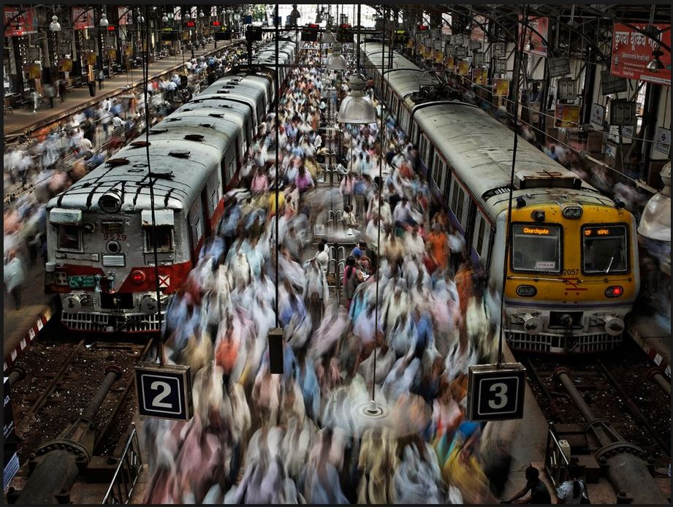
Motion
Notes:
Example of deep depth of field
HAVE TO CLICK TO BRING UP THE CAPTION
Everything in focus, gives a clear bright mood

Slide 16
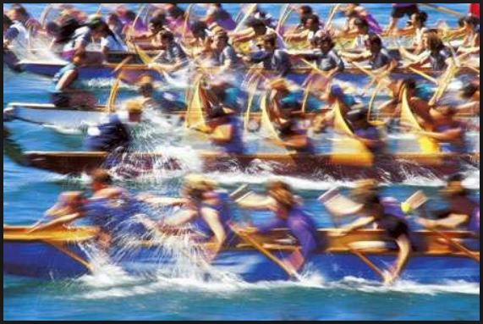
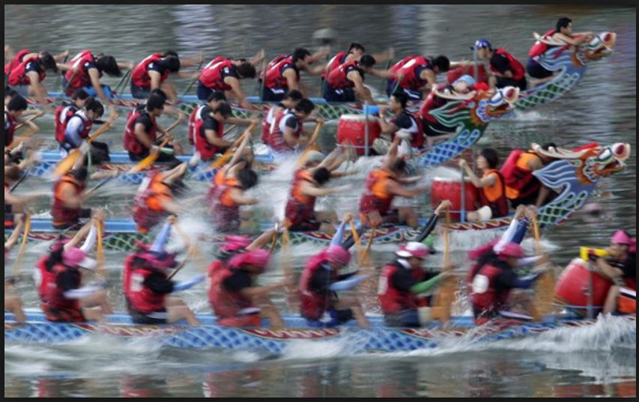
Motion
Blurred image gives the feeling of movement
Notes:
Example of deep depth of field
HAVE TO CLICK TO BRING UP THE CAPTION
Everything in focus, gives a clear bright mood

Slide 17
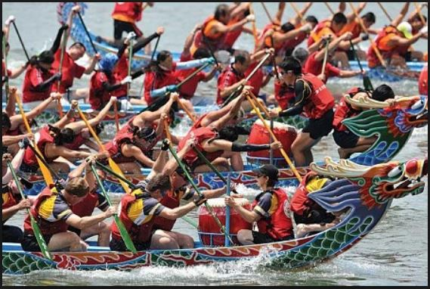
Motion
Contrast with
Blurred image gives better feeling of motion.
Notes:
Example of deep depth of field
HAVE TO CLICK TO BRING UP THE CAPTION
Everything in focus, gives a clear bright mood

Slide 18
Creative Camera Techniques
Motion
Camera Controls of Motion:
Lens focal length: The longer the focal length the easier to create blur. Affects composition.
Shutter Speed: the longer the shutter speed the easier to create blur.
No effect on composition.
Use Shutter Priority Mode (‘Tv’ Canon, ‘S’ Nikon)
Notes:
Example of deep depth of field
HAVE TO CLICK TO BRING UP THE CAPTION
Everything in focus, gives a clear bright mood

Slide 19
Motion
Considerations:
Bright Day: requires a fast shutter speed. No problem to stop motion.
Problem: To create blur requires a slow shutter speed.
Increase the aperture number
Decrease the ISO.
(For best image quality use the native ISO for your camera.)
Use a neutral density filter (polarizing filter).
Dark environment: requires a slow shutter speed. No problem to create blur.
Problem: to stop action requires a fast shutter.
Use a smaller aperture number. Trade sharpness for shallow depth of field.
Increase the ISO. Trade sharpness for noise.
Use a tripod. Will stop camera shake blur but will not stop subject motion blur.
Use a flash. On camera flash causes a flat pasted look. Off camera flash done well is extremely effective.
Most convenient way to control shutter speed is to use Shutter Priority: you set the shutter speed, the camera sets the aperture.
Notes:
Example of deep depth of field
HAVE TO CLICK TO BRING UP THE CAPTION
Everything in focus, gives a clear bright mood

Slide 20
Exposure
Exposure Control:
Putting it all together:
The Exposure Triangle
The exposure triangle contains all of the exposure functions:
Each function plays a role in the final image.
Exposure triangle provides a rational for exposure settings.
ISO
Noise
Motion Blur
Depth of Field
Shutter
Aperture

Slide 21
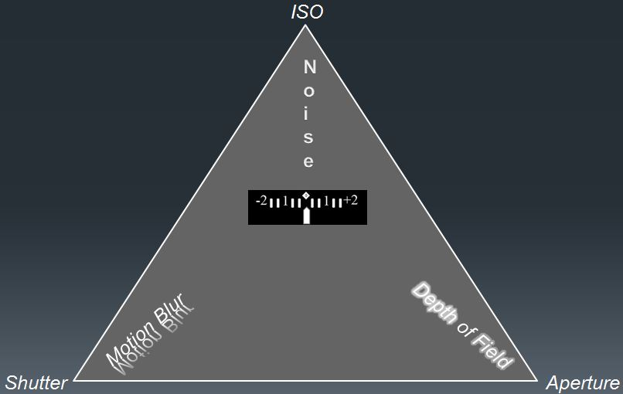
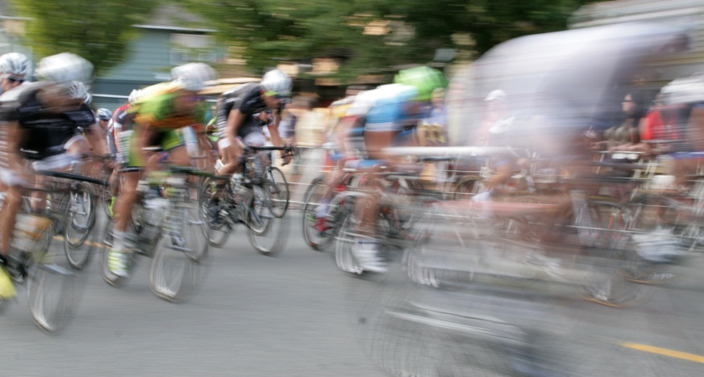
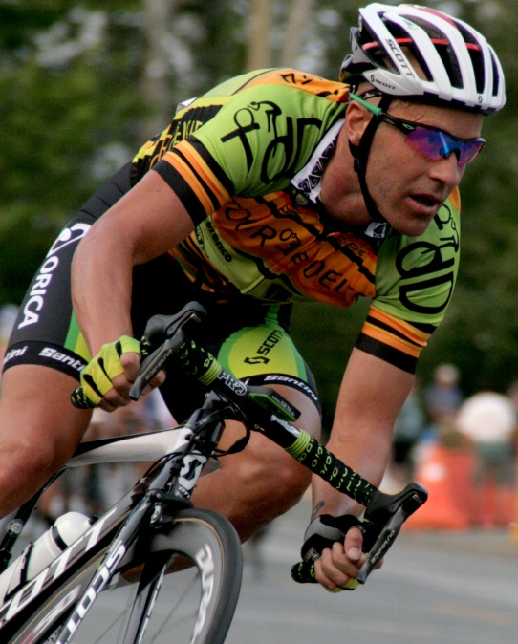
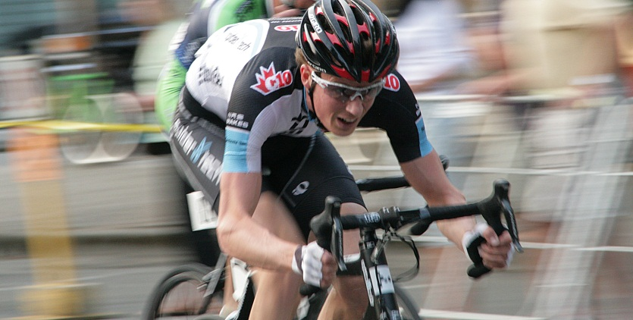
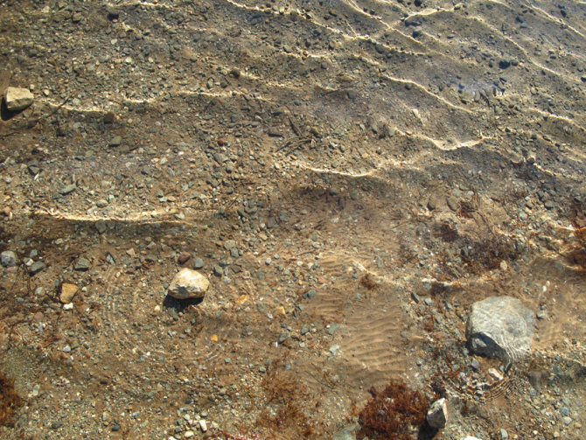
Exposure
Exposure Control:
Putting it all together cont:
Examples
Slow shutter
Large aperture #
Panning
Medium shutter
Medium aperture
Fast shutter
Small aperture #
Fast shutter
Small aperture #

Slide 22
Taking the Picture…
Assess the scene and imagine the image
(pre-event visit)
1. Is this an action image or a depth of field image?
Action: use shutter priority mode (‘Tv’ Canon, ‘S’ Nikon)
Stop action: use fast shutter speed,
Blur action: use slow shutter
Depth of field: use aperture priority mode (‘Av’ Canon, ‘A’ Nikon)
Shallow depth of field: use a small aperture number
Deep depth of field: use a large aperture number
Is the shutter speed high enough (for hand holding)?
Use a tripod
Increase ISO
Very fast action: consider continuous shooting mode with continuous focus.
Is this an unusual lighting situation? Use exposure compensation?
Bright, low contrast: need to “over expose”
Dark, low contrast: need to “under expose”
Bracket?
Compose the image. Check focus
Click!

