Slide 1
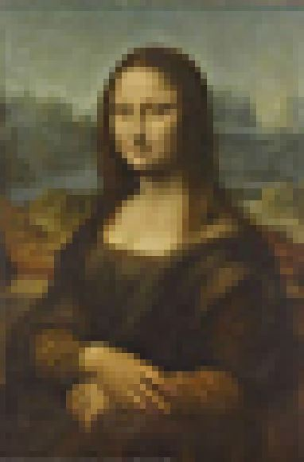
Changing Pixel Number with Photoshop Elements

Slide 2
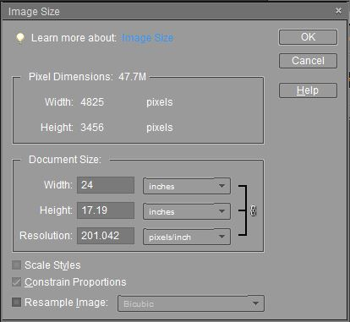
Photoshop Elements (digital Image manipulation software including: Photoshop, Lightroom, Corell Painter…)
Photoshop Elements
Image -> Resize -> Image Size
Pixel Dimensions:
47.7 M size of uncompressed file
Width: number of pixels in width
Height: number of pixels in height
Document Size:
Width length (inches, centimeters)
Height length (inches, centimeters)
Resolution = Pixels/inch…
Scale Styles: keeps proportions of layers with styles
Constrain Proportions: keeps the proportion of the image (ie 3:2 or 16:9)
Resample Image: computer will add or throw away pixels.

Slide 3
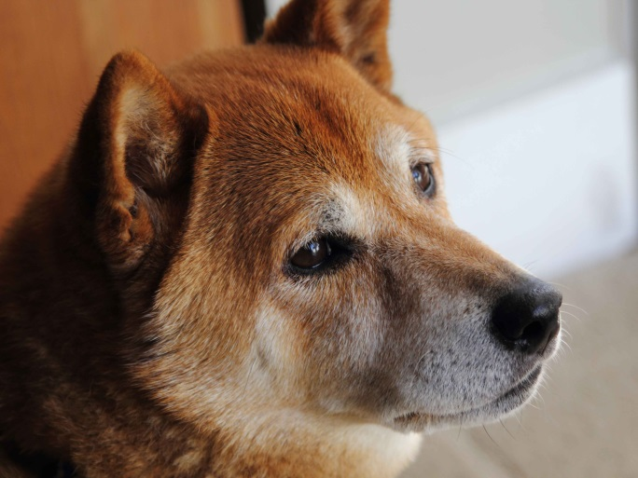
Image Size Review (Pixels)
Kyo Original.jpg
This image was captured with a 15 Mpixel camera. How can we tell if this is truly 15 Mp?
Pixel Dimensions:
Width: 4825 pixels
Height: 3456 pixels
4825 pixels
3456 pixels
Image size = 4825 x 3456 =
16,675,200 pixels

Slide 4
Changing the Number of Pixels (add or remove pixels)
Fraser Valley Invitational photo contest. SIZE RULES - Digital images must be in JPEG format, and sized as max width 1400 pixels by max height 1050 pixels, regardless of orientation.
or
How can I change the number of pixels without changing image proportions?
In this image we have 4825 pixels wide and 3456 pixels high.
(16,675,200 pixels)
The contest requires 1400 pixels wide and 1050 pixels high.
(1,470,000 pixels).
I need to get rid of 16,675,200 -1,470,000 = 15,205,200 pixels!
Answer: specify the number of pixels and Resample.

Slide 5
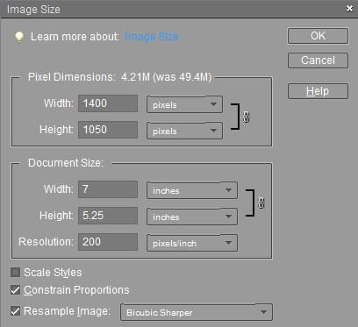
Changing the Number of Pixels (Resampling)
Fraser Valley Invitational photo contest. SIZE RULES - Digital images must be in JPEG format, and sized as max width 1400 pixels by max height 1050 pixels, regardless of orientation.
Steps:
Image > Resize > Image Size
Select “Constrain Proportions”
Select “Resample Image”
Enter the number of width pixels in the “Width” box (1400)
Select “Bicubic Sharper” from the dropdown as the resampling method
Press “OK”
Photoshop Elements will remove pixels and produce an image with the correct number of pixels.

Slide 6
Changing the number of Pixels (pixels are added or removed [Resampling])
How is the resampling method chosen?
Nearest Neighbor: A fast but less precise method that replicates the pixels in an image. This method can produce jagged effects.
Bilinear: A method that adds pixels by averaging the color values of surrounding pixels. It produces medium-quality results.
Bicubic: A slower but more precise method. Bicubic produces smoother tonal gradations than Nearest Neighbor or Bilinear.
Bicubic Smoother: A good method for enlarging images.
Bicubic Sharper: A good method for reducing the size of an image.

