Slide 1
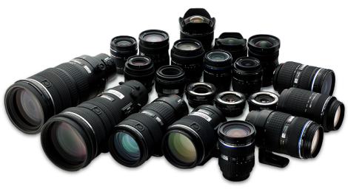
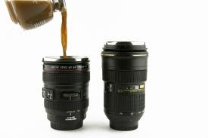
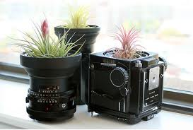
Lenses???!
Evaluate

Slide 2
Lenses???!
Review: Light Volume Control:
f stops are light transmission standards: f 8 transmits the same amount of light for any lens.
Lenses can be evaluated by the maximum aperture (the smallest f stop):
A large maximum aperture gives more flexibility in low light and in depth of field…..Desirable.
Lenses are considered fast if they have a maximum aperture of <= f 2.8.
Lenses with larger maximum apertures and zoom lenses with constant maximum apertures are more $expensive$. (contain more glass)
IS or VR allows for hand holding at reduced shutter speed. (Up to 4 stops reduction in speed)

Slide 3
Lenses???!
focal Length:
Important consideration when buying a lens.
The focal length determines the size of the image on the sensor.

Slide 4
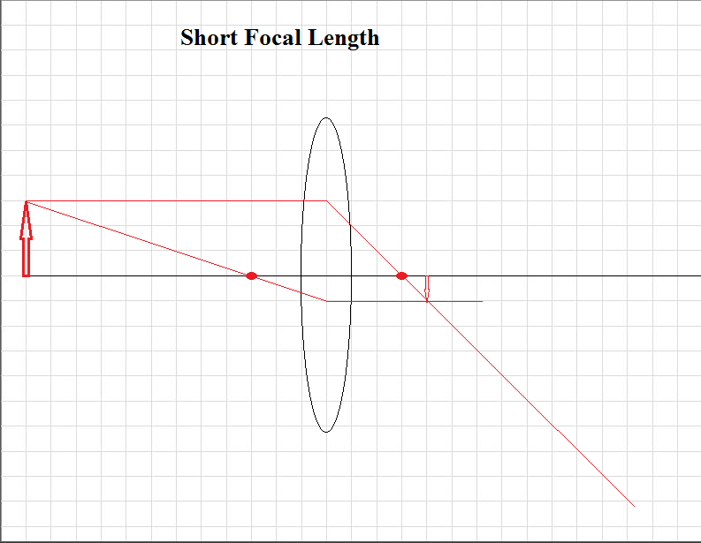
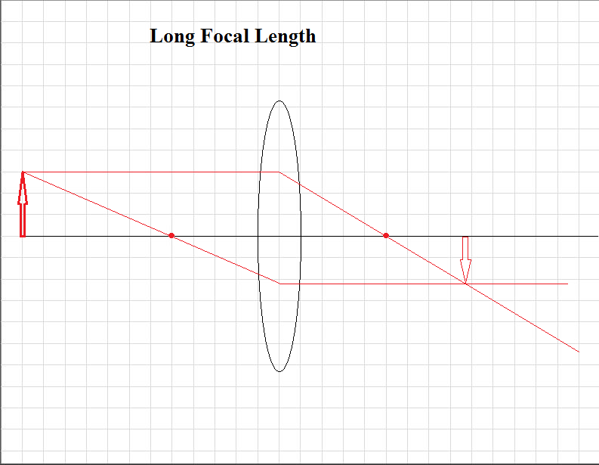
Lenses???!
Focal Length: Image size

Slide 5
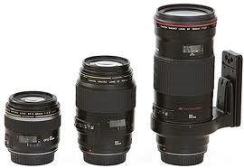
Lenses???!
focal Length:
Four Classes of Lenses based on Focal Length:
(based on a full frame sensor)
Wide angle…35 mm and lower
Normal…35-85 mm
Telephoto…100-300 mm
Super-Telephoto…300 mm and higher

Slide 6
Lenses???!
focal Length:
Wide angle…35 mm and lower
Characteristics:
Smaller/lighter
Easy to hand hold (shutter speeds < 1/50th sec.)
Faster: easier to manufacture with a large aperture (f 2.0 or less)
Captures a wide field of view (24 mm view angle 53.1°V × 73.7°H)
Large depth of field
Accentuates close objects by size
Apparent extreme close-up
Accentuates distance between near and far objects. Images have appearance of depth

Slide 7
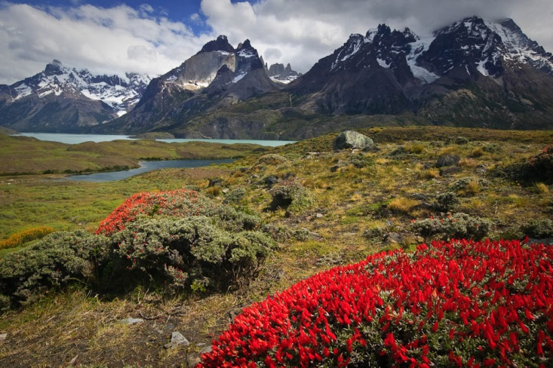
Lenses???!
focal Length:
Wide angle…35 mm and lower
Example:
Landscapes

Slide 8
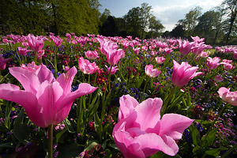
Lenses???!
focal Length:
Wide angle…35 mm and lower
Example:
Emphasize by size

Slide 9
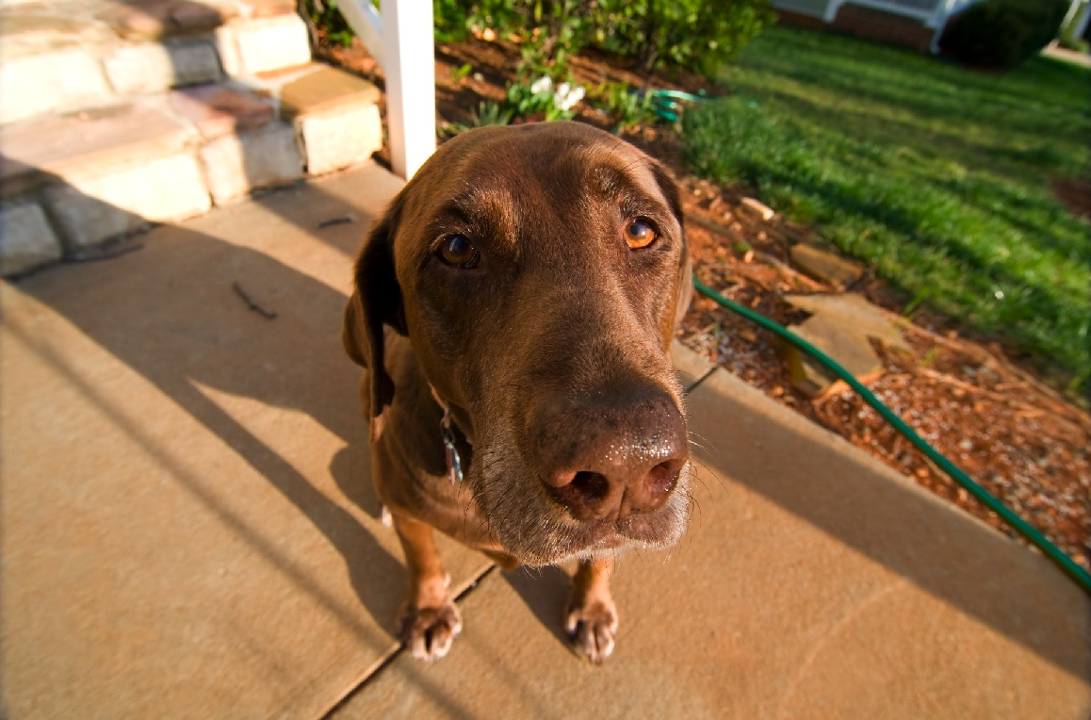
Lenses???!
focal Length:
Wide angle…35 mm and lower
Examples:
Huge head in comparison to legs and feet.
Empty space in upper right corner.
Clutter in lower right and upper left

Slide 10
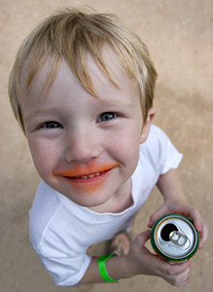
Lenses???!
focal Length:
Wide angle…35 mm and lower
Examples:
Forehead enlarged.
This is appealing for a small child but would very unflattering for an adult.
Good use of the frame.
No clutter in the background. Little empty space in the corners.

Slide 11
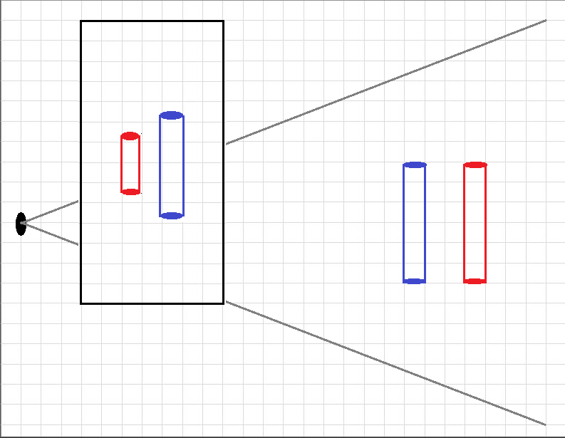
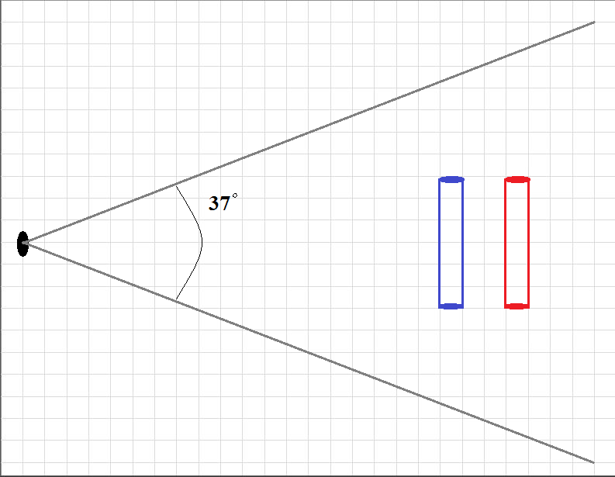
Lenses???!
focal Length:
Wide angle…35 mm and lower
Characteristics:

Slide 12
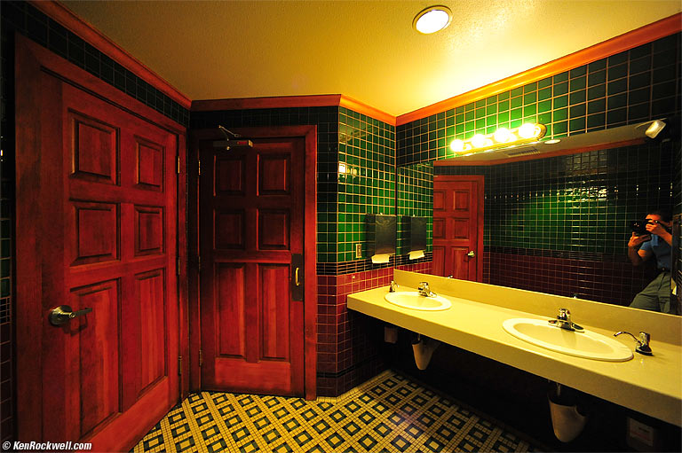
Lenses???!
focal Length:
Wide angle…35 mm and lower
Examples:
Useful for small interior spaces

Slide 13
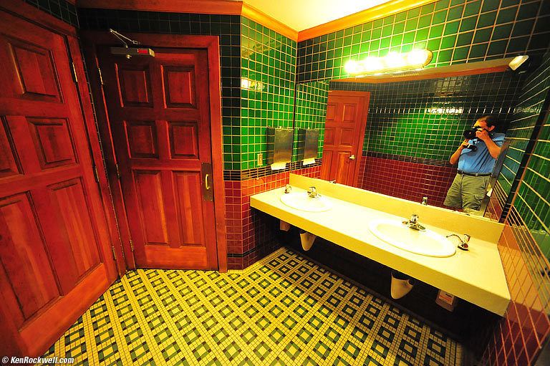
Lenses???!
focal Length:
Wide angle…35 mm and lower
Examples:
Be careful of converging parallel lines.
Converging parallel lines caused by the camera not perpendicular to lines.

Slide 14
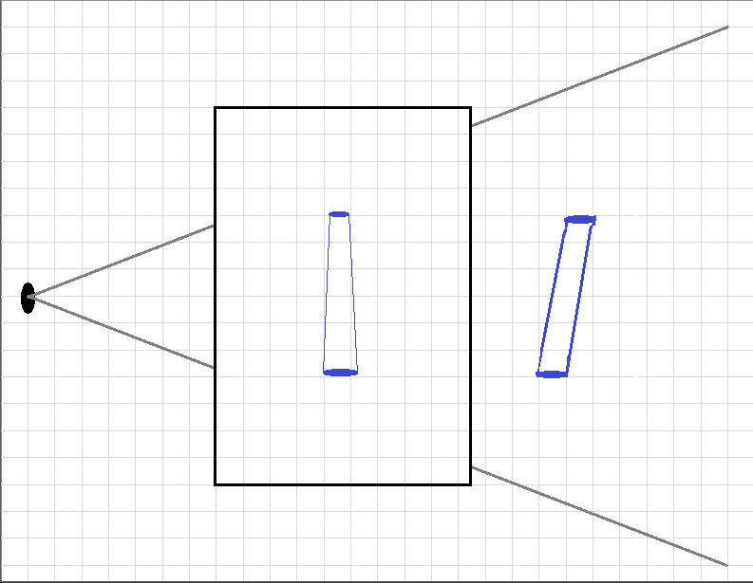
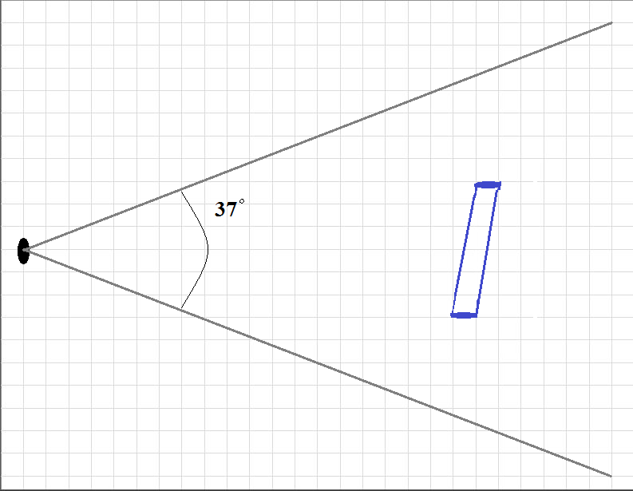
Lenses???!
focal Length:
Wide angle…35 mm and lower
Converging lines:

Slide 15
Lenses???!
focal Length:
Wide angle…35 mm and lower
Uses:
Landscapes
Architecture
Indoor:
a. Limited space
b. Limited light
Accentuate an object by SIZE or d i s t a n c e difference.

Slide 16
Lenses???!
focal Length:
Wide angle…35 mm and lower
Tips:
Subject distance: To accentuate an object get uncomfortably close – physically immerse yourself in the subject.

Slide 17
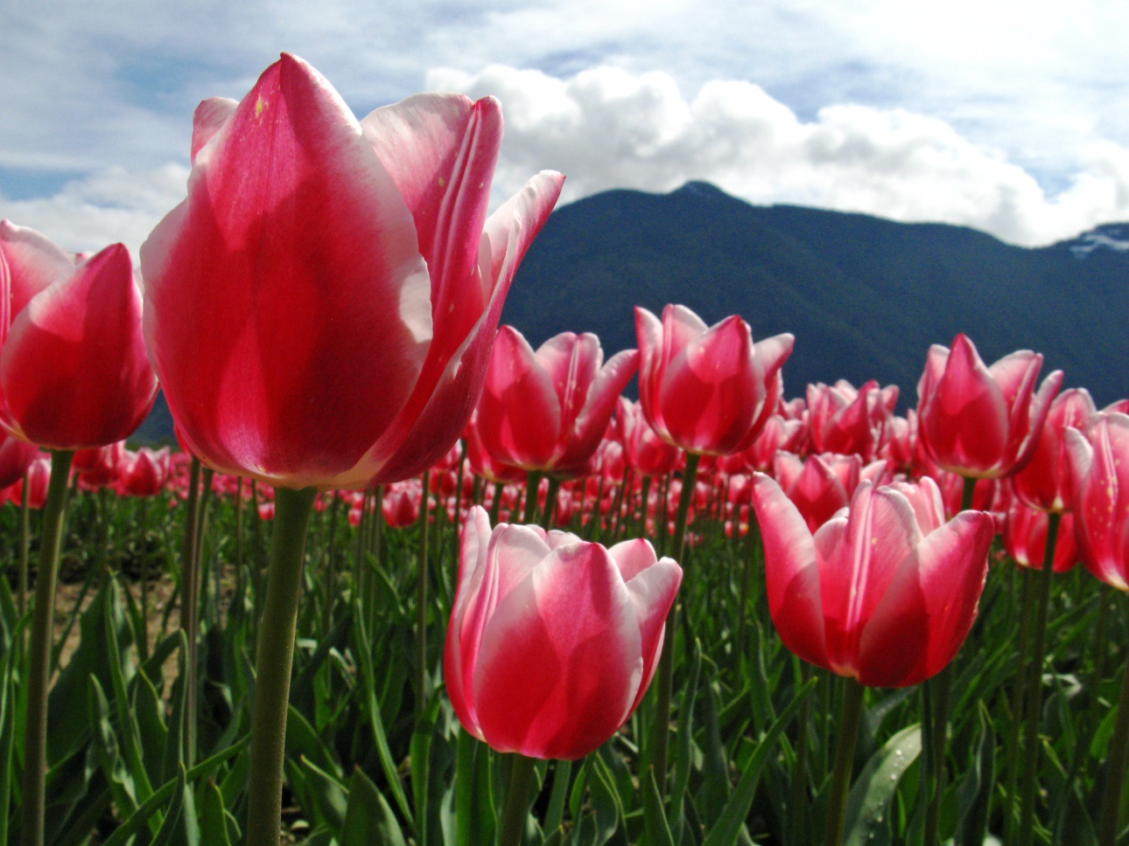
Lenses???!
focal Length:
Wide angle…35 mm and lower
Tips:
Get close for emphasis

Slide 18
Lenses???!
focal Length:
Wide angle…35 mm and lower
Tips:
Subject distance: To accentuate an object get uncomfortably close – physically immerse yourself in the subject.
Do not use for portraiture. Large unflattering noses

Slide 19
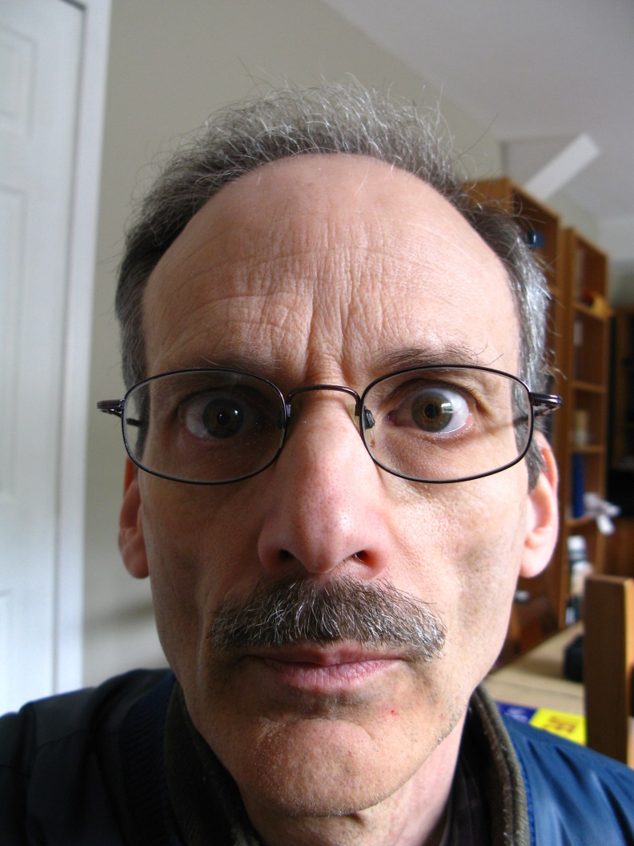
Lenses???!
focal Length:
Wide angle…35 mm and lower
Example:
Monsieur Nez Grand
Clutter background
Converging lines

Slide 20
Lenses???!
focal Length:
Wide angle…35 mm and lower
Tips:
Subject distance: To accentuate an object get uncomfortably close – physically immerse yourself in the subject.
Do not use for portraiture. Large unflattering noses
Organization: Carefully place near and far objects to achieve clear compositions. Avoid cluttered backgrounds or large blank corners.
Perspective: Keep your camera level to avoid converging verticals, otherwise be aware of how converging verticals will impact your composition.

Slide 21
Lenses???!
focal Length:
2. Normal…35 mm to 85 mm
Characteristics:
Approximates what the human eye sees (50 mm view angle: 27.0° × 39.6°)
Fast (aperture f 2.0)
Uses:
Portraits (head and shoulders)
Documentary/travel
Low light

Slide 22
Lenses???!
focal Length:
3. Telephoto…100-300 mm
Characteristics:
Like a telescope: Long/heavy/can disrupt camera balance

Slide 23
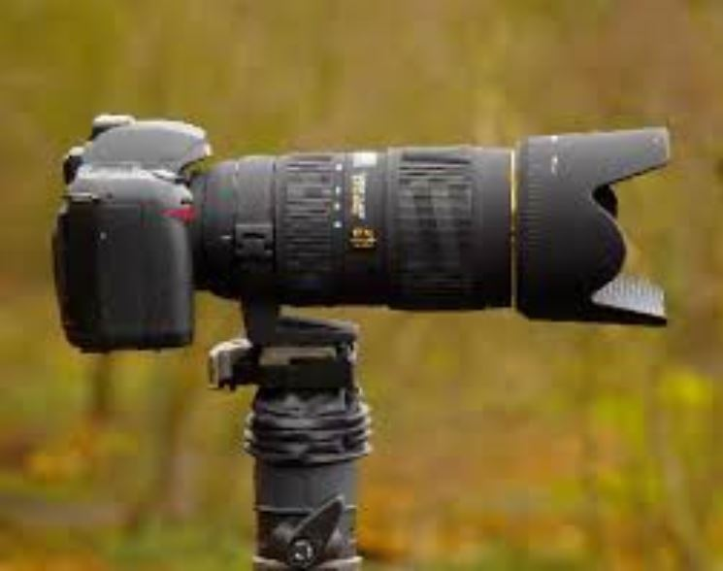
Lenses???!
focal Length:
3. Telephoto…100-300 mm
Characteristics:
Long and heavy

Slide 24
Lenses???!
focal Length:
3. Telephoto…100-300 mm
Characteristics:
Like a telescope: Long/heavy/can disrupt camera balance
Slow: difficult to manufacture with large aperture (f 2.8-4)
Difficult to hand hold (@ shutter speeds < 1/100th sec.)
Narrow view angle: (105 mm 13.0°V x 19.5°H) (300 mm 4.58°V x 6.87°H)
Shallow depth of field. Isolate the subject from clutter. Focus is critical.

Slide 25
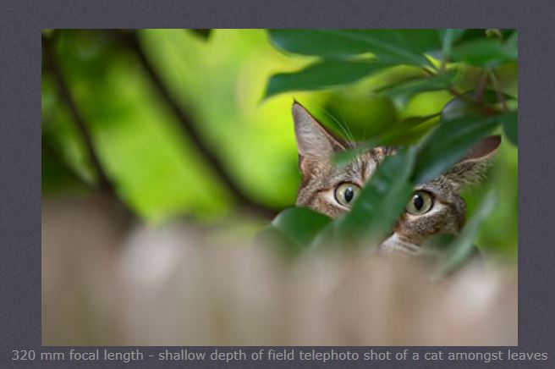
Lenses???!
focal Length:
3. Telephoto…100-300 mm
Characteristics:
Isolate subject by focus

Slide 26
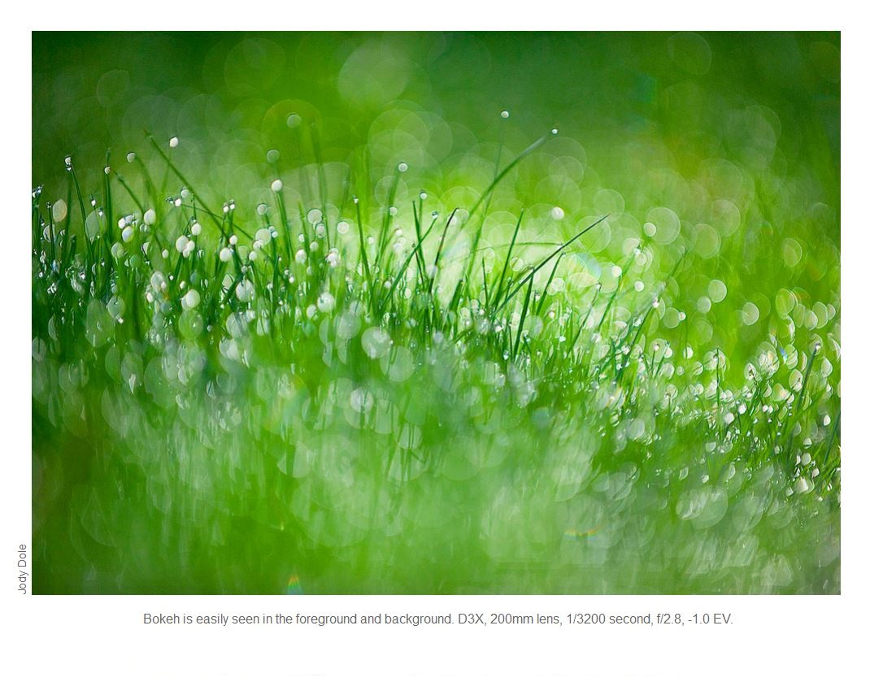
Lenses???!
focal Length:
3. Telephoto…100-300 mm
Characteristics:
Isolate subject by focus

Slide 27
Lenses???!
focal Length:
3. Telephoto…100-300 mm
Characteristics:
Like a telescope: Long/heavy/can disrupt camera balance
Difficult to hand hold (@ shutter speeds < 1/100th sec.)
Slow: difficult to manufacture with large aperture (f 2.8-4)
Narrow view angle: (105 mm 13.0°V x 19.5°H) (300 mm 4.58°V x 6.87°H)
Shallow depth of field. Isolate the subject from clutter. Focus is critical.
Enlarges out of focus regions to give soft backgrounds.

Slide 28
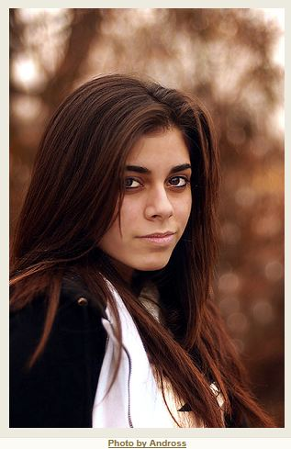
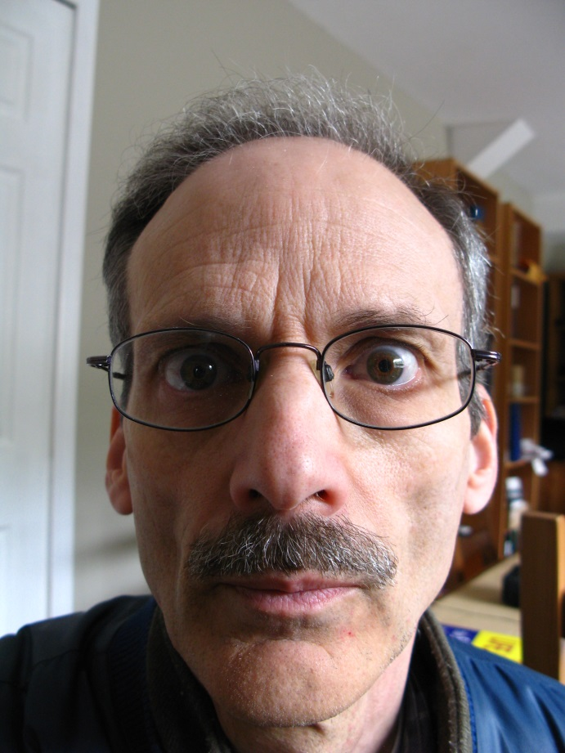
Lenses???!
focal Length:
3. Telephoto…100-300 mm
Characteristics:
Portraiture: soft backgrounds

Slide 29
Lenses???!
focal Length:
3. Telephoto…100-300 mm
Characteristics:
Like a telescope: Long/heavy/can disrupt camera balance
Difficult to hand hold (@ shutter speeds < 1/100th sec.)
Slow: difficult to manufacture with large aperture (f 2.8-4)
Narrow view angle: (105 mm 13.0°V x 19.5°H) (300 mm 4.58°V x 6.87°H)
Shallow depth of field. Isolate the subject from clutter
Enlarges out of focus regions to give soft backgrounds.
Compresses the background into the subject. Image appears flattened.

Slide 30
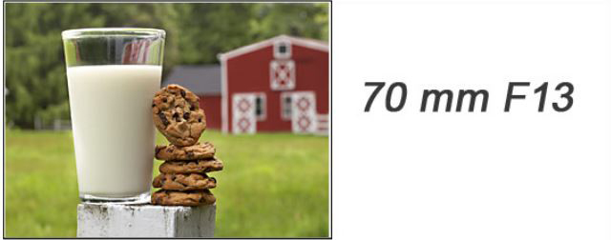
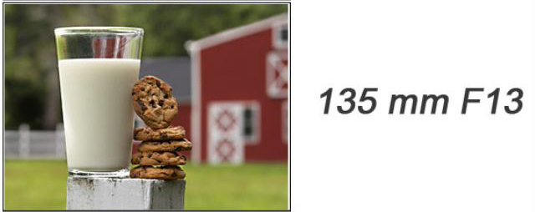
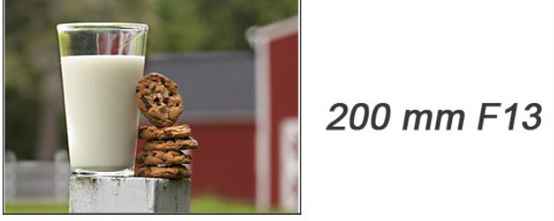
Compression:
Learnmyshot.com
The size of the barn increases compared to the milk and cookies as the focal length increases.
The sharpness of the focus of the barn decreases as the focal length increases.

Slide 31
Lenses???!
focal Length:
3. Telephoto…100-300 mm
Characteristics:
Portraiture: features balanced

Slide 32
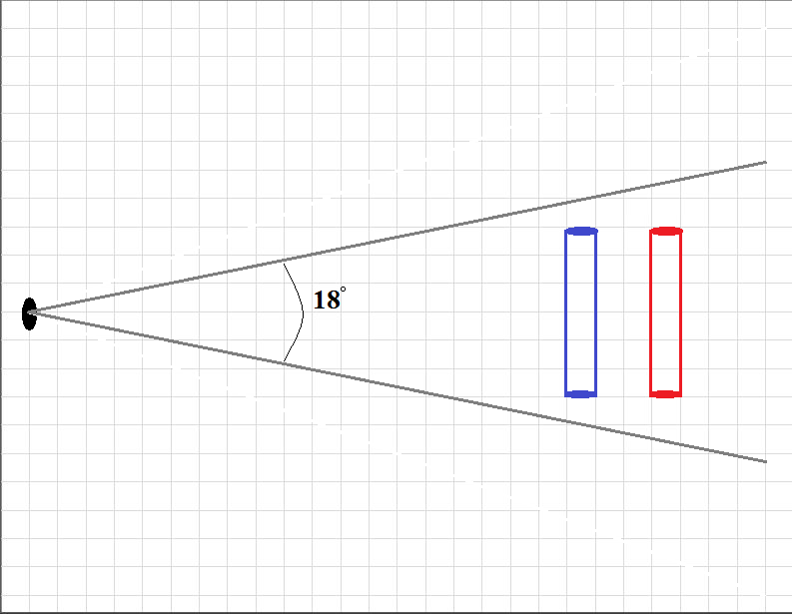
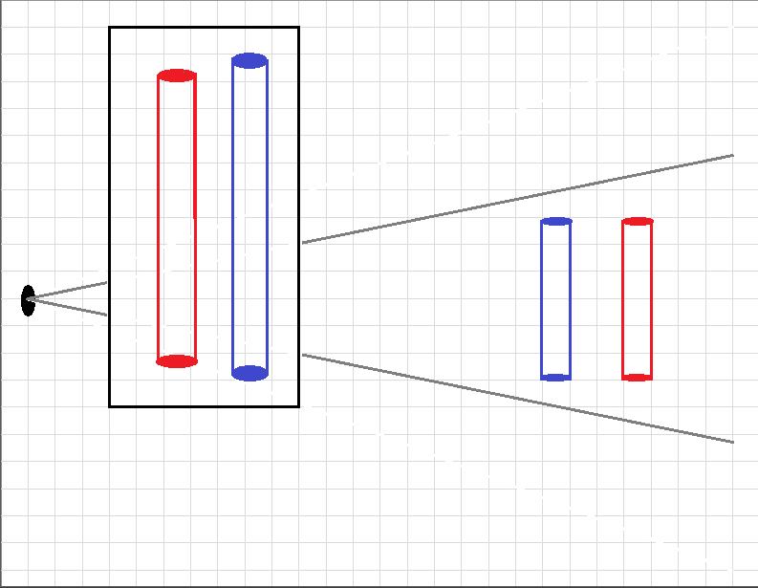
Lenses???!
focal Length:
3. Telephoto…100-300 mm
Characteristics:

Slide 33
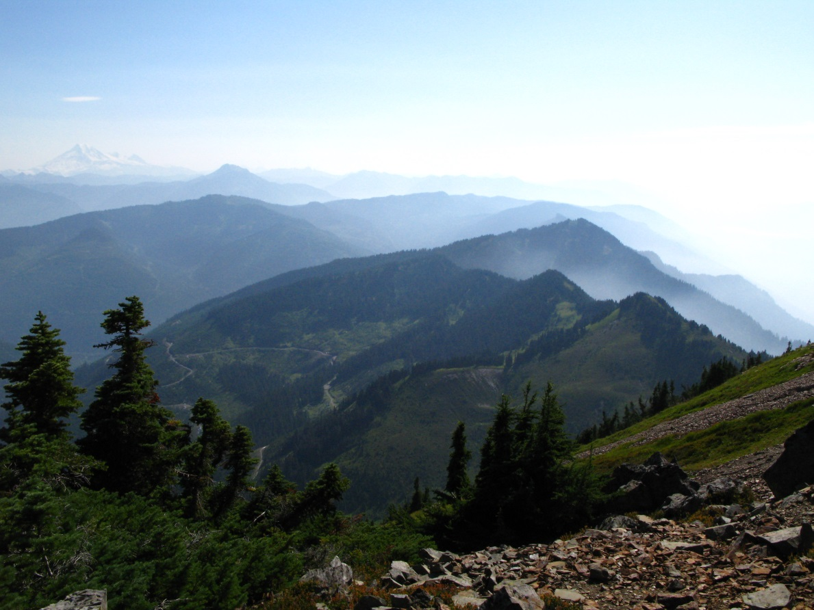
Lenses???!
focal Length:
3. Telephoto…100-300 mm
Characteristics:
Wide angle view

Slide 34
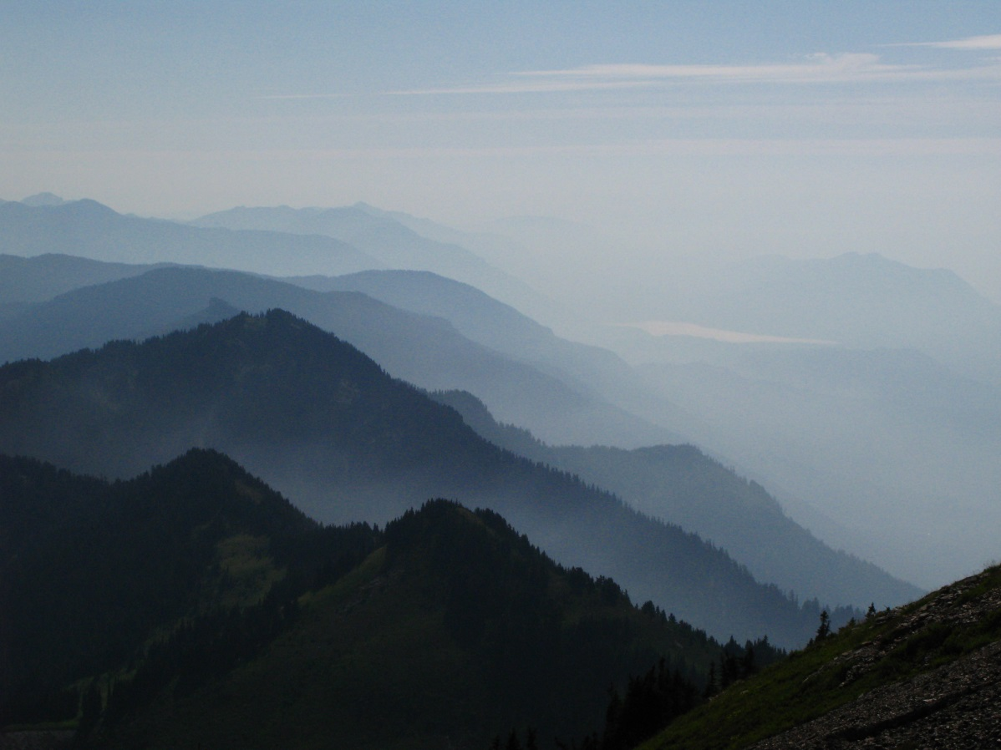
Lenses???!
focal Length:
3. Telephoto…100-300 mm
Characteristics:
Telephoto view: peaks compressed

Slide 35
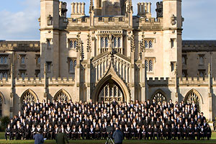
Lenses???!
focal Length:
3. Telephoto…100-300 mm
Problems:
Telephoto lens used:
What is the subject?
If the people then a shorter lens would reduce the relative size of the building and give more emphasis to the graduates.

Slide 36
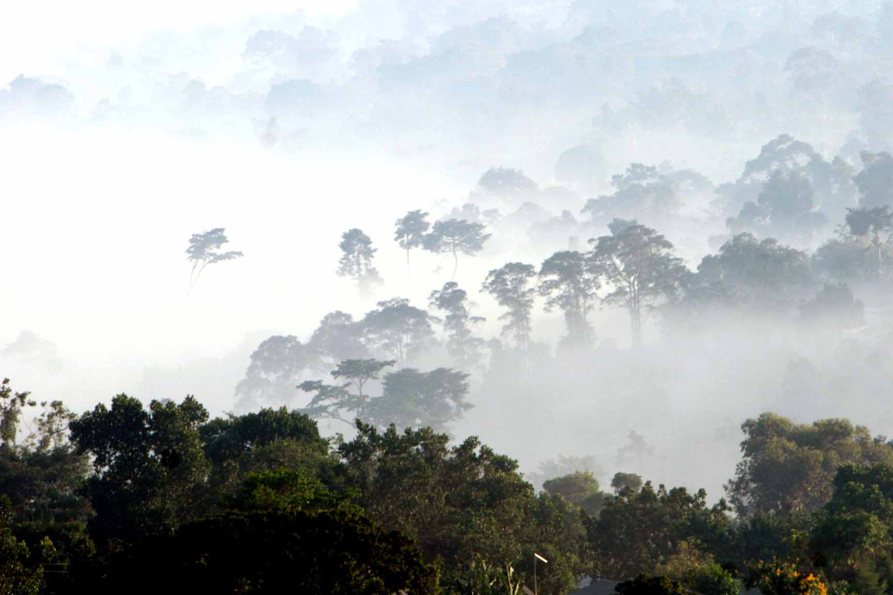
Lenses???!
focal Length:
3. Telephoto…340 mm
Paul Antturi

Slide 37
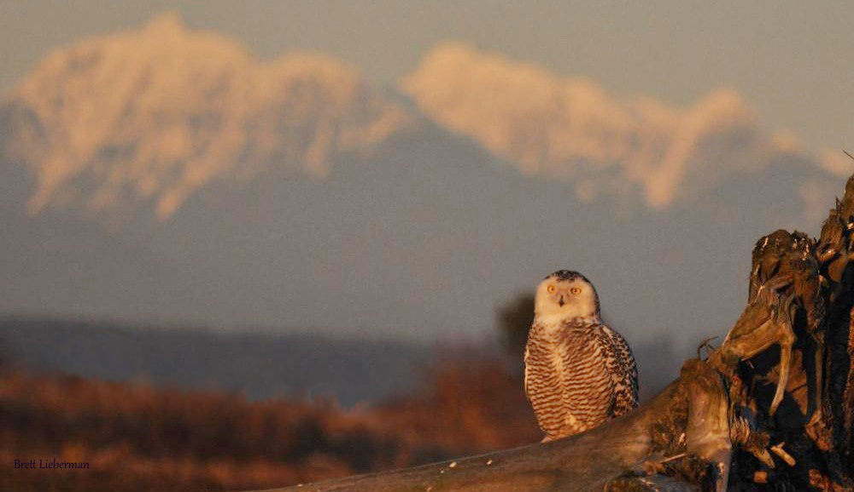
Lenses???!
focal Length:
3. Telephoto…100-300 mm
Characteristics:
Telephoto view
Brett Lieberman

Slide 38
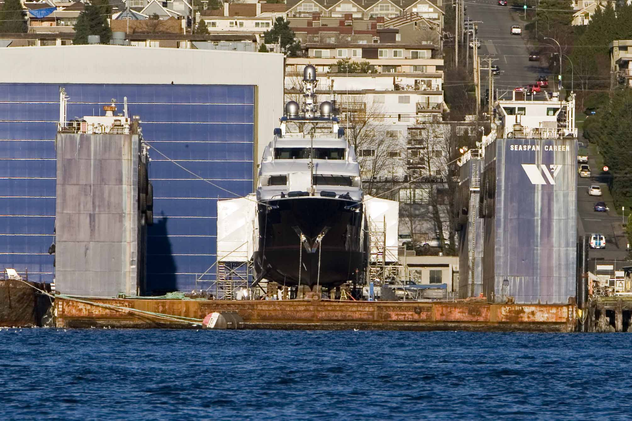
Lenses???!
Paul Antturi
focal Length:
3. Telephoto…200 mm: buildings compressed

Slide 39
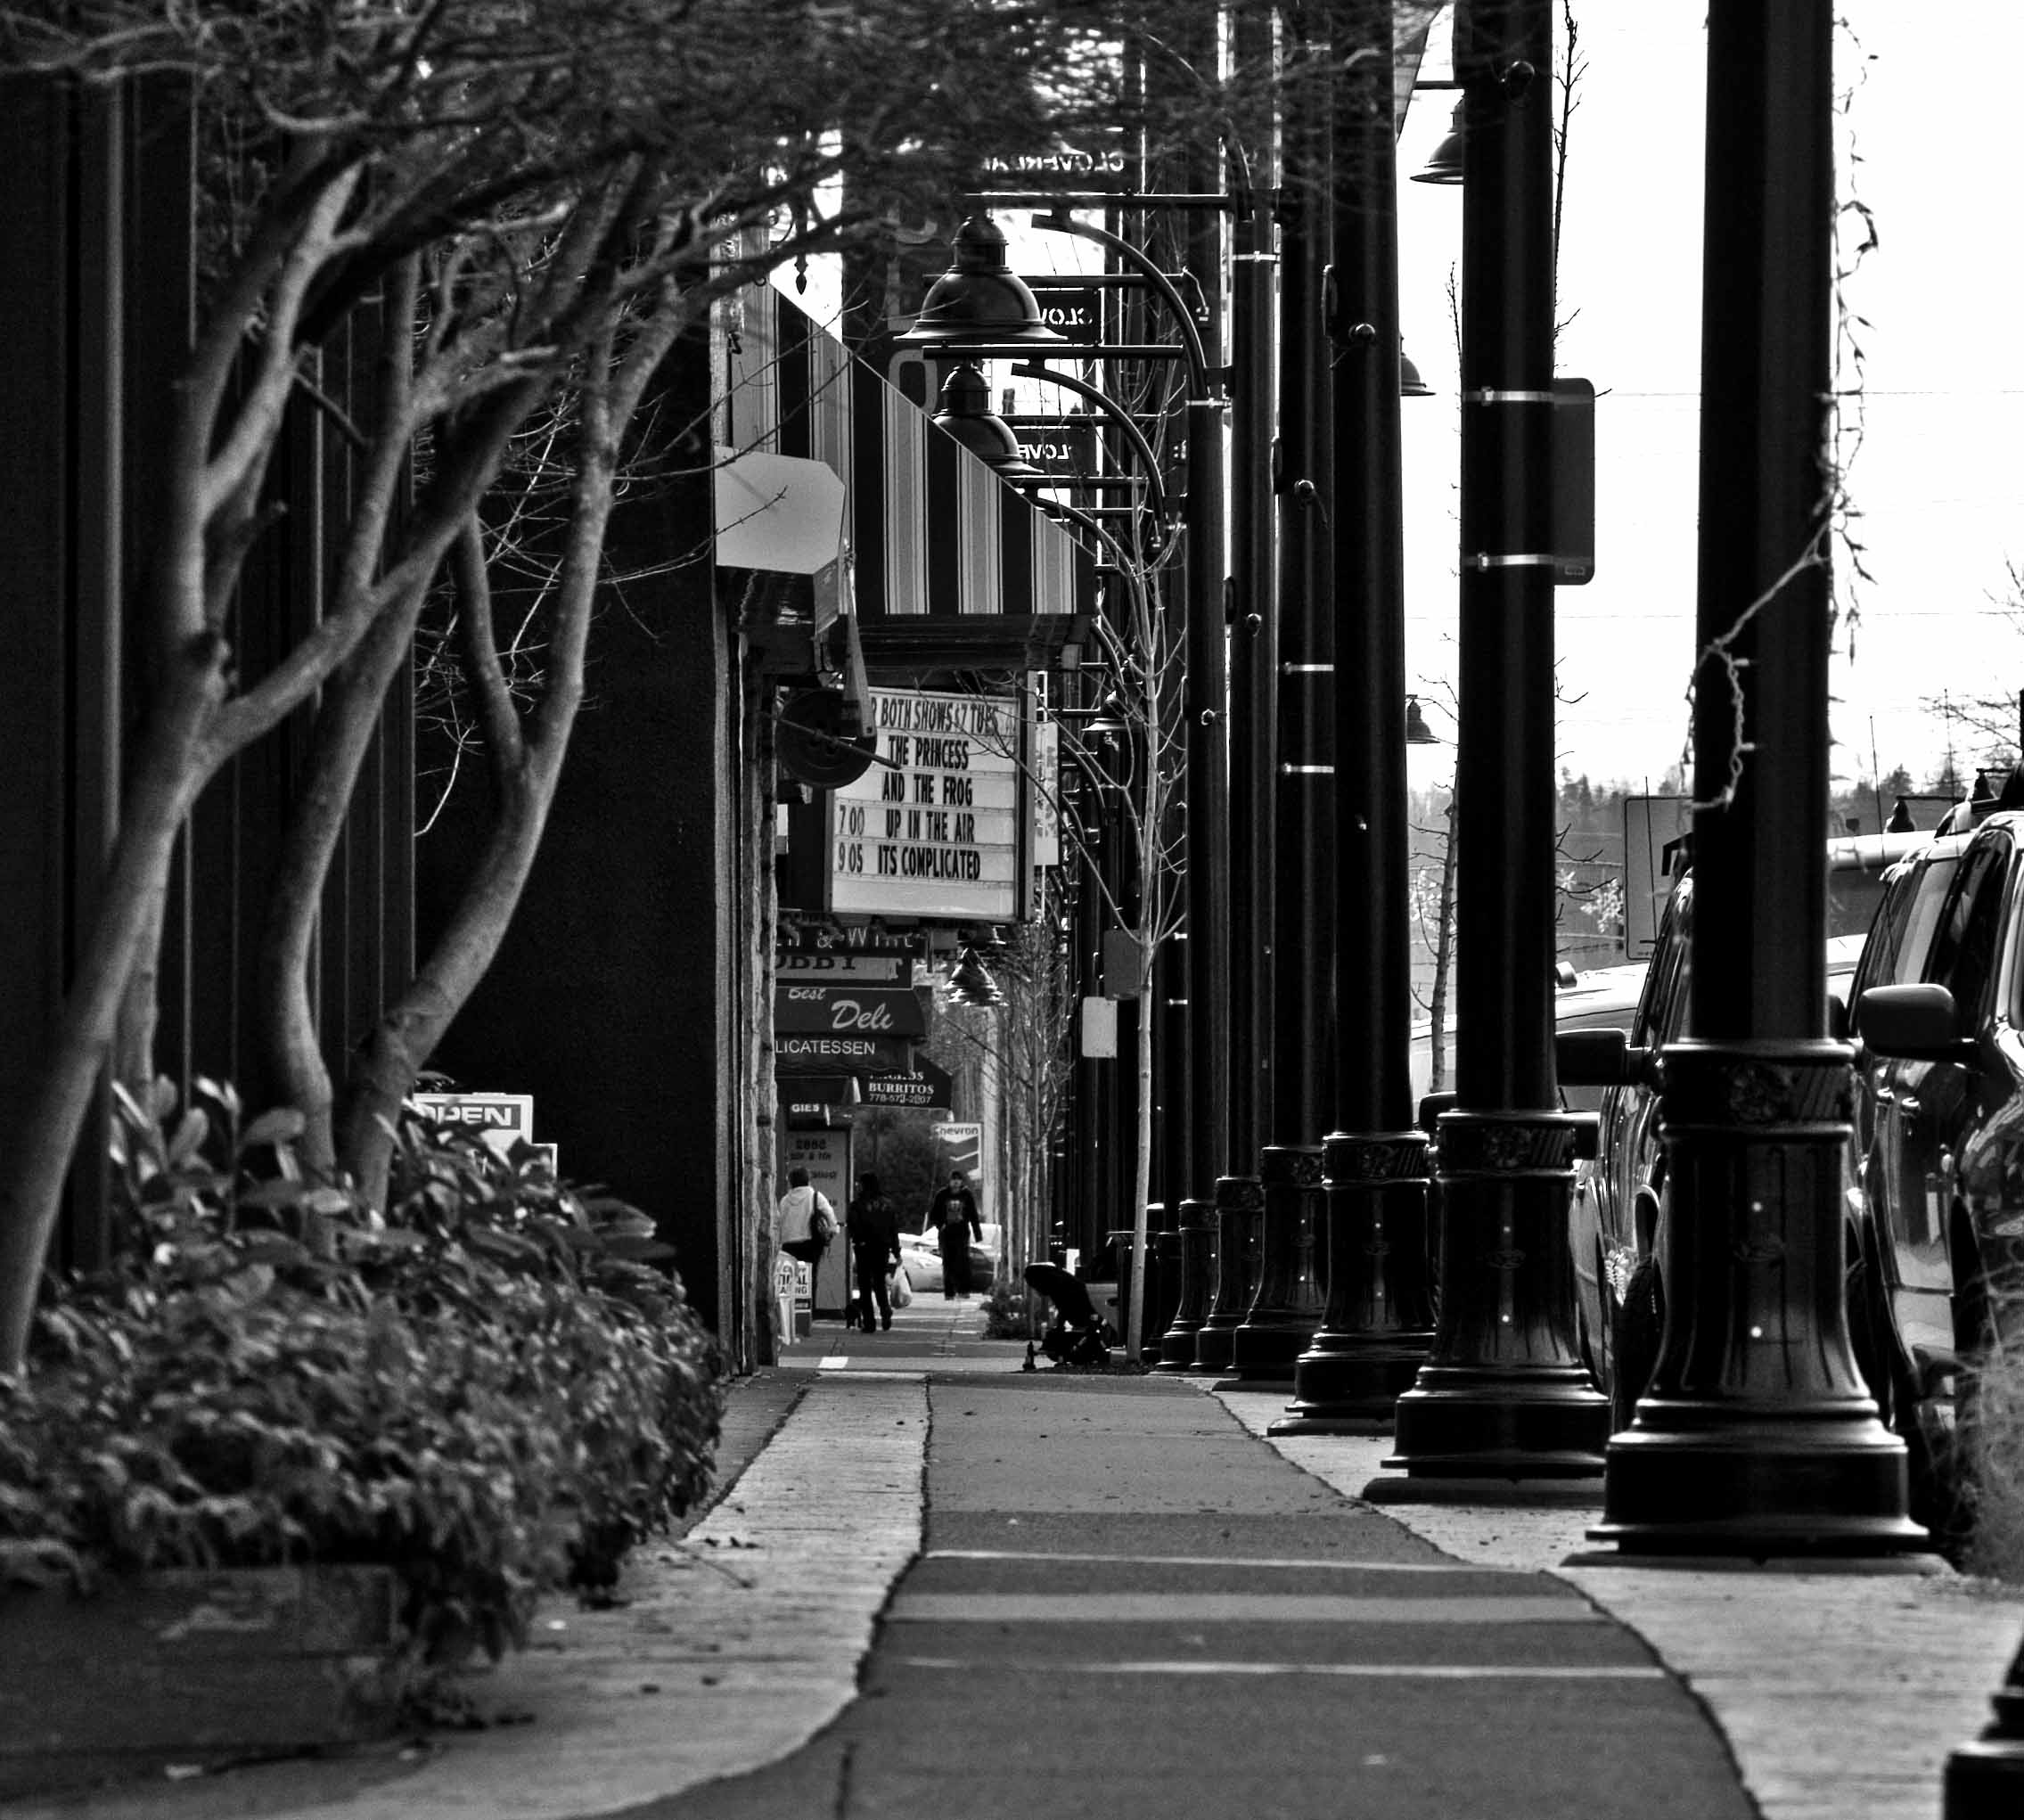
Lenses???!
Paul Antturi
focal Length:
3. Telephoto…200 mm: posts compressed

Slide 40
Lenses???!
focal Length:
Summary
The smaller the sensor the longer the focal length of the lens appears to be. (Crop Factor)
Short focal lengths:
Large depth of field
Emphasize objects by size difference
Emphasize near from far
Long focal lengths:
Short depth of field
Emphasize objects by sharp focus and out of focus background.
Compress near and far. Appears to bring the background close to the subject.

