Slide 1
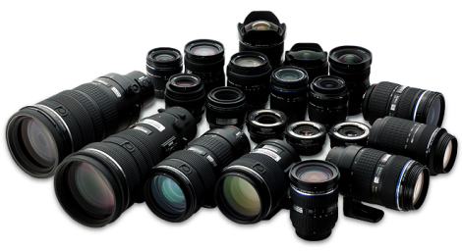
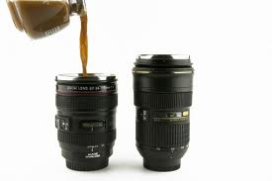
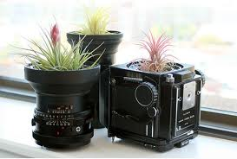
Lenses???!
Evaluate

Slide 2
Lenses???!
Review: Light Volume Control:
f stops are light transmission standards: f 8 transmits the same amount of light for any lens.
Lenses can be evaluated by the maximum aperture (the smallest f stop):
A large maximum aperture gives more flexibility in low light and in depth of field…..Desirable.
Lenses are considered fast if they have a maximum aperture of <= f 2.8.
Lenses with larger maximum apertures and zoom lenses with constant maximum apertures are more $expensive$. (contain more glass)
IS or VR allows for hand holding at reduced shutter speed. (Up to 4 stops reduction in speed)

Slide 3
Lenses???!
focal Length:
Important consideration when buying a lens.
The focal length determines the size of the image on the sensor.

Slide 4
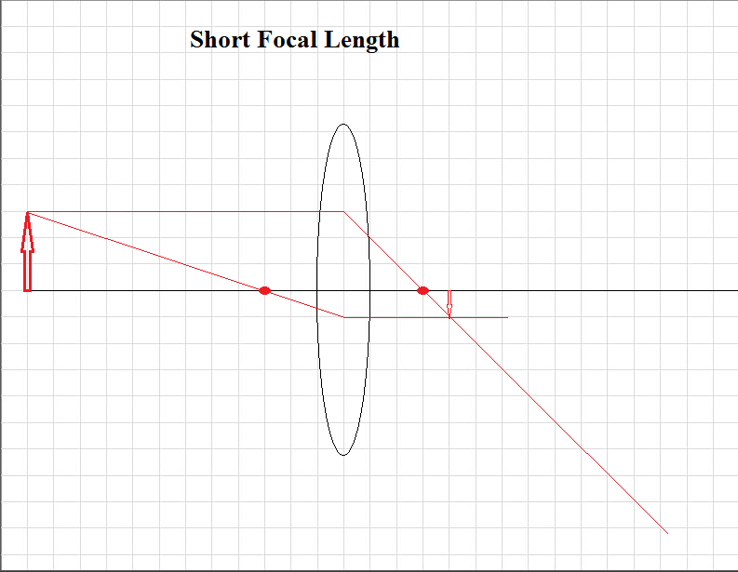
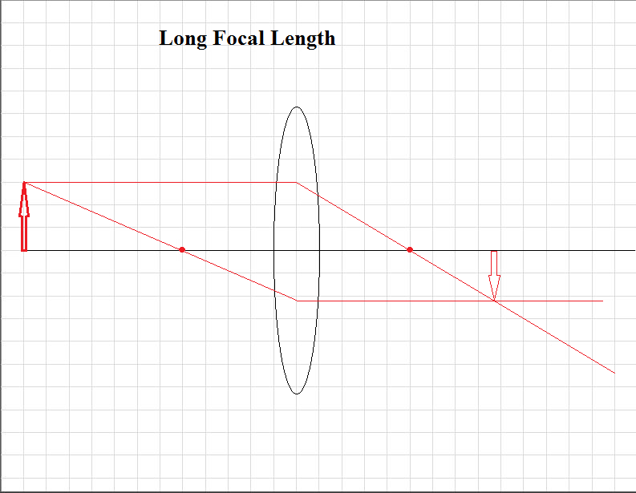
Lenses???!
Focal Length: Image size

Slide 5
Lenses???!
focal Length:
The focal length determines the size of the image on the sensor.
But the sensor and the lens determine the viewed image size…
Crop Factor: the effect of sensor size
Not all cameras have the same sensor size
Most documentation describes focal length in terms of a full frame sensor (24 mm x 36 mm)

Slide 6
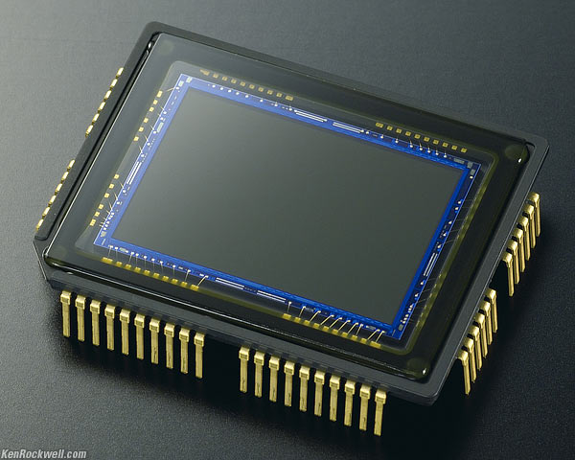
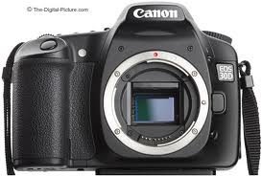
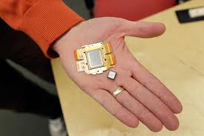
Lenses???!
focal Length:
Digital Light Sensor

Slide 7
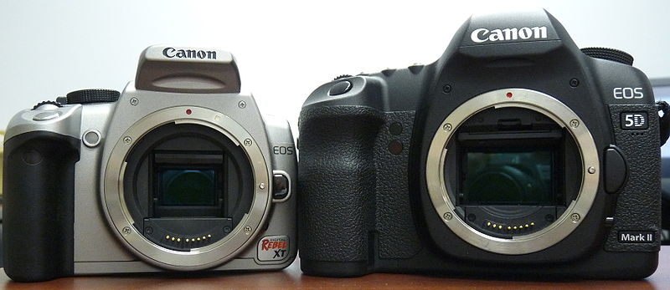
Lenses???!
focal Length:
Digital Light Sensor
APS-C (Canon) 22.2 x 14.8 mm sensor
vs
Full frame sensor 36 x 24 mm

Slide 8
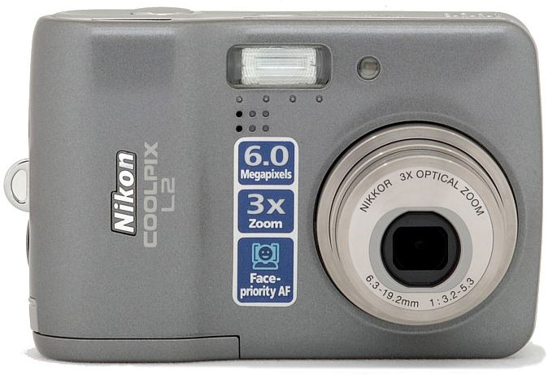
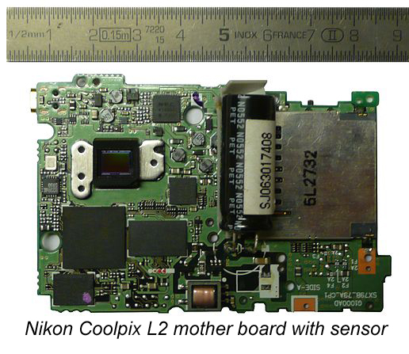
Lenses???!
focal Length:
Digital Light Sensor

Slide 9
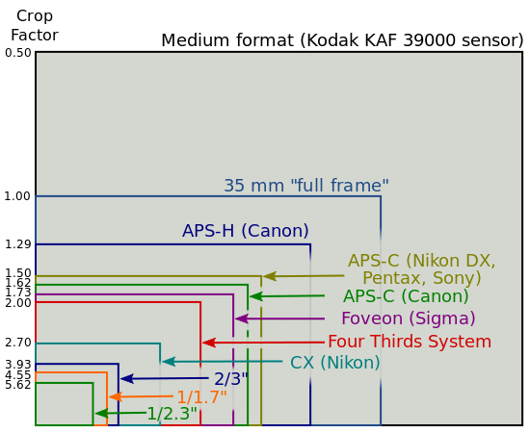
Lenses???!
focal Length:
Crop Factor:
http://en.wikipedia.org/wiki/File:Sensor_sizes_overlaid_inside_-_updated.svg

Slide 10
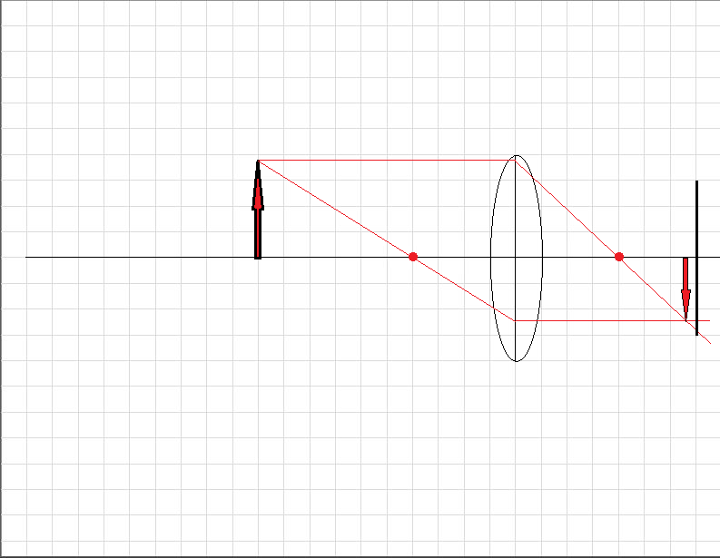
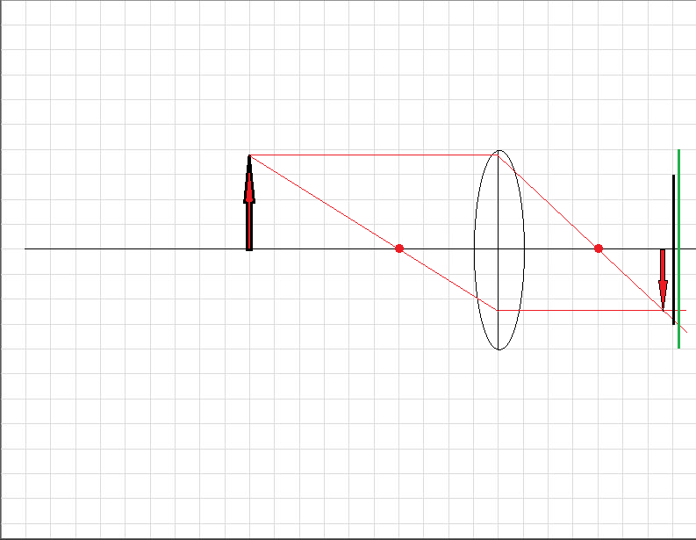
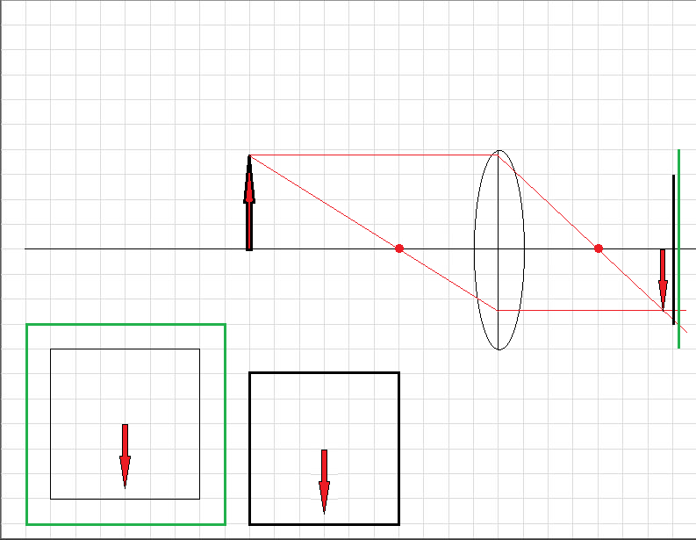
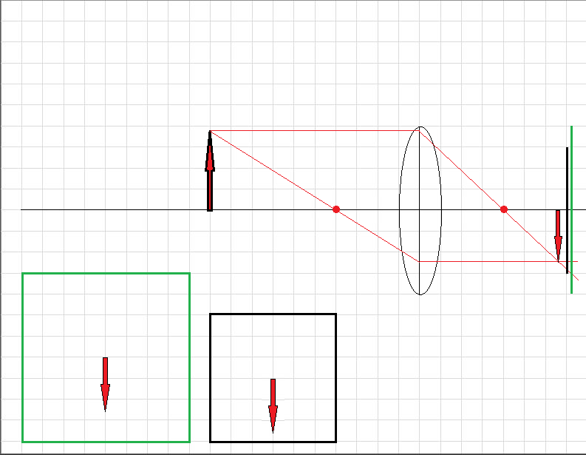
Lenses???!
focal Length:
Crop Factor:

Slide 11
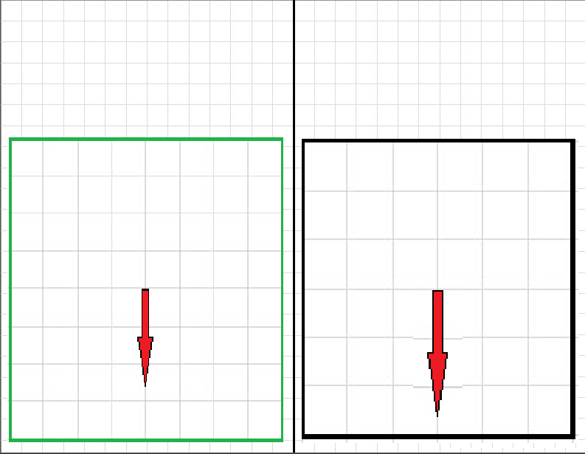
Lenses???!
focal Length:
Crop Factor:
Image enlargement

Slide 12
Lenses???!
focal Length:
Crop Factor:
The smaller the sensor the smaller the amount of the scene captured. The smaller sensor crops the scene.
The smaller sensor has the apparent effect of increasing the focal length of a lens. This is because the smaller sensor image is enlarged more when viewed or printed.

Slide 13
Lenses???!
focal Length:
Crop Factor:
In order to compare the effect of a lens focal length to a smaller sensor (your camera) the focal length of the lens needs to be multiplied by the crop factor.

Slide 14
Lenses???!
focal Length:
Crop Factor:
In order to compare the effect of a lens focal length to a smaller sensor (your camera) the focal length of the lens needs to be multiplied by the crop factor.

Slide 15
Lenses???!
focal Length:
Crop Factor: Examples
APS-C (Canon 50D [22.3x14.9 mm]) Crop Factor = 1.62. You own a 50 mm lens. This is equivalent to a 50 mm x 1.62 = 81 mm lens on a full frame sensor. (p32)
APS-C (Nikon DX [24x16 mm]) Crop Factor = 1.50. You own a 35 mm lens. This is equivalent to a
35 mm x 1.5 = 52 mm lens on a full frame sensor.

Slide 16
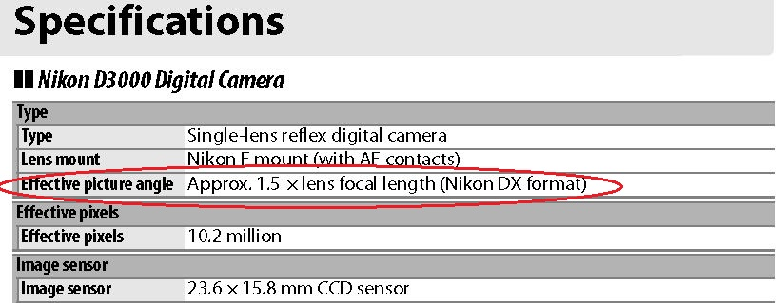
Lenses???!
focal Length:
Crop Factor: The Crop Factor for your camera will be in the documentation.

Slide 17
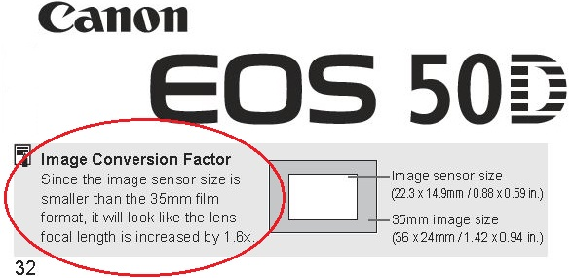
Lenses???!
focal Length:
Crop Factor: The Crop Factor for your camera will be in the documentation.

