Slide 1
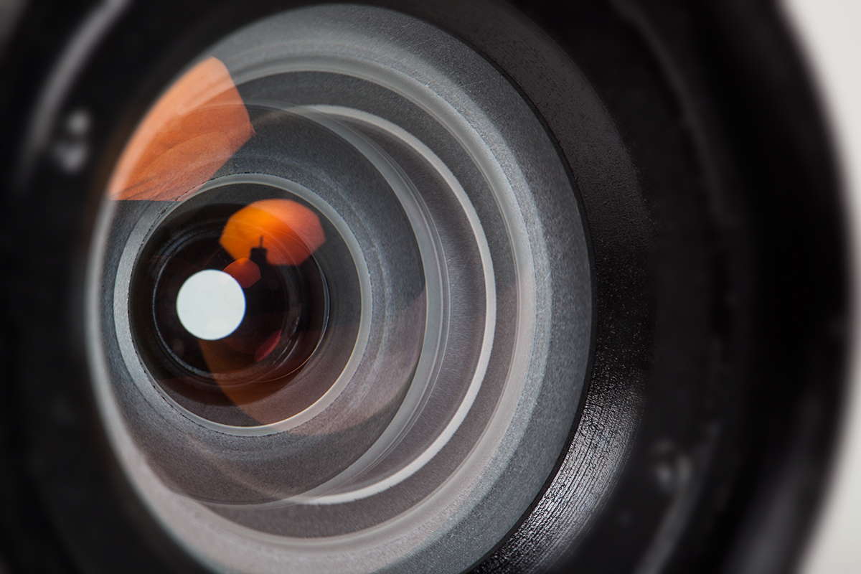
Auto Focus

Slide 2
Auto Focus
What is auto focus?
The camera focuses the image
Autonomously (no photographer direction)
Photographer directed
Location in scene (focus points)
Mode (method)
single shot
Continuous
Back Button Focus
Manual focus

Slide 3
Auto Focus
How does autofocus work?
Two common technologies
Phase Detection (PD)
Contrast Detection (CD)

Slide 4
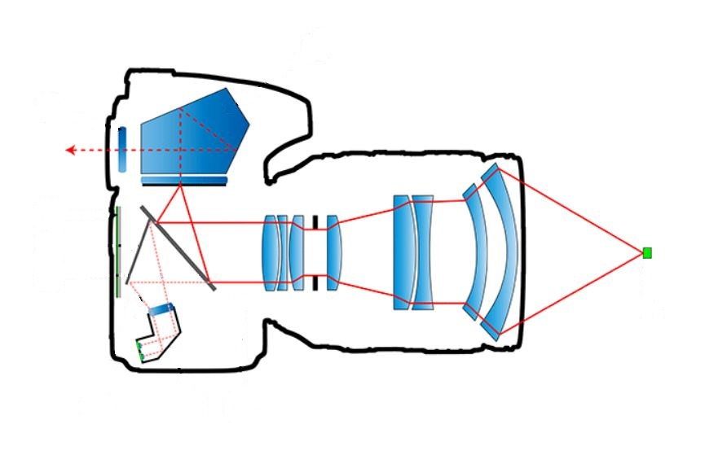
Auto Focus
How does autofocus work?
Phase Detection (PD) (light ray sampling)
viewfinder
Image
sensor
Reflex mirror
Partially transparent
object
Secondary mirror
2 Phase detection sensors

Slide 5
Auto Focus
How does autofocus work?
Phase Detection (PD) (light ray sampling)
The light rays coming from the same point on the object will show the same image.
The distance between back of the lens and the image sensor is the same as the optical distance between the back of the lens and the two phase detection sensors.
If the image is in focus, the images in the two phase detection sensors will be identical because light is coming from the same point on the object.
If the image is not in focus, the images in the two phase detection sensors will be different. One will be shifted relative to the other.
Phase Detection Animation

Slide 6
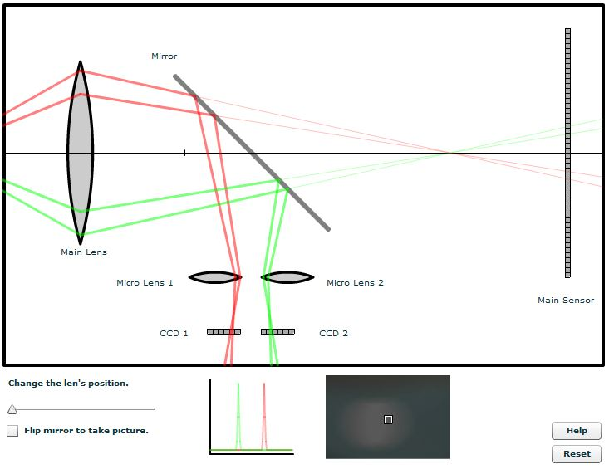
Auto Focus
How does autofocus work?
Phase Detection (PD) (light ray sampling)
1. Green ahead of red:
move lens away
2. Distance between green and red 2 units
move lens away 2 units
Camera knows the direction to move the lens and the exact amount of movement:
Phase Detection Focusing is FAST

Slide 7
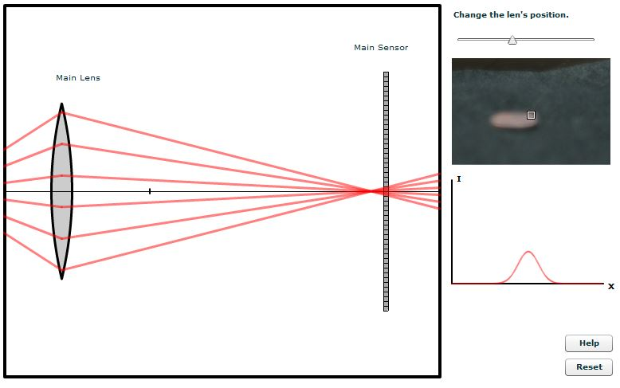
Auto Focus
How does autofocus work?
Contrast Detection (CD) (digital trial and error)
Contrast Detection Animation
Uses the sensor’s data to maximize contrast.
Let’s focus this using Contrast Detection

Slide 8
Auto Focus
How does autofocus work?
Contrast Detection (PD) (digital trial and error)
Uses the sensor’s data to maximize contrast.
Is the image in focus?
I DON’T KNOW??

Slide 9
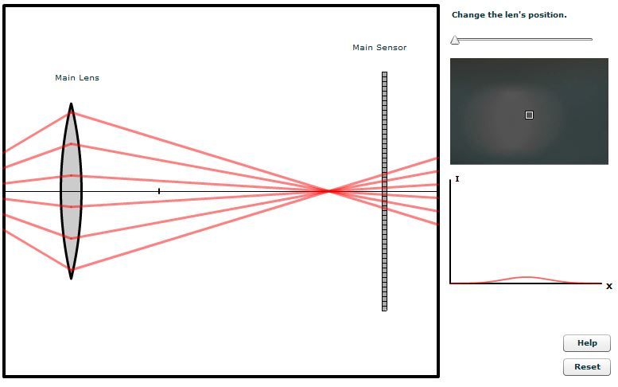
Auto Focus
How does autofocus work?
Contrast Detection (PD) (digital trial and error)
Uses the sensor’s data to maximize contrast.
Is the image in focus now?
No! The contrast decreased!
Wrong way!

Slide 10
Auto Focus
How does autofocus work?
Contrast Detection (PD) (digital trial and error)
Uses the sensor’s data to maximize contrast.
Is the image in focus Now?
I don’t know but you went the right way.
Try a little more the same way.

Slide 11
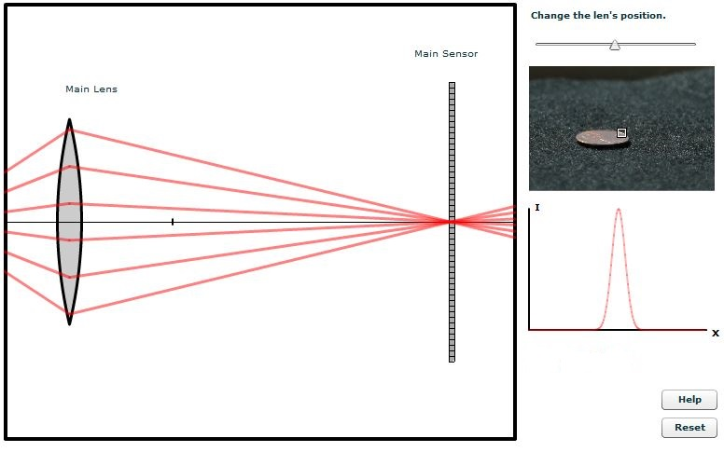
Auto Focus
How does autofocus work?
Contrast Detection (PD) (digital trial and error)
Uses the sensor’s data to maximize contrast.
Is the image in focus Now?
I don’t know but you went the right way.
Try a little more the same way.

Slide 12
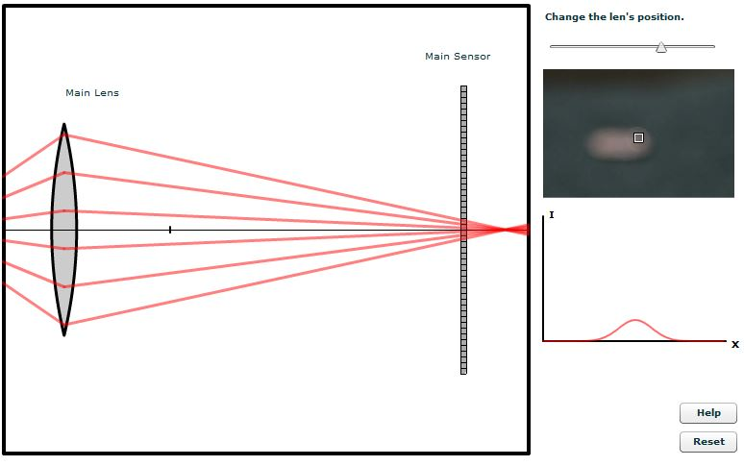
Auto Focus
How does autofocus work?
Contrast Detection (PD) (digital trial and error)
Uses the sensor’s data to maximize contrast.
Is the image in focus Now?
BOX HERE WITH OUT OF FOCUS OTHER WAY
No! You have gone too far! Move back.

Slide 13
Auto Focus
How does autofocus work?
Contrast Detection (PD) (digital trial and error)
Uses the sensor’s data to maximize contrast.
Is the image in focus Now?
Hmm. That is the highest contrast I have seen. You are in focus!
Contrast Detection autofocus is slow.

Slide 14
Auto Focus
How does autofocus work?
Two technologies
Phase Detection (PD)
Fast (sports, moving children, pets)
Complex (expensive)
Calibrate for accuracy, focus is independent of the image
Contrast Detection (CD)
Slow (delays the shutter)
Simple (inexpensive) point and shoot and most mirrorless cameras
Accurate (uses the final image data)
Hybrid: achieve best of both technologies (Sony A6000)

Slide 15
Auto Focus
Auto Focus Problems
Low Contrast
Select portions of the scene with high contrast, press shutter ½, recompose*.
Low Light
Select high contrast areas, shutter ½, recompose*.
Auto focus assist beam
Auto focus flash with autofocus assist beam
Subject Motion
Choose a portion of the scene not moving, shutter ½, recompose*.
Select a dynamic focusing mode
Canon (AI-servo)
Nikon (Continuous [AF-C])
*It is always best to focus with a focus point on the subject vs focus then recompose.

Slide 16
Auto Focus
Selecting Auto Focus Points
Selecting Autofocus points video
Assignment:
Select the individual autofocus points in your camera
If you have a point and shoot camera see Beeve.

Slide 17
Auto Focus
Selecting Auto Focus Points
Assignment:
Select the individual autofocus points in your camera
Canon:
Press autofocus button on back, extreme upper right
Roll front dial or the thumb wheel to select an autofocus point
Nikon:
Menu: choose AF- area mode
Choose single point or dynamic area
Use dial pad on back to choose AF points

Slide 18
Auto Focus
Focus Modes:
Focus modes video
Continuous Focus tracking video PD 10:00
The “AI” in Canon’s AI servo stands for Artificial Intelligence of the motion predictive software.
Nikon has the software but is not as ostentatious.
Assignment:
Select the three or four autofocus modes in your camera.
If you have a point and shoot camera see Beeve.

Slide 19
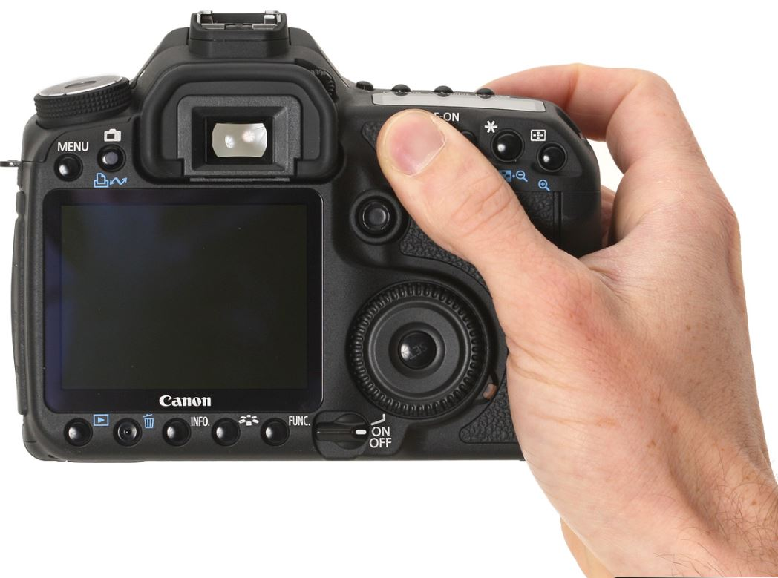
Auto Focus
Back Button Focus:
By default when the shutter button is pressed ½ way the focus and exposure are locked.
Back Button Focus uncouples the focus and focus lock from the shutter button.
AUTO FOCUS IS ASSIGNED TO A BUTTON
WITHIN THUMB REACH OF THE SHUTTER

Slide 20
Auto Focus
Back Button Focus:
By default when the shutter button is pressed ½ way the focus and exposure are locked.
Back Button Focus uncouples the focus and focus lock from the shutter button.
AUTO FOCUS IS ASSIGNED TO A BUTTON
WITHIN THUMB REACH OF THE SHUTTER
Advantages:
Convenience: eliminate shutter button hold ½ and re-composition. Press back focus button, hold and “forget”.
Finger slips off shutter button
Press too hard and take a shot
Accuracy: prefocus, and be assured the subject is in focus.
Wedding during the ceremony, prefocus on couple and then be assured not focusing on the minister. (Default: camera refocuses every shot)
Studio: focus very deliberately and know what is in focus.
Speed: Prefocus stops lag when the shutter button is pressed
Prefocus and focus lock for action
Quick “switch” to AI-Servo or Continuous. Set focus mode to Continuous (AI-Servo) and pulse assigned button for stationary subjects, but HOLD IT DOWN for moving subjects. NO DELAY to SWITCH MODE or the SHUTTER.

Slide 21
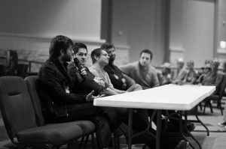
Auto Focus
Back Button Focus:
Example: Pre focused for action
James Brandon
“I turned on a single auto focus point and placed that point over the lead singers face. I then used my back button to focus that point over his face and waited for the right moment. When he looked my way, everything was already done, all I had to do was hold down the shutter. “
http://digital-photography-school.com/advanced-tips-for-tack-sharp-images

Slide 22
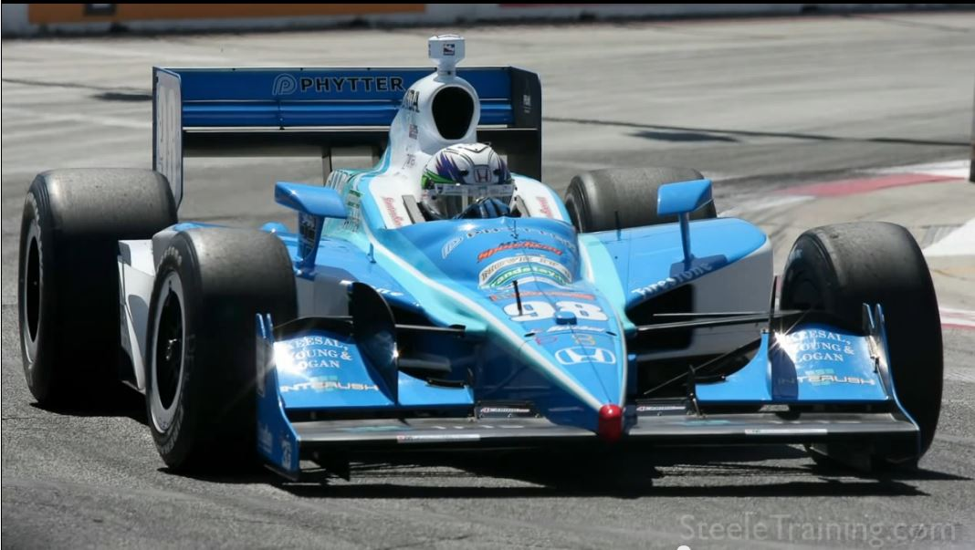
Auto Focus
Back Button Focus:
Example: Pre focused for action
Phil Steele
Method:
Anticipate where the subject will be
Set a focus point on that location and press the back focus button once. This sets the focus at that point
When the subject reaches the focus point, shoot.
An alternative would be to use AF-continuous. Press the back focus button and hold it. Track the subject. When the subject reached the desired point, press the shutter button.
https://www.youtube.com/watch?v=x4bQc36r5ek&feature=em-share_video_user

Slide 23
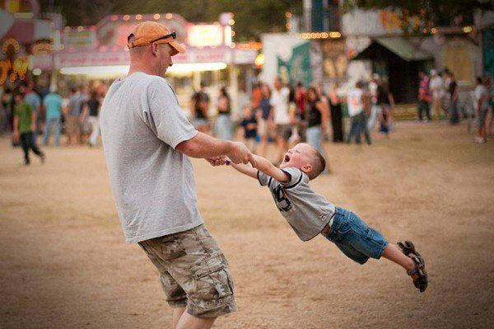
Auto Focus
Back Button Focus:
Example: Hold focus tracking, then concentrate on subject
No lag on the shutter
James Brandon
For this shot, I had a single point activated in my focus grid and used AI-Servo to track my nephew as he spun around in circles. Because I had back button auto focus on and Servo tracking, I was able to hold down the focus button to track focus as he spun around. This allowed me to track focus using my thumb and hold down the shutter with my index finger.
http://digital-photography-school.com/advanced-tips-for-tack-sharp-images

Slide 24
Auto Focus
Back Button Focus:
Example: Hold focus tracking, then concentrate on subject
No lag on the shutter
James Brandon
I used Servo focus tracking and held it down during the jump using back button focus. I grabbed this frame as he made a bit of a rough landing.
http://digital-photography-school.com/advanced-tips-for-tack-sharp-images

Slide 25
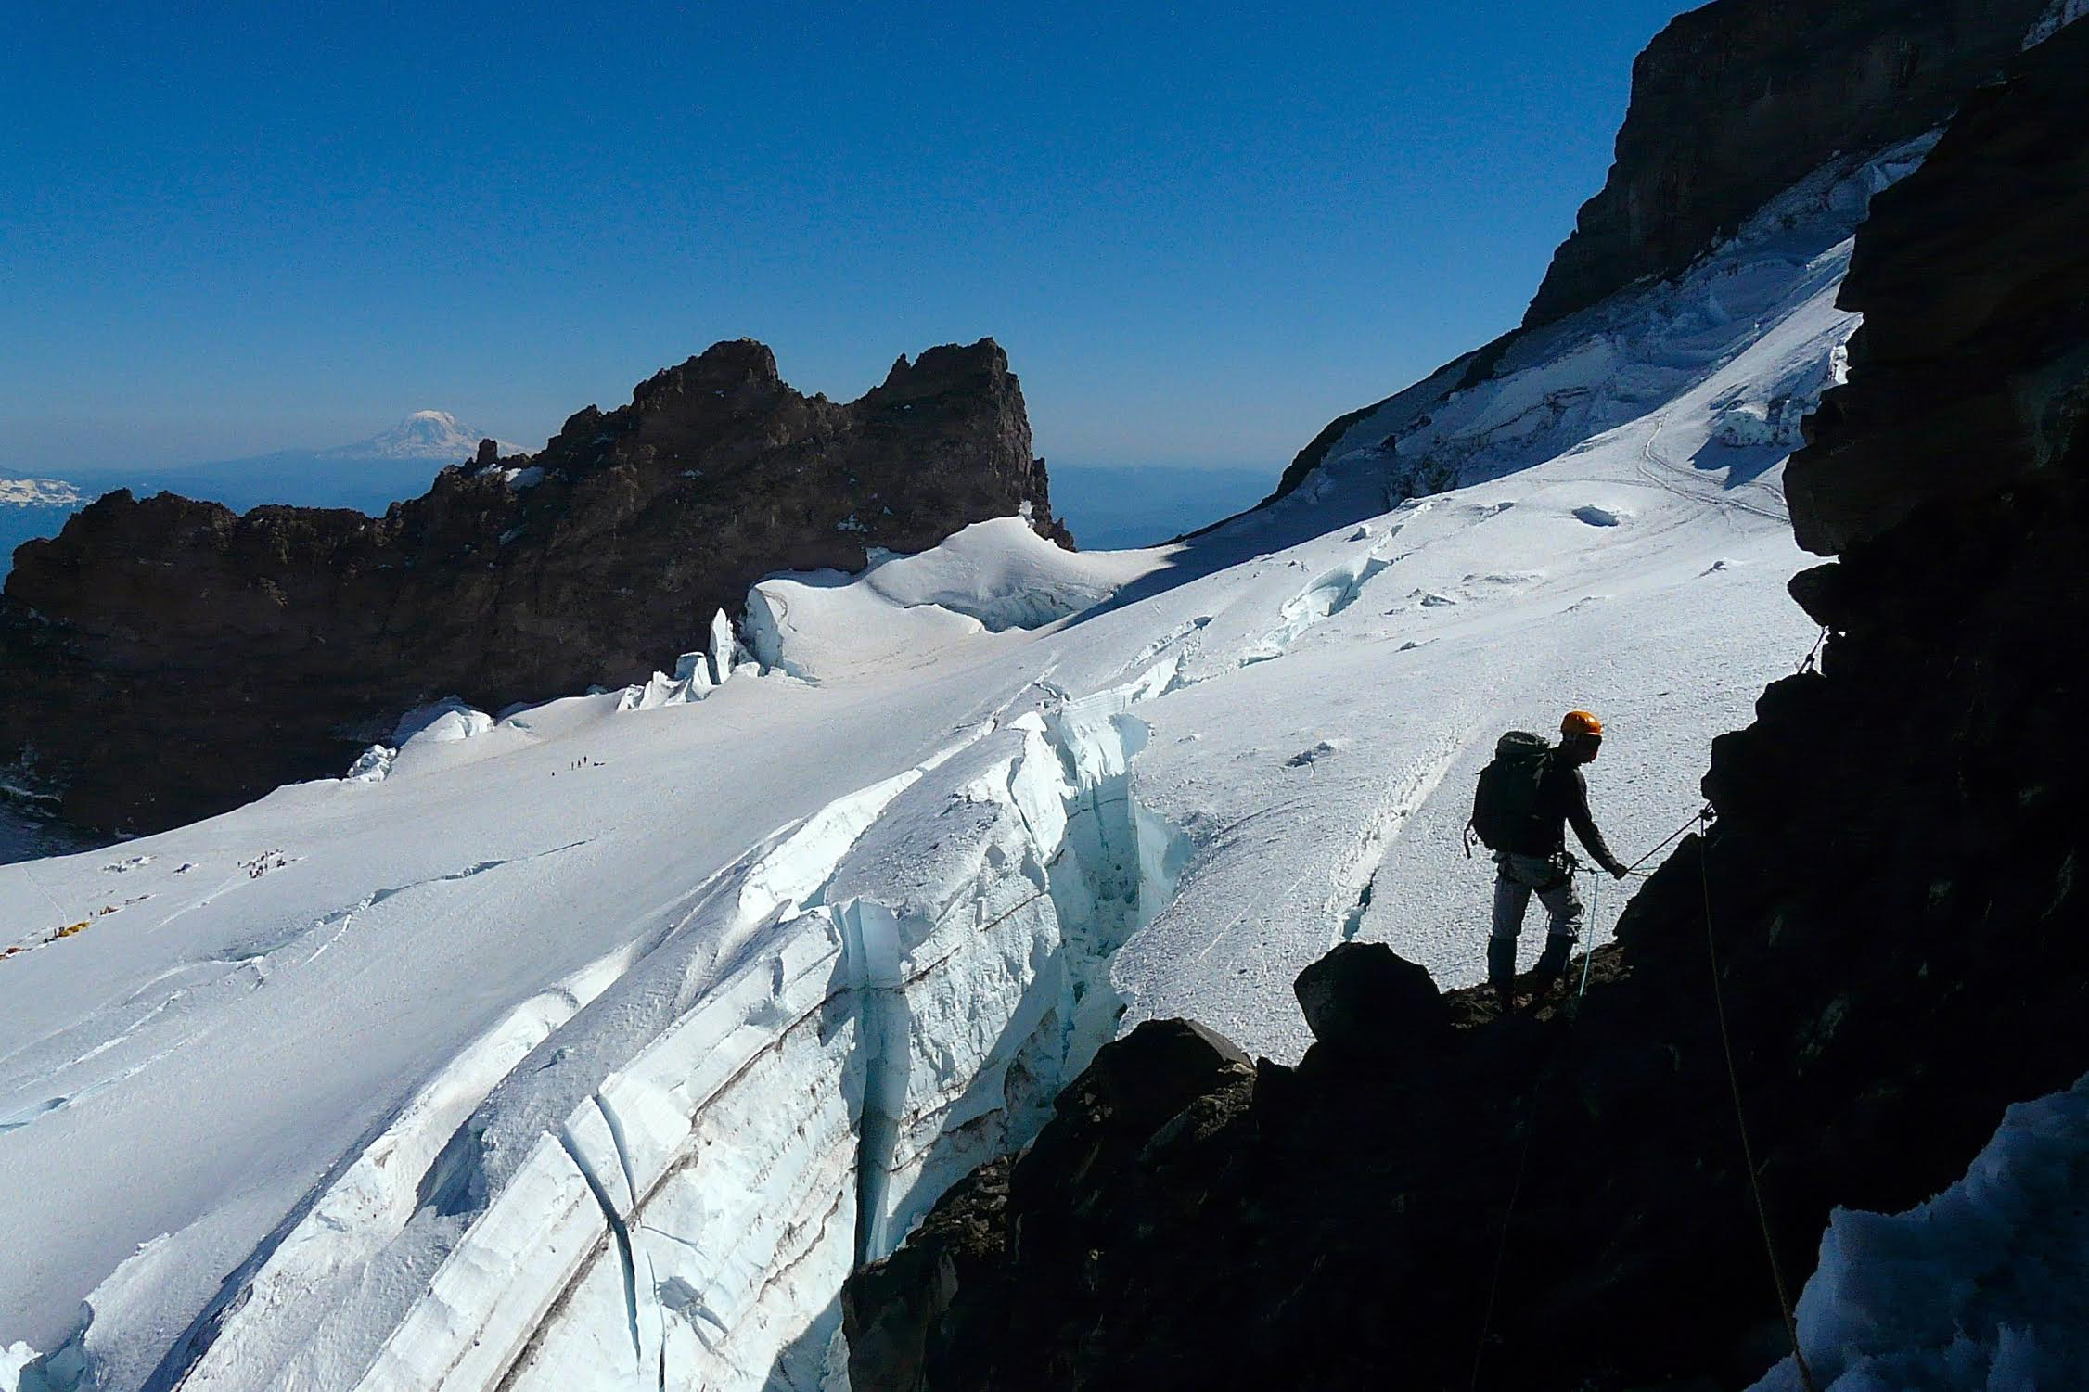
Auto Focus
Back Button Focus:
Example: Hold focus tracking, then concentrate on subject
Robert Clark
Method:
Set camera on continuous focus.
Set focus tracking point on climber and hold the back focus button.
Compose the shot.
When the climber reaches the desired location press shutter.

Slide 26
Auto Focus
Back Button Focus:
Disadvantages:
1. Need to practice. Not natural.
2. Complex setup
Setup:
Each camera setup is different.
Put the Brand and model number into Google along with “Back Focus Button Setup” for specific instructions.
This can be setup on some point and shoot cameras.
Tip:
Every time you put your camera away set it in a certain way. When you use it again you will know how it is set up and you won’t be surprised.

Slide 27
Auto Focus
Summary:
Two common technologies:
Phase Detection (PD)
Fast
Complex, expensive, independent of the image
Contrast Detection (CD)
Slow
Accurate, computer in camera uses the image
Setting focus points
Setting auto focus modes
Single (focuses once then stops)
Continuous focusing/tracking with shutter button pressed Canon (AI-Servo), Nikon (AF-C).
Back Button Focus: advanced focus technique, separate focus from shutter button, reassign focus to a button on the back of the camera
Convenient: (don’t need to hold shutter button ½ way). Hold button and “forget”.
Accurate: (prefocus and lock to be assured of subject)
Fast: “switch” between single and continuous focus
Pulse back focus button for single
Hold and “forget” back focus button for continuous focus mode

